Slide 1




Agronomic Performances of biodegradable films
as an alternative to polyethylene mulches
in vineyards
Emmanuelle Gastaldi

emmanuelle.gastaldi@umontpellier.fr

UMR IATE Agro-Polymers Engineering and Emerging Technology
Campus INRA-Montpellier SupAgro
2 place Pierre Viala, Bat 31
34060 Montpellier cedex 01 France
Notes:
Good morning,
I am Emmanuelle gastaldi and I am associate professor at the university of Montpellier located in the south of France
I Thank the PPs-33 organizing commitee for offering me today the opportunity to talk about the performance…..

Slide 2
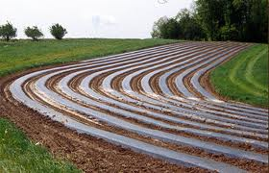
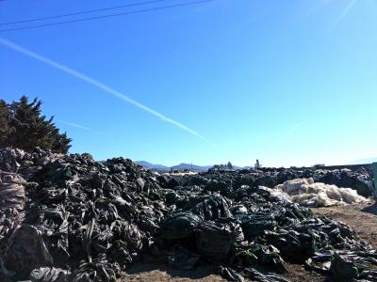
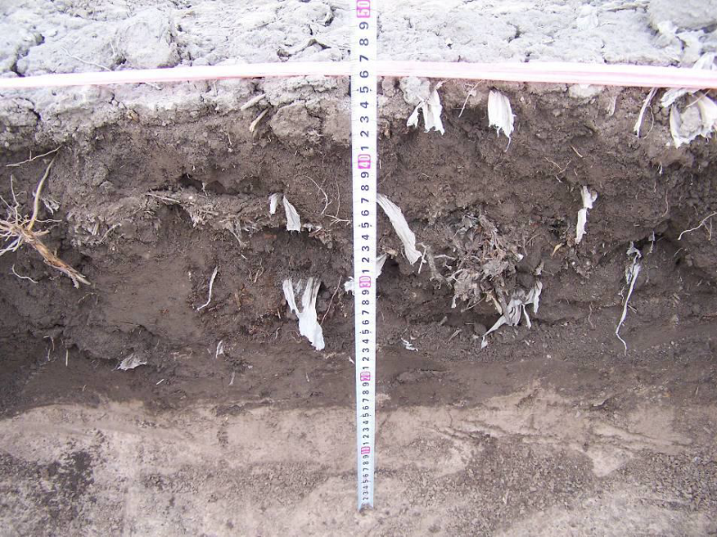
Context
Agricultural films = PE
Environmental issues
Wastes
Microplastics
Long-term stability of PE >> targeted lifespan
2
Notes:
However, even if mulching is an agricultural practice commonly and widely used for a lot of newly planted crops for a long time,
up to now, mulch films are made of polyethylene (PE), a non biodegradable material whose the waste management at the end of the crop lead to both aesthetic and environmental issues.
Indeed, as you can see here at the end of the crop the resulting plastic wastes are generally - stocked beside - wildly burnt releasing hazardous residues - left in the field where they progressively broke up into microplastics that are not recoverable at the end of the crop and lead to an irreversible and detrimental contamination of the soil.
To finish with it is worth mentioning that the long term stability of PE is estimated in comparison with the targeted lifetime which rarely exceed a few weeks or 4 months
Leading to the conclusion that conventional plastics are not appropriate for applications in which plastic are required for so short time
And for all these reasons the biodegradable polymers are worthy of consideration as a suitable alternative

Slide 3

Challenge
Biodegradable mulch films as a suitable alternative to PE ?
Long term crops requirements
Functional properties
Integrity vs mechanical P^{ties}
Positive effects on the crop
End of life
Biodegradation
without ploughing
3
Notes:
Thus, recent developments among biodegradable polymer films allow considering them as an environmentally friendly alternative to polyethylene
Whose lifespan can exceed (go over) 50 years
For that purpose, the considered biodegradable material should meet the requirements of the perennial crop and associated farming practices i.e. remain intact in the field long enough to provide its expected positive effects on the crop and then, biodegrade at the topsoil without additional ploughing attesting that its biodegradation could be guaranteed afterwards.

Slide 4


Experimental site
Domaine de Vaissière (400 years old)
Vineyard : 300 ha (≈ 10 ha planted/year)
Wine production : 25 000 hl per year
Mediterranean climate
Clay and calcareous soil
Vines exclusively grown under mulch film
  Successful and homogeneous establishment of vineyard
  Weed control (black film)
  Growth and vigour enhancement
  One year earlier fruiting production
  Economical benefit for wine-growers
Blomac
4
Notes:
The successful establishment of a new vineyard strongly depends on the first growing years, grapevines generally starting producing during the third season. The use of polyethylene (PE) mulch films in the vine row is sometimes used in newly planted vineyards, not only for a herbicidal effect and to ensure their successful and homogeneous establishment, but also to deliver earlier production. Indeed, mulched vines may produce a crop one year earlier than unmulched vines (Godden and Hardie 1981; Moore 1963; Pinamonti 1998; Van der Westhuizen 1980). Such films lead to a better preservation of soil moisture, more uniform soil temperatures, less leaching of fertilizers, lower soil compaction, weed control, an increased growth and a higher survival rate (Van der Westhuizen 1980). Moreover, an increase in vegetative growth and yield were observed up to three years after planting when the film was removed after the first season (Moore 1963), or up to five years after planting when it was maintained 18 months (Van der Westhuizen 1980).

Slide 5




Integrated scientific approach
Climate data
Cumulated solar radiations
AGRONOMIC
PERFORMANCE
Growth, Grapes quality Fruiting yield, Root stock
FILM AGEING
Integrity & Mechanical properties, Structure (Gel content)
End of life
Biodegradability assessment
before and after field ageing
Soil properties
Nematofauna
μorganisms
5
Notes:
two experiments set up with an interval of one year
Regarding the vineyard, two experiments set up with an interval of one year and conducted in a part of the commercial vineyard “Domaine de Vaissière” belonging to the winegrower Olivier Mandeville and located in Languedoc Roussillon (Southern France, 43°12 N-02°36 E, altitude 71 m). The first experiment (Trial 1) was initiated in April 2010 and the second one (Trial 2) in March 2011, both having been monitored during 3 and 2 crop cycles, respectively. These two experiments were launched to verify that the considered materials should meet the requirements of the perennial crop and its correlated farming practices i.e. remain intact in the field long enough to provide its expected positive effects on the crop, and also to attest that its biodegradation at the topsoil could be guaranteed afterwards.

Slide 6
Experimental design Trial 1
3 treatments
  BF 40 μm
Mater-Bi® CF04P grade (Novamont)
  PE 40 μm
  Bare Soil
Randomized block design => 3 Blocks => 3 repetitions (3x63 vine stocks)
Cepage: Chardonnay on SO4
  Size : L=223x5x3 m A=0.33 ha
≈ 17m ≈ 21 vine stock
Trial 1
buffer line
buffer line
Repetition 1
Repetition 2
Repetition 3
buffer line
BLOCK 1
BLOCK 2
BLOCK 3
Notes:
Each treatment has 3 replicates in a randomized complete block design. Five guard vines in the row between each modality prevent potential border effects.
DISPOSITIF ALEATOIRE PAR BLOCS

Slide 7
Experimental design Trial 2
8 treatments
  BF 25 μm (Mater-Bi® CF04P grade)
  BF 40 μm
  BF* 40 μm (10% scraps)
  BF 70 μm
  PE 40 μm
  Bare soil BS
  PBAT/PLA 40 μm (FKüR)
  PBAT/PCC 40 μm (Xinfu)
Randomized block design
- 4 Blocks
- 4 repetitions (4x54 vine stocks)
Cepage: Côt (Malbec) on SO4
Size: L=172x8x3 m A=0.41 ha
42-43 m
54 vine stocks
 |  |  | PE |  |  |  |  | BS
 |  |  |  |  | * |  | PE
 |  | BS |  |  | BS |  | *
 |  |  | *
 | PE
 |  |  |  | BS | PE
 | *
 | BLOCK 1 |  | BLOCK 2 |  | BLOCK 3 |  | BLOCK 4
Trial 2
Notes:
Each treatment has 4 replicates in a randomized complete block design. Five guard vines in the row between each modality prevent potential border effects.

Slide 8
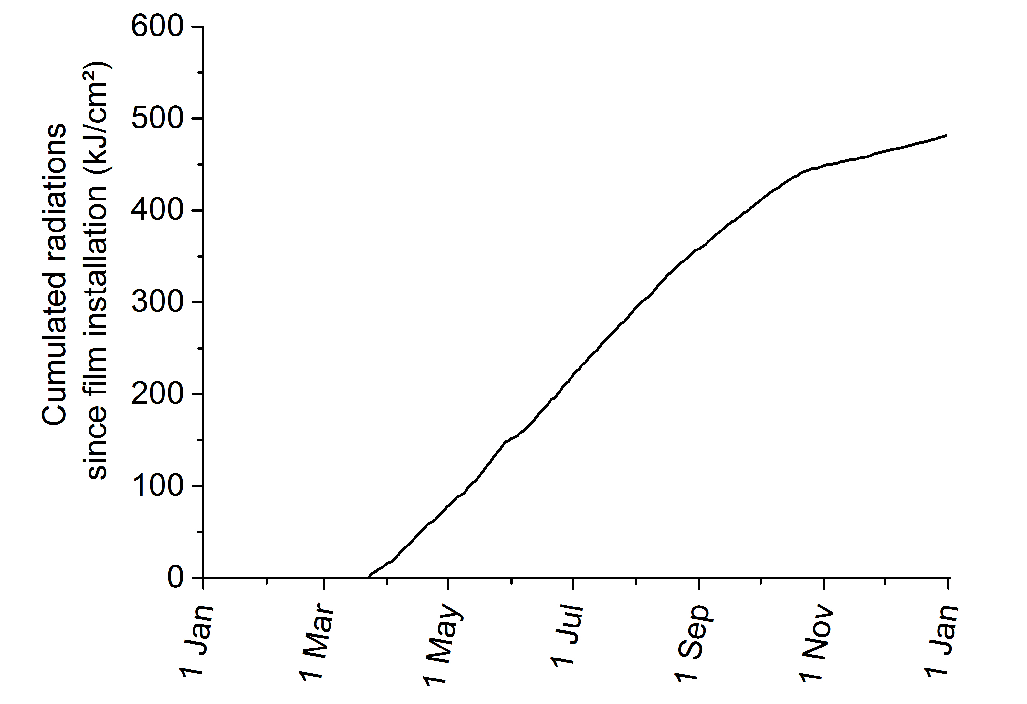
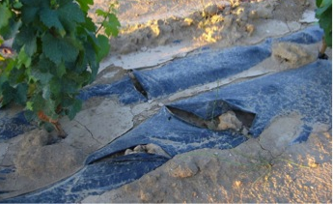
Physical integrity vs UV-light exposure
Loss of integrity
270 kJ/cm²
Film installation
5 months
8
8
Notes:
If we look now what ‘s happen in the field regarding the films we observed a loss of physical integrity for all the biodegradable films 5 months after installation which correspond to a cumulated radiations of 260 kJ/cm2
At this stage of the study, the reasons for the film deterioration were probably due to abiotic factors especially UV light combined with biotic ones

Slide 9
Agronomic performance : fruiting yield
Fruiting yield
Trial 1
First harvest
Positive effect of mulching despite the loss of integrity
BF = Mater-Bi® CF04P grade 40 μm
PE 40 μm
Notes:
Regarding the agronomical performances, in all cases mulched vines are more vigorous and productive than those grown on bare soil
no significant difference In terms of pruning and fruiting yield was noted between the different biodegradable films used and PE whatever their composition and formulation and also no difference with PE mulched ones
Vines initially grown under biodegradable films (whatever their composition; MB, MBR, PPC/PBAT or PLA/PBAT) were as vigorous and as productive as PE-mulched ones, showing no significant difference in terms of vegetative growth and fruiting production during the first two growing seasons.
Correlation with film integrity and ageing in field conditions

Slide 10
Agronomic performance : fruiting yield
Fruiting yield
Fruiting yield (t/ha)
Trial 2
No impact of film’s thickness
No impact of 10% scraps (BF40*)
First harvest
16 months after planting
Notes:
Regarding the agronomical performances, in all cases mulched vines are more vigorous and productive than those grown on bare soil
no significant difference In terms of pruning and fruiting yield was noted between the different biodegradable films used and PE whatever their composition and formulation and also no difference with PE mulched ones
Vines initially grown under biodegradable films (whatever their composition; MB, MBR, PPC/PBAT or PLA/PBAT) were as vigorous and as productive as PE-mulched ones, showing no significant difference in terms of vegetative growth and fruiting production during the first two growing seasons.
Correlation with film integrity and ageing in field conditions

Slide 11
Early film deterioration vs root growth
inter-plant distance = 80 cm
raw
vine
stock
A
B
40 cm
inter-raw distance = 300 cm
40 cm
Voronoi polygon defined
by half-distance
between sampled vine
and neighbours
Excavation
Roots collection
- Dry mass
- Length vs diameter
raw

Slide 12
Agronomical performances : root growth
Dry root weight (g)
2-year-old vines
depth
BF>PE>BS
40-60 cm 20-40 cm 0-20 cm
BF => More developed rootstock
in all the soil horizons
BF>BS>PE
Adaptation of the root system
BF>BS>PE
Notes:
To go further and try to understand why vines grown under biodegradable films led to so high agronomical performance in spite of the early degradation of the mulch
Their root growth has been investigated after excavation of the roots followed by dried mass and length measurements
The results obtained are presented her and underline that whatever the considered depth, the mass of root developed by the vines grown under BF is always higher than for the two other modalities
Meaning that in comparison with PE the loss of integrity undergone by the biodegradable mulch films 5 months after planting is even more advantageous for rootstock development.
Indeed, when the topsoil moisture content starts decreasing, as evaporation is no longer stopped by the mulch, the rootstock starts developing deeper in search of water, becoming then more vigorous and better distributed than for vines grown on a bare soil
So in the case of a newly planted vineyard, mulching seems to have a key role mainly during the first months after planting,
by improving soil water availability and maintaining a slightly higher temperature under the film.
The combination of these two effects should enable the young vines to develop their root system without having to compete with weeds for water and nutrients.

Slide 13
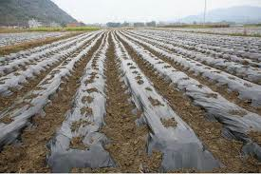
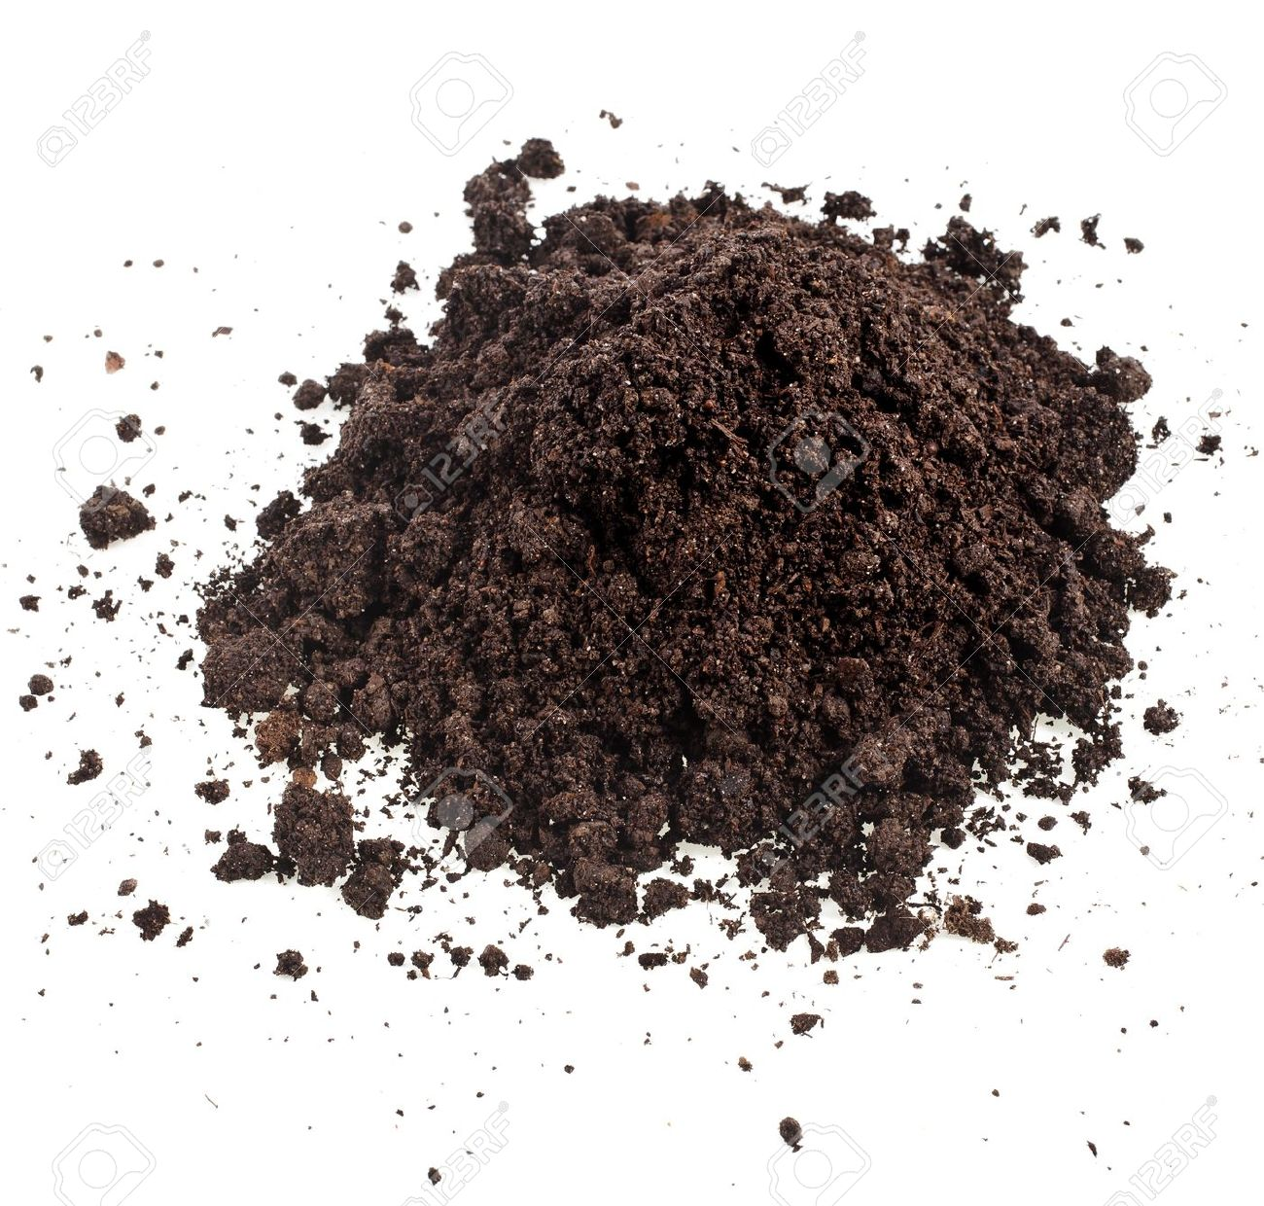
Agronomic performances : soil quality improvement
Abundance of the nematode trophic groups
2 years after planting
Increase of the total and plant-feeding nematodes
More diversified soil biological activity
Notes:
The results obtained are presented her and underline that whatever the considered depth, the mass of root developed by the vines grown under BF is always higher than for the two other modalities
Meaning that in comparison with PE the loss of integrity undergone by the biodegradable mulch films 5 months after planting is even more advantageous for rootstock development.
Indeed, when the topsoil moisture content starts decreasing, as evaporation is no longer stopped by the mulch, the rootstock starts developing deeper in search of water, becoming then more vigorous and better distributed than for vines grown on a bare soil
So in the case of a newly planted vineyard, mulching seems to have a key role mainly during the first months after planting,
by improving soil water availability and maintaining a slightly higher temperature under the film.
The combination of these two effects should enable the young vines to develop their root system without having to compete with weeds for water and nutrients.

Slide 14
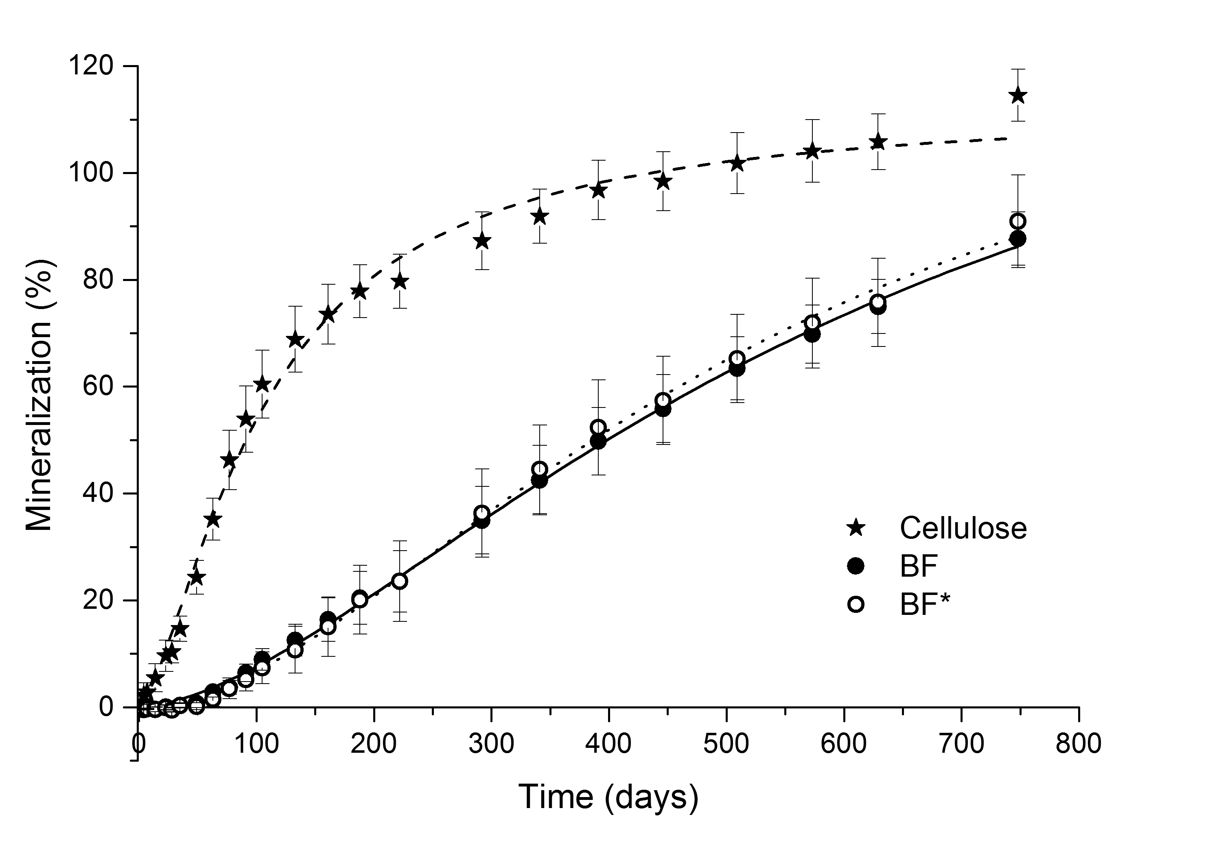
End of life : Biodegradability in soil
Ageing of the biodegradable mulch film (BF40)
Respirometry in soil at 28°C
in aerobic conditions
Assessment of biodegradability
in a vineyard soil
Notes:
Even if both Mater-Bi® films biodegraded faster than the two others biodegradable films, all the biodegradable films comply with the requirements of the 52001 standard ie reach a degradation level higher than 60% related to cellulose in less than 2 years.
As you can notice on this cure, the incorporation of recycled material into Mater-Bi® film (MBR) doesn’t fasten its biodegradation rate in spite of its expected lowered Mw distribution. To compare, PLA/PBAT exhibited the lowest degradation rate but satisfied the 60% degradation threshold (relative to cellulose) required by the standard within two years.
This is attributed to the presence of PLA (30%) that is hardly biodegradable in glassy state.
On tolère dans la 52001 de poursuivre le test pendant 2 ans
In the 52001 2 of the 3 tests must be validated
Generally the most often used are soil test and compost test however the soil test is the most difficult to validate since at the lowest temp
Rappel : compost 6 mois 90% cellulose
On tolère dans la 52001 de poursuivre le test pendant 2 ans
In the 52001 2 of the 3 tests must be validated
Generally the most often used are soil test and compost test however the soil test is the most difficult to validate since at the lowest temp
Rappel : compost 6 mois 90% cellulose
Biodeg Cellulose = 108 after 2 years => 60% ➔ 65%

Slide 15
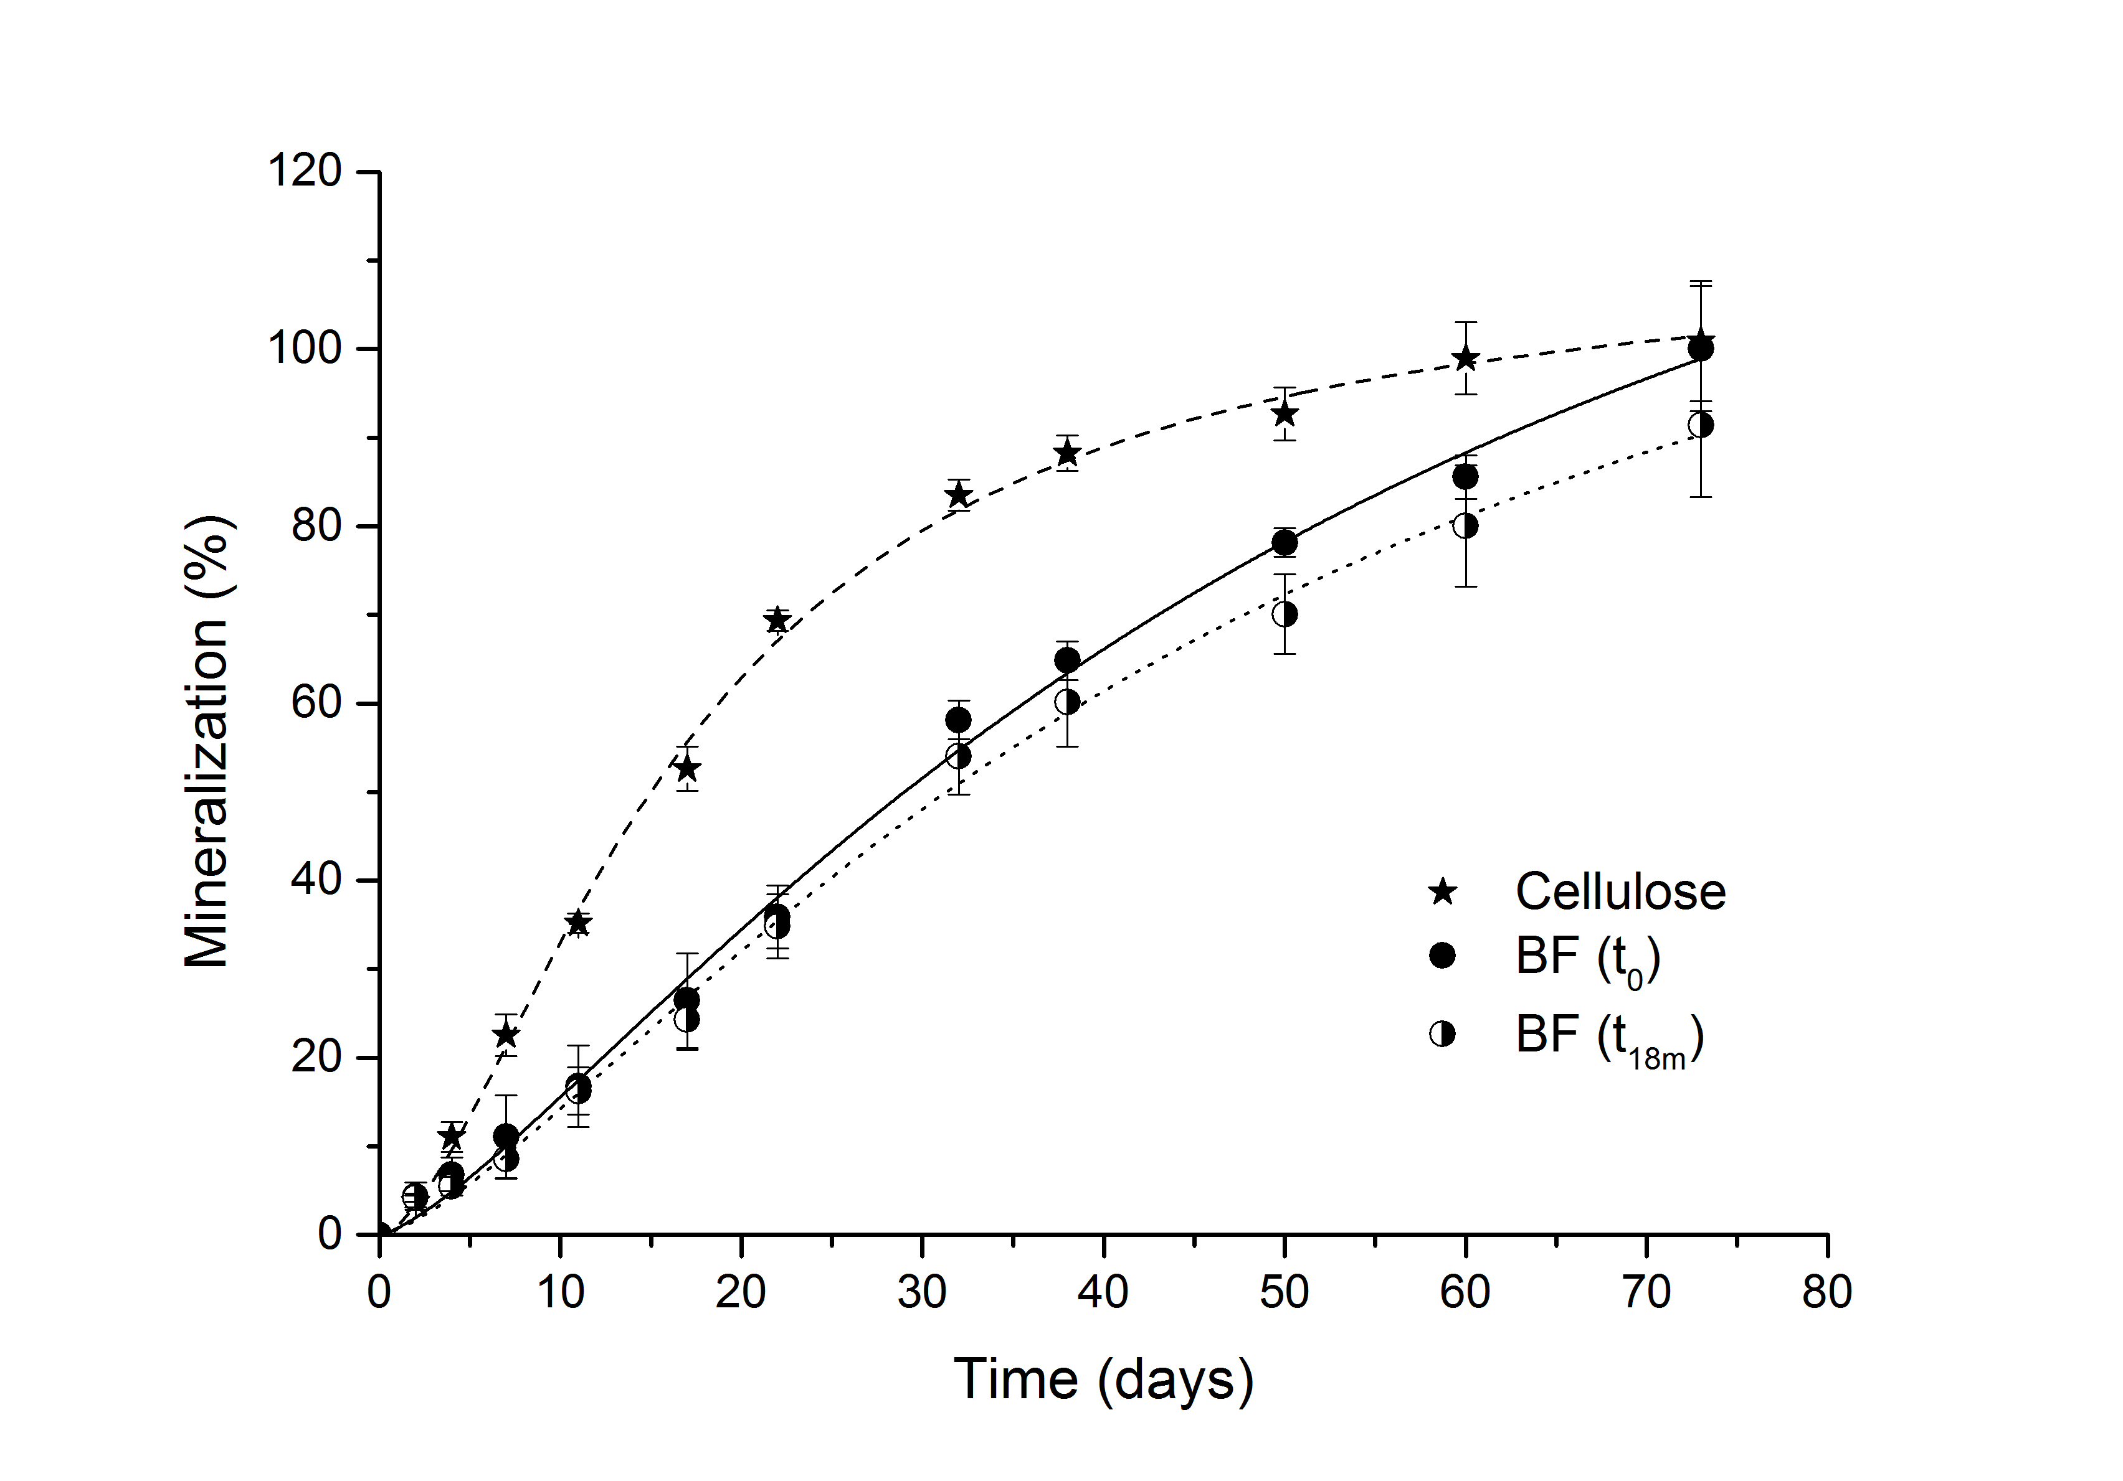
Biodegradation rate after 18 months ageing
Ageing of the biodegradable mulch film (BF40)
Respirometry in compost at 58°C
in aerobic conditions
Impact of 18-months ageing on the biodegradation rate
Notes:
Even if both Mater-Bi® films biodegraded faster than the two others biodegradable films, all the biodegradable films comply with the requirements of the 52001 standard ie reach a degradation level higher than 60% related to cellulose in less than 2 years.
As you can notice on this cure, the incorporation of recycled material into Mater-Bi® film (MBR) doesn’t fasten its biodegradation rate in spite of its expected lowered Mw distribution. To compare, PLA/PBAT exhibited the lowest degradation rate but satisfied the 60% degradation threshold (relative to cellulose) required by the standard within two years.
This is attributed to the presence of PLA (30%) that is hardly biodegradable in glassy state.
On tolère dans la 52001 de poursuivre le test pendant 2 ans
In the 52001 2 of the 3 tests must be validated
Generally the most often used are soil test and compost test however the soil test is the most difficult to validate since at the lowest temp
Rappel : compost 6 mois 90% cellulose
On tolère dans la 52001 de poursuivre le test pendant 2 ans
In the 52001 2 of the 3 tests must be validated
Generally the most often used are soil test and compost test however the soil test is the most difficult to validate since at the lowest temp
Rappel : compost 6 mois 90% cellulose
Biodeg Cellulose = 108 after 2 years => 60% ➔ 65%

Slide 16
Conclusions
Agronomic performance of BF similar to PE despite the early deterioration of the film
Significant positive effect
- earliness of the harvest
- vine growth
- fruiting yield and quality
Root growth enhanced by the breakage of the film
Life time expectancy of mulch film in vineyard ≈ 4-5 months (critical early stage of growth)
Touchaleaume et al. Chemosphere (2016)
Touchaleaume et al. J. Polym. Environ. (2017)
Notes:
The results obtained for the biodegradable film are consistent with the values available on Novamont website for Mater-Bi materials, with a WVP ranging from 1,65x10⁻¹² to 8,25x10⁻¹² mol.m⁻¹.s⁻¹.Pa⁻¹ (www.novamont.com).

Slide 17





A special thanks to
François Touchaleaume
Christophe Jourdan
Patrice Coll
Guy Cesar
Carlos Rodrigues
17

