Slide 1


Alliance for Nature
XXIst CIPA Congress

Slide 2
Plasticulture Mondiale
Worldwide Plasticulture
A focus on films
Bernard Le Moine
General secretary CIPA
President APE Europe
General secretary CPA
Notes:
Aknowledgement: No official statistics, assumption made out of several analysis and communications. Number are subject to be critisized and amended. Nevetheless, global tendencies are well shared in the plasticulture community and can be used as a reference today.

Slide 3
Plasticulture Mondiale
Worldwide Plasticulture
A focus on films
Pourquoi la Plasticulture?
Gestion des externalités négatives
Activités du CIPA
Why plasticulture?
Negatives externalities management
CIPA Activities
Notes:
Aknowledgement: No official statistics, assumption made out of several analysis and communications. Number are subject to be critisized and amended. Nevetheless, global tendencies are well shared in the plasticulture community and can be used as a reference today.

Slide 4
Pourquoi la Plasticulture?
Mal aimé
Mal connu
MAIS
Produit indispensable pour une agriculture moderne et responsable
Réduit l’impact environnemental de la production
Doit contribuer à l’économie circulaire
Why plasticulture?
Bad liked
Poorly known
BUT
Essential product for a modern and responsible agriculture
Environmental impact reduction
Must contribute to the circular economy

Slide 5
Pourquoi la Plasticulture?
Augmente quantités et qualités
Diminue la consommation intrants
Protège les plantes et récoltes
Protège le fourrage
Libère des terres arables
Why plasticulture?
Increase quantity and quality
Reduce input consumption
Protecting plants & harvest
Protecting fodder
Free arable lands

Slide 6
Pourquoi la plasticulture?
Les besoins alimentaires vont croissants
Les besoins de plastiques agricoles augmentent:
Les caractéristiques changent
Why plasticulture?
Increase in alimentary needs
Increase on agri-plastics
Changes in caracteristics
Consommation
films agricoles
Agri-film
consumption
+ 3,5 MT
+ 50%

Slide 7
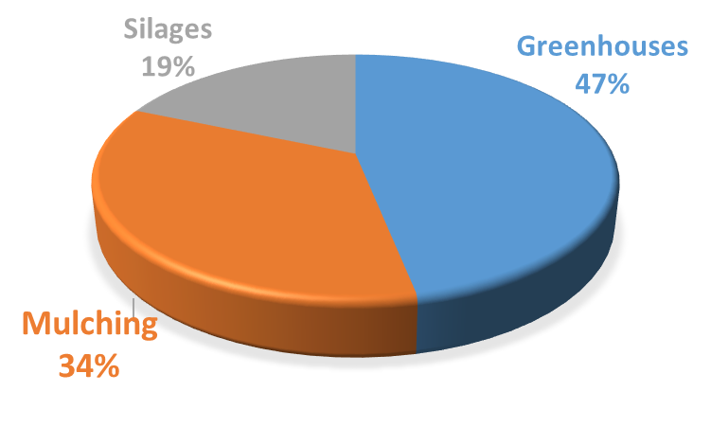

Slide 8
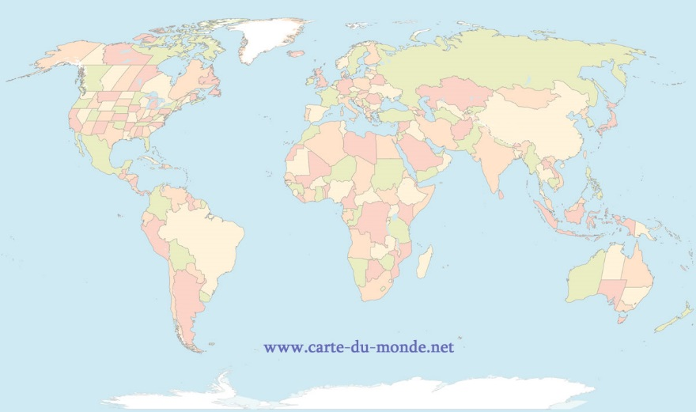
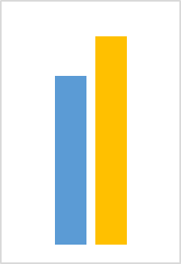



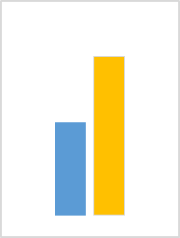
755
650
7 050
490
550
+16%
+12%
+105
+70
680
4 300
450
410
240
+51%
+71%
+230
+170
+64%
2018 – 6 120KT
2030 - 9 500KT
+2 750
+55%
+3 380
Notes:
Asia/ China: Greenhouses+ thickness increase on mulching + Agri-plastics development plan in India (
Europe, mainly eastern Europe
Independence in alimentary production: China, India, Brazil, Russia and generally speaking Africa

Slide 9
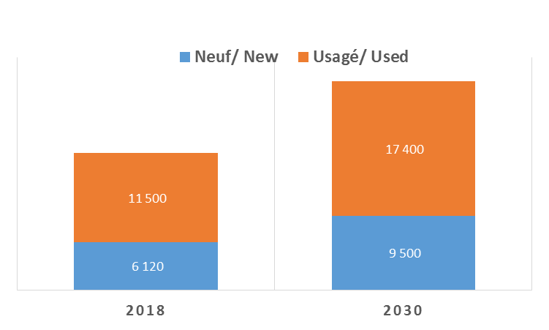
Gestion des externalité négatives?
Croissance des externalités négatives aussi
Negatives externalities management
Increase of negatives externalities as well
KT
Agri-film
consumption
Consommation
films agricole
+ 5,5 MT

Slide 10
Pourquoi la Plasticulture?
Why plasticulture?
KT
Consommation
films agricole
Agri-film
consumption
Costs
Ressource
Coûts
Ressource
+ 5,5 MT
Notes:
1000 tons of plastics = 150 loads with 70% soilage rate, 50 loads with 30% soilage rate
Cost per ton between 250/350€, 70% to finance the the soilage contend! (200€!)

Slide 11
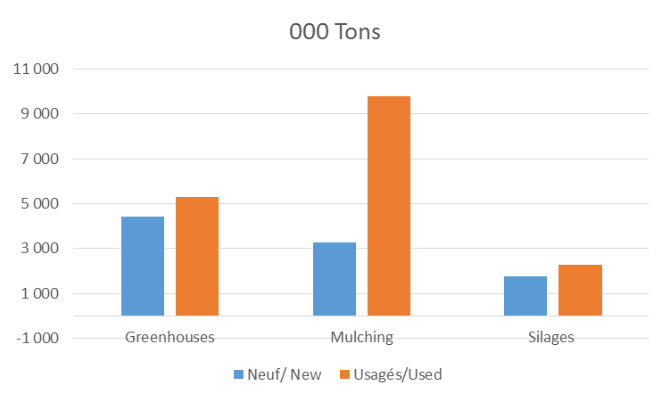
Notes:
We have to do somethings…
The mulching situation is critical since resposible of most of the negatives externalities

Slide 12
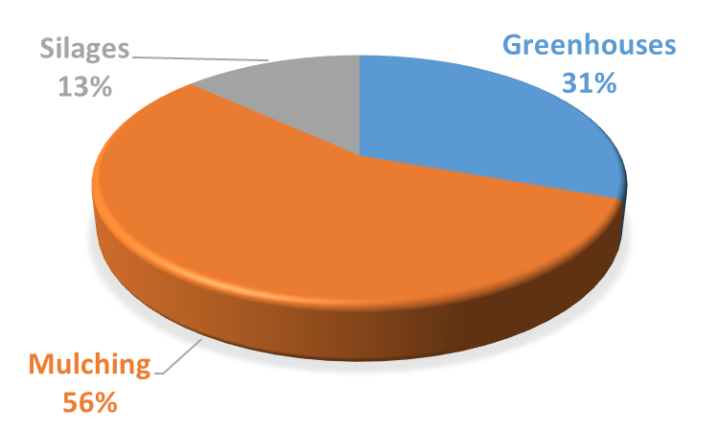
Neuf/ New
9.5 MT
Usagé/ Used
17MT
Notes:
We must reduce the soilage contend of used films

Slide 13
ACTIONS
Development of collecting schemes
Waste reduction at source
Good practices
Biodegradable
Equipment (RAFU)
ACTIONS
Développement des schémas de collectes
Réduction des déchets à la source:
Bonnes pratiques
Biodegradable
Equipement (RAFU)

Slide 14
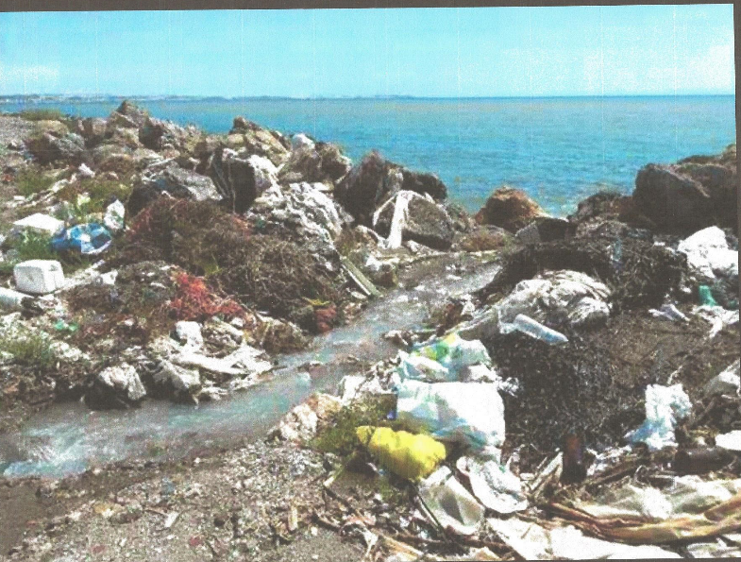
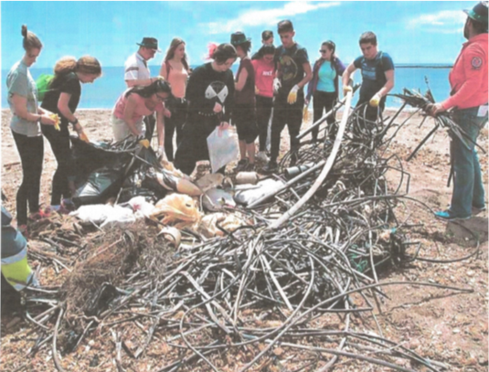
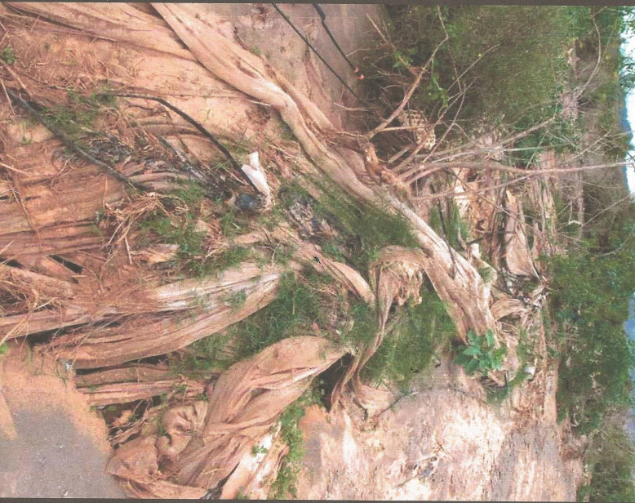
C’est la réalité!
Pas de plastique brulé ou enfouis
Pas de plastique dans les océans
This is reality!
No plastics burned or buried
No plastics in the oceans!
Notes:
The lack of collecting scheme and waste management system cause tremendous damage on the environement.
There are very few places really safe on the matter in the world. Agri-waste management is a priority for every country for the next decade.

Slide 15
Activités du CIPA
Le CIPA réunit la communauté de la Plasticulture* du monde entier pour partager, diffuser les pratiques, expériences et innovations sur les plastiques agricoles
Porte parole de la Plasticulture
Congrès du CIPA
Plasticulture Magazine
CIPA ‘s Activities
The CIPA bring todethers the worldwide plasticulture’s community to share on practices, expériences and innovation on plasticS for agriculture
Plasticulture’s speaking voice
CIPA Congress
Plasticulture Magazine
* Agriculteurs, distributeurs fabricants chercheurs
Farmers & growers, producers, research

Slide 16
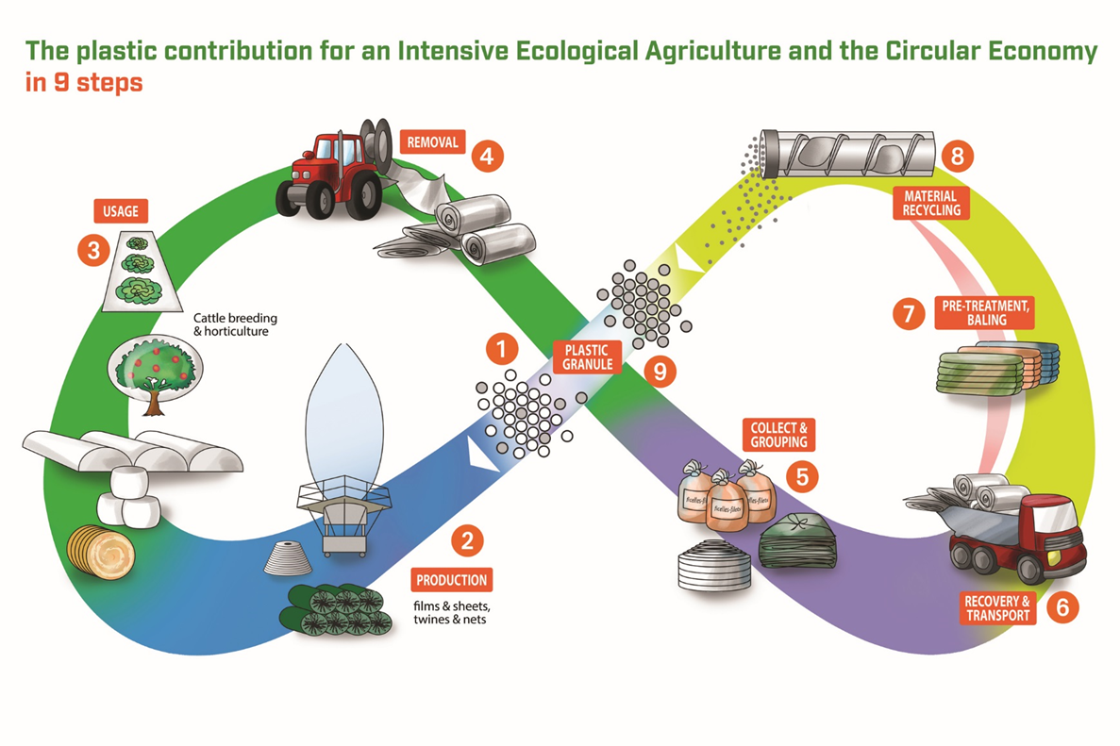
La Plasticulture améliore la production en utilisant moins de phytopharmaceutiques, d’engrais, d’eau, etc.
La communauté de la Plasticulture est engagée dans la protection de l’environnement et réduit l’impact négatif de la production agricole: comment produire plus avec moins…?
Plasticulture improves production using less pesticides, fertilizers, water, etc.
The plasticulture community is involved in the environmental protection, reducing the negative impact of the agricultural production: how to produce more with less?
Une contribution à l’agro-écologie
A contribution to the agro-ecology

Slide 17
Les plasticulteurs sont conscients de leur responsabilité en matière de gestion des déchets.
Les plastics sont fait de polymères de très bonnes qualités, faciles à recyclés.
Plasticultors are highly aware of their environmental responsibility for an efficient waste management
Plastics are made of high quality polymers, easy to recycle
Une contribution à l’économie circulaire
A contribution to the circular economy

Slide 18
La responsabilité environnementale du Plasticulteur
The Plasticultor’s environmental responsibility

Slide 19
Bienvenue …. Welcome !
XXIème CIPA Congress
Congressistes, réunis à Arcachon, vous contribuez au développement de la plasticulture pour améliorer la condition de vie de l’humanité.
Plasticulteurs vous êtes également soucieux de la condition de vie de la planète.
On peut investir dans la plasticulture…
Delegates, meeting in Arcachon, you contribute to the development of the plasticulture to improve the condition of life of the mankind.
Plasticulteurs you are also concerned about the living conditions of the planet.
Plasticulture is the place to invest…
Plasticultors, be involved!

Slide 20



Slide 22

Plasticulture & Circular Economy
Messages clés
Key messages
Plasticultors, be involved!

Slide 23
https://www.youtube.com/watch?v=Ez6FNzx3F_E&sns=tw&t=1&cn=ZmxleGlibGVfcmVjcw%3D%3D&refsrc=email&iid=90c461db1d254a2d9e560695f1e6f24c&uid=943126495320596481&nid=244+272699400
C’est la réalité!
Pas de plastique brulé ou enfouis
Pas de plastique dans les océans
This is reality!
No plastics burned or buried
No plastics in the oceans!
Notes:
The lack of collecting scheme and waste management system cause tremendous damage on the environement.
There are very few places really safe on the matter in the world. Agri-waste management is a priority for every country for the next decade.

Slide 24
Plasticulture & Circular Economy
Le plastique est un produit miraculeux!
17 Millions de tonnes en 2030…
Irresponsabilité humaine….
Plastic is a miraculous material
17 M tons in 2030…
Human irresponsibility
Plasticultors, be involved!
Notes:
If you kill the plastic, you kill the production: no coton any more in China, a strategic product.

Slide 25
Plasticulture & Circular Economy
La gestion des plastiques agricoles usagés est juste une nécessité;
C’est une responsabilités collective et partagée entre les TOUS différents acteurs de la plasticulture…
Les solutions d’organisation, techniques et financières existent!
Nous pouvons le faire…
The plastic agri-waste management is just a necessity.
It is a collective and shared responsability between ALL plasticulture actors…
Solutions in organization, technical and financial exist!
We can do it…
Plasticultors, be involved!
Notes:
The scientific community should consider in any single project, the end of life of the plastic involved in their project.
Producer = your 100% responsibility, Farmers 100% responsible, Distributors 100% responsibility
Thank to the workshop Plasticulture and Circular Economy for the

Slide 26
Plasticulture & Circular Economy
Merci à EPRO de nous engager dans une réflexion sur ces sujet à l’occasion du congrès.
EPRO assure la promotion et accompagne le développement des schéma de collecte nationaux en Europe.
Ce sont des experts
Thanks to EPRO to lead for this think tank about agri-plastic waste management during this congress
EPRO insure the promotion, and the development of national collecting schemes (NCS) in Europe.
They are experts!
Plasticultors, be involved!
Notes:
Thanks to EPRO
We can depend on them
Thank to the workshop Plasticulture and Circular Economy for the

