Slide 1



Light quality and its effect on soilless strawberries cultivated in greenhouse
François PASCAUD

Slide 2
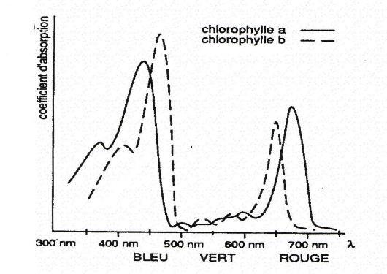
Strawberry light response and L.E.D light
  Blue = 440 nm
  Red= 660nm

Slide 3
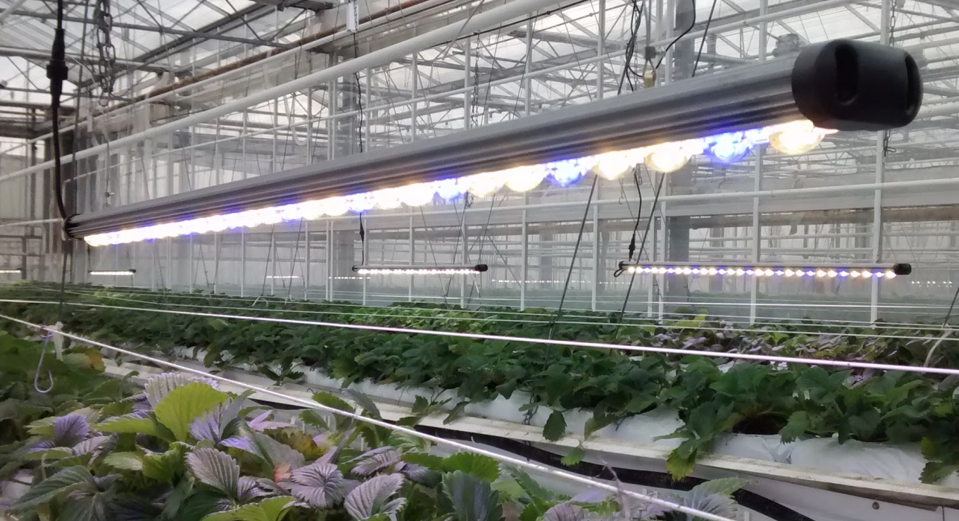
Experimental design
Within the greenhouse compartment , L.E.D ligths are randomized. The following trait are recorded:
Plant development
Flowering
Yield and Fruit quality (Sugar/Acid content)

Slide 4
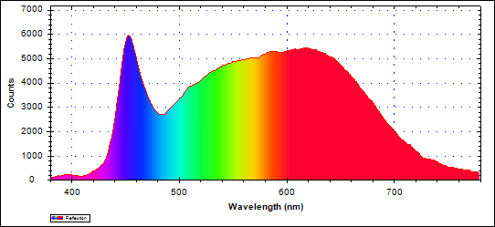
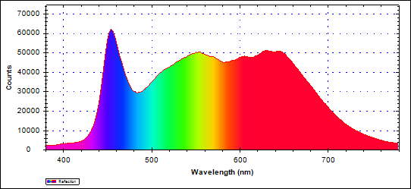
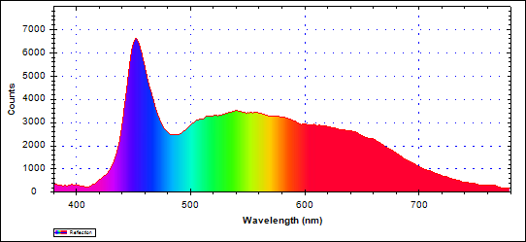
L.E.D. and Lighting Setup
Trials have been performed in 2016 and 2017 with differents :
Lighting setup
L.E.D. Lights (light spectrum)
  BCB
  BFR
Year of testing | Lighting setup | Objectives
2016 | 16h30-00h30 | Supply of 150 µmol/m²/s from December to February
2017 | 06h30-10h00 15h30-19h30
  FRBFR
  6000 K
  4000 K
  3000 K

Slide 5
2016
Condition | Stalk lenght (cm) |  | Leaf area (cm²) |  | Number of flowers |  | Yield (g/plant)
 | Mean | NKS | Mean | NKS | Mean | NKS | Mean | NKS
BFR | 18.2 | ab | 1737 | ab | 16.5 | ab | 374 | bc
BCB | 21.3 | bc | 1730 | ab | 17.9 | b | 384 | c
FRBFR | 24.9 | c | 2071 | b | 16.6 | ab | 341 | ab
Control without lighting | 17 | a | 1232 | a | 14.3 | a | 328 | a
ANOVA (Pr(>F)) | 3x10⁻⁴ |  | 0.01 |  | 0.04 |  | 0.002
Results :
Artificial light increased plant development and in some conditions (BFR and BCB) yield is also increased
In regards to electrical consumption and L.E.D. costs, the yield increase is not sufficient -> in 2017, we have tried to optimize the light settings.
Year of experimentation | Light settings | Objectives
2016 | 16h30-00h30 | Supply of 150 µmol/m²/s from December to February
2017 | 06h30-10h00 15h30-19h30

Slide 6
2017
Condition | Stalk lenght (cm) |  | Leaf area (cm²) |  | Number of flowers |  | Yield (g/plant)
 | Mean | NKS | Mean | NKS | Mean | NKS | Mean | NKS
BFR | 27,6 | - | 2135 | - | 27,3 | - | 336 | -
BCB | 25,0 | - | 1788 | - | 27,4 | - | 332 | -
V3000 | 26,0 | - | 2035 | - | 25,9 | - | 348 | -
V4000 | 25,5 | - | 1831 | - | 28,1 | - | 347 | -
V6000 | 25,1 | - | 1670 | - | 29,2 | - | 338 | -
Control without lighting | 24,8 | - | 1760 | - | 25,7 | - | 325 | -
ANOVA (Pr(>F)) | 0,647 |  | 0,498 |  | 0,579 |  | 0,823
Results :
Unlike 2016, artificial light did not affect plant development nor the yield. Even under BCB and BFR conditions, which demonstrated interesting results in 2016, plant development and yield are not different from the control in 2017.

Slide 7
Conclusions
Year of testing | Light settings | Objectives
2016 | 16h30-00h30 | Supply of 150 µmol/m²/s from December to February
2017 | 06h30-10h00 15h30-19h30
Artificial light quantity was the same in 2016 and 2017
The only difference is the period where artificial light is on
Photosynthesis saturation?
Day lenght?

Slide 8
Photosynthesis saturation?
During a bright day in February :
Even in these light conditions (which are ideal for the period), radiation does not exceed 580 µmol/m²/s, photosynthesis saturation is not likely.

Slide 9
Day length increase?
Year of testing | Light settings
2016 | 16h30-00h30
2017 | 06h30-10h00 15h30-19h30
28/02 | Sunrise | Sunset
Horaire | 07:36 | 18:32
In 2016, day length was artificially kept longer than 14h/day and increased. In 2017 day length was kept at 13h during the entire trial.

Slide 10
Day length increase?
Leaf area increase
Condition | Leaf area (cm²) |  | Yield (g/plant)
 | Mean | NKS | Mean | NKS
BFR | 1737 | ab | 374 | bc
BCB | 1730 | ab | 384 | c
FRBFR | 2071 | b | 341 | ab
Control with lighting | 1232 | a | 328 | a
ANOVA (Pr(>F)) | 0.01 |  | 0.002
Better use of natural light
  BFR
Large increase of leaf area to the cost of yield
  FRBFR
A long exposure to Far red strongly affects strawberry development
Leaf area increase
Better use of natural light

Slide 11
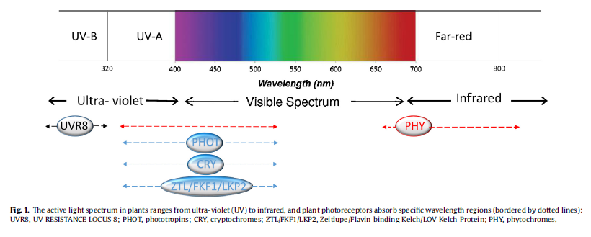
Summary : Light effect
Intensity is not the only parameter affecting plant development and yield.
Day length and light quality have also a large impact on plant development and yield.
➔ Day length : an increase can promote plant development/ a decrease can promote flower bud development
➔ Quality : the visible spectrum is important but other part of the light spectrum are also necessary
From :
Huché-Thélier et al., (2016).
horticulture. Environ. Exp. Bot.
121, 22–38.

