Slide 1
Accumulation of (bio)degradable plastics in soil
CIPA Congress 2018, Arcachon, May 29, 2017

Slide 2
TOPICS
OWS
Different end-of-life options
Expert statement
(commissioned by European Bioplastics)

Slide 3
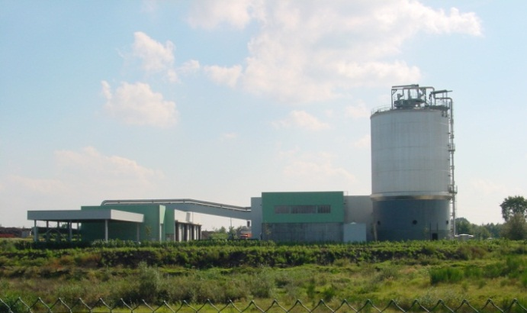
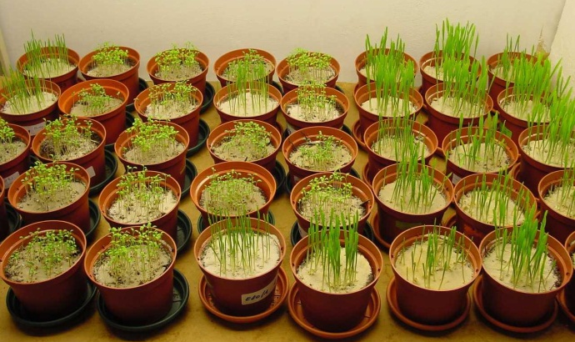
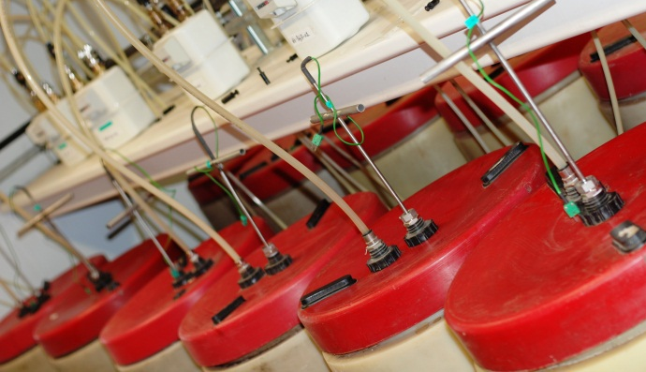
COMPANY PROFILE
DRANCO technology – UG, 1983 (pilot in 1984)
Founded in 1988
Consolidated sales (2015-2017): 20 million €/yr
Export: 90%
80 employees
Head office: Gent, Belgium
Affiliates: OWS Inc., Dayton, Ohio, USA
DRANCO N.V.
BES GmbH, Germany
Partner: DJK International, Tokyo, Japan

Slide 4
CONTRACT RESEARCH LABORATORY
‘One-stop’ laboratory for biodegradability
& compostability testing
Strictly independent
Quality control: ISO 17025
Recognized by all certification
bureaus worldwide
Active in standardization: CEN/ASTM/ISO
Member of several certification committees
& industrial associations (EuBP, BBP,…)
More than 30 years of experience
10,000+ samples tested for 1,250+ clients

Slide 5
REFERENCES
Base Polymers | BASF, Bio-Fed, Corbion, Du Pont, FKuR, NatureWorks, Novamont,…
Paper & Board | Ahlstrom, Huhtamaki, Int. Paper, Kuan Chun Paper, Pactiv, UPM,…
Packaging | Alcan Packaging, Amcor, Mondi Packaging, Sealed Air, Tetra Pak,…
Consumer Goods | Henkel, Kimberly-Clark, Lenzing, Nestlé, P&G, Sara Lee, SCA, Unilever,…
Inks & Masterbatches | PolyOne, CIBA, Chimigraf, Flint, Sun Chemical, Wacker,…
Films & Bags | Because We Care, Cortec, Kafrit, Sabic, Sphere, Wuhan Huali,…
Food Service Ware | Medac, Minima, Seda, Smurfit Kappa, Solo Cup,…
Other categories | Smithers-Oasis, EBPA, EuBP,…
Oxo-degradable | CIBA, Goody (ACCC), Wells Plastics, Symphony, EPI, EconVerte,…
Enzyme-mediated | Enzymoplast, ECM, Bio-Tec,…

Slide 6
TOPICS
OWS
Different end-of-life options
Expert statement

Slide 7
ENVIRONMENTAL NICHES
PRODUCT USE/DISPOSAL
CONTROLLED
UNCONTROLLED
(LITTER or IN SITU)
WASTEWATER
SOLID WASTE
OPEN WATER
SOIL
MARINE
AEROBIC
TREATMENT
ANAEROBIC
TREATMENT
Biodegradable plastics are no solution/excuse for littering!
ANAEROBIC
STABILISATION
COMPOSTING
BIOGASIFICATION
LANDFILL
CENTRAL HOME
USE OF COMPOST IN SOIL

Slide 8
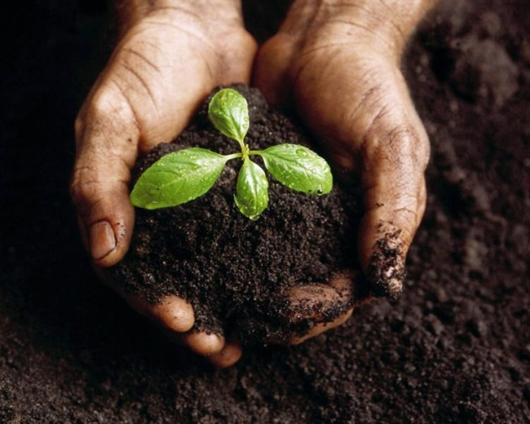
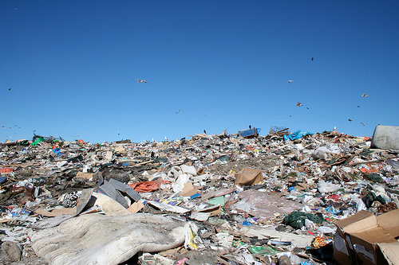
AGGRESSIVENESS OF ENVIRONMENT
60°C
21°C
compost > soil > fresh water > marine water > landfill
anaerobic digestion

Slide 9
AGGRESSIVENESS OF ENVIRONMENT
Fungi + Bacteria + Actinomycetes
Bacteria only
(Fungi inactive)
compost > soil > fresh water > marine water > landfill
Multiple Bacteria
anaerobic digestion

Slide 10
BIODEGRADATION vs. ENVIRONMENTAL NICHE
AEROBIC (WATER) + ANAEROBIC
BACTERIA, NO FUNGI
AEROBIC (COMPOST & SOIL)
BACTERIA & FUNGI
High T
(50-60°C)
Chemical pulp
Mechanical pulp
Starch
PLA
Starch/PCL
PHA
PBAT
Chemical pulp
Starch
PLA
Starch/PCL
PHA
THERMOPHILIC
DIGESTION
INDUSTRIAL
COMPOSTING
Low T
(≤ 35 °C)
MESOPHILIC
DIGESTION
WATER
HOME
COMPOSTING
SOIL
PBAT
PHA
Starch/PCL
Starch
Chemical pulp
Mechanical pulp
Chemical pulp
Starch
Starch/PCL
PHA

Slide 11
RELEVANT LEGISLATION & STANDARDS
Revision of the EU Fertilisers Regulation
Mulching films
Controlled release fertiliser coatings
Growth media
(Body bags)
European standard EN17033
Heavy metals & Fluorine content
Biodegradation
Plant toxicity
Earthworm toxicity
Toxicity towards micro-organisms
No disintegration!
Environmental safety!

Slide 12
TOPICS
OWS
Different end-of-life options
Expert statement
What is “complete” biodegradation?
Accumulation of plastics in soil

Slide 13
“COMPLETE“ BIODEGRADATION
Only scientific correct parameter is conversion to CO₂
General opinion: “complete” = 100%
Biochemical pathway of biodegradation:
C_{polymer} + O₂ ⇒ CO₂ + H₂O
+ C_{residual} + C_{biomass}
Intermediate degradation products
Biomass growth
Not all C_{polymer} is converted to CO₂!

Slide 14
“COMPLETE“ BIODEGRADATION
Biochemical pathway of biodegradation:
C_{polymer} + O₂ ⇒ CO₂ + H₂O + C_{residual} + C_{biomass}
EN 17033 (2018) standard on soil biodegradation :
complete biodegradation = 90% (absolute or relative)
Can be quantified
Cannot be quantified

Slide 15
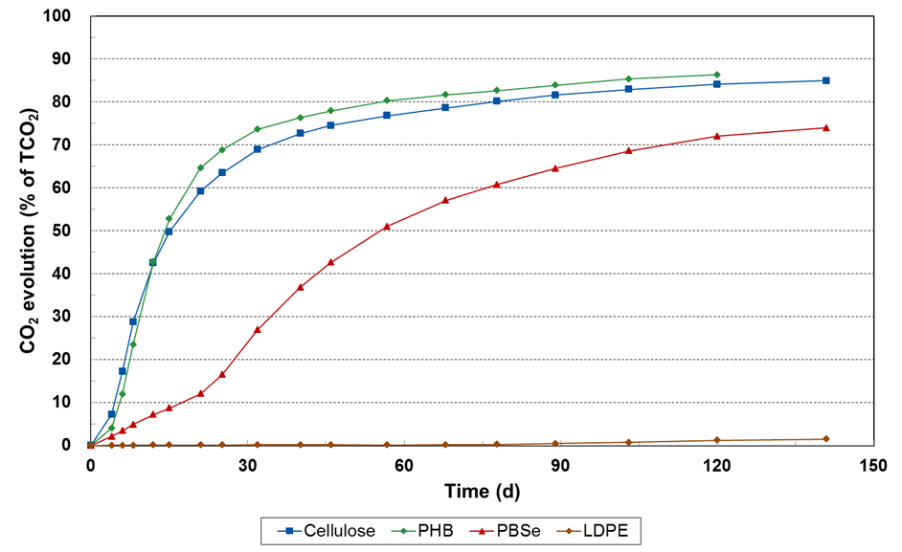
“COMPLETE“ BIODEGRADATION – C_{biomass}
C_{biomass} typically varies between 10% and 40%
10-15%
± 10%
± 25%
Straw: 25-30%
Wood fibers, birch leaves, pine needles: up to 40%

Slide 16
ACCUMULATION IN SOIL
(LD)PE mulching film (15-50 µm)
Removal is costly and labor intensive
Contamination hinders recycling
Accumulation increases with decreasing thickness¹:
25µm PE film: 10% remains in/on soil
20µm PE film: 25% remains in/on soil
10µm PE film: 68% remains in/on soil
Soil biodegradable mulching film (15 µm)
No need for removal
Complete biodegradation within maximum 2 years under laboratory conditions
¹: APE Europe (Agriculture Plastic Environment), industry association for the non-packaging agri-plastics presentation by Bernard Le Moine at Agricultural Film 2014

Slide 17
ACCUMULATION IN SOIL
20 µm LDPE film – 1 cultivation period/year
463 kg/hectare after 10 years
4.6 tonnes/hectare after 100 years
(accumulation continues over time)
15 µm soil biodegradable film – 1 cultivation period/year
188 kg/hectare after the first year
281 kg/hectare after the second year
(= maximum accumulation level!)

Slide 18
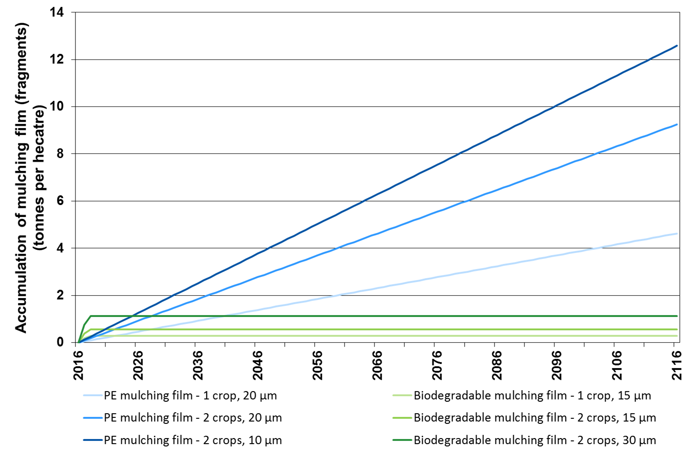
ACCUMULATION IN SOIL
4.6 tonnes

Slide 19
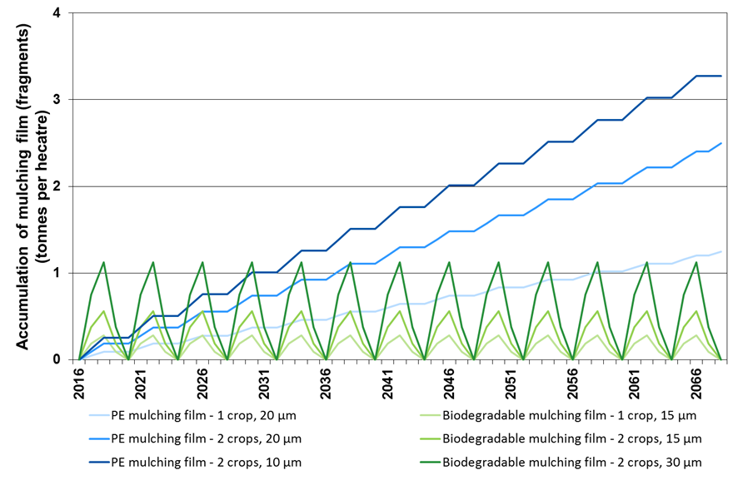
ACCUMULATION IN SOIL
What if cultivation is ceased every two years?

Slide 20
CONCLUSIONS
Complete biodegradation does not mean “100% conversion to CO₂”.
Conventional (LD)PE mulching films accumulate at a rate of 463 kg per hectare per decade¹.
Soil biodegradable mulching films have a maximum accumulation level of 281 kg per hectare¹, returning to no accumulation if cultivation is ceased for two years.
(LD)PE mulching films cannot be downgauged as this increases the relative level of contamination and decreases the recovery rate.
¹: Assuming one cultivation period per year and a thickness of 20 µm for LDPE and 15 µm for soil biodegradable mulching films

Slide 21
THANK YOU FOR YOUR ATTENTION
OWS nv, Dok-Noord 5, B-9000 Gent, Belgium
Email: sam.deconinck@ows.be
Website: www.ows.be

