Slide 1
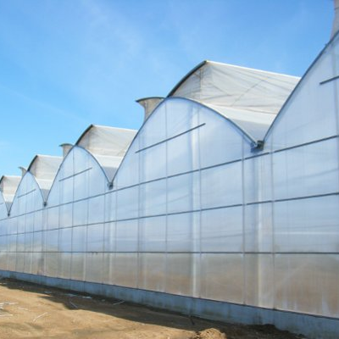
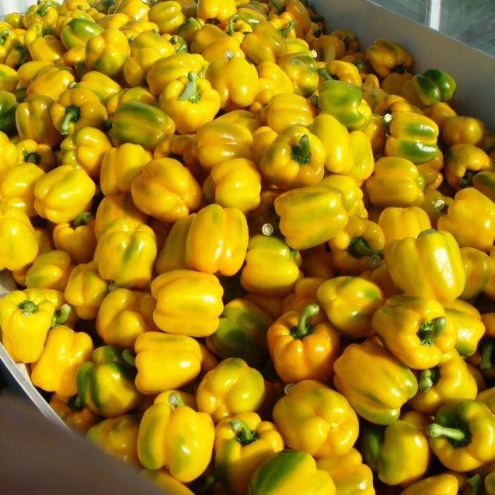
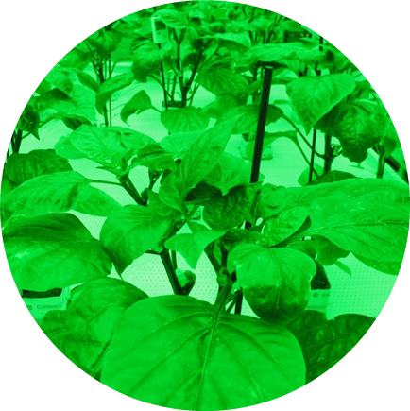
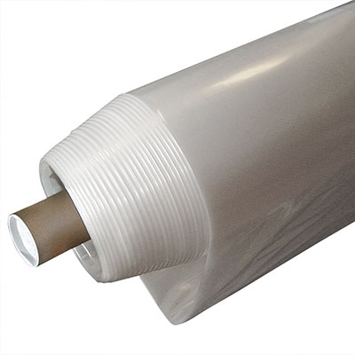
Effect of greenhouse films on climate, energy, light distribution and crop performance-measuring film properties and modeling results
S. Hemming, E. Baeza Wageningen University & Research,
Business Unit Greenhouse Horticulture
esteban.baezaromero@wur.nl ; silke.hemming@wur.nl
XXIst CIPA Congress, Bordeaux-Arcachon, France,

Slide 2

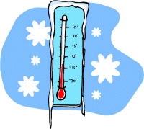
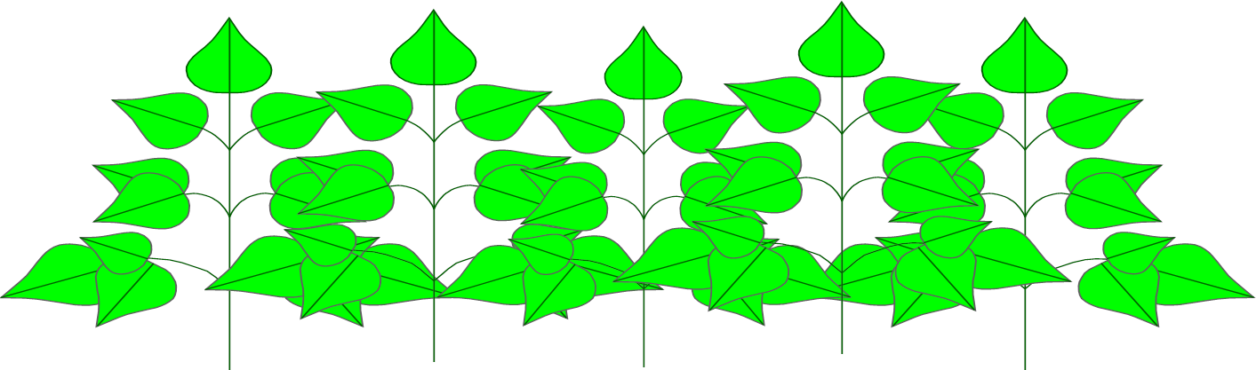

Protected cultivation = modification of the aerial growth factors
Field cultivation = improvement of root-zone environment
Protected cultivation = improvement also of the aerial environment
The properties of the shelter determine the aerial factors inside

Slide 3
Limiting factor concept
Ambient
radiation
temperature
[CO₂]
[H₂O]
€
A sub-optimal factor can not be compensated optimizing the others
Water, minerals, carbohidrates
Root zone
H₂O
Minerals

Slide 4
Important function greenhouse film
Plants need:
Light
Plants give:
Vapour
τ_{IR}, ε
α_{c}
Plants need:
CO₂
humidity
τ_{PAR,} τ_{NIR}
temperature
Photosynthesis, growth, development, production
CO₂
Plants need:
Water & nutrients
Cecilia Stanghellini

Slide 5

How do greenhouses work?
Solar energy is trapped → heat
Excess energy is “ventilated away”
UV PAR NIR
[spectral] reflectivity & transmissivity
diffusivity
Ventilation capacity
temperature inside
heat
Drawbacks of ventilation:
impossible to control [CO₂]
way-in for pathogens
way-out for predators
photosynthesis + heat
Morphogenesys
Color & Insects

Slide 6
Night-time
apparent sky temperature
Ambient temperature
TIR emissivity/ transmissivity
Heat conductance
temperature
heating

Slide 7
Heat IR loss from greenhouse
Transmission τ, reflection ρ, absorption α
Transmission τ_{IR}
=Emission ε
Absorption α_{IR}
Reflection ρ_{IR}
Thermal infrared
IR
τ_{IR}+ρ_{IR}+ε=1

Slide 8
The desired spectral properties of covers…
...change with external conditions: location and time
τ as high as possible
“visible” light (PAR)
Near Infrared (NIR)
Thermal infrared (TIR)
ρ high to cool
ρ low to keep warm
τ ; ε low to keep warm
τ ; ε high to cool

Slide 9
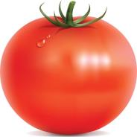
The adaptive greenhouse...
©Wageningen Research
Temperature
Humidity
Solar radiation
Wind
Heating
CO₂
Cooling
Artificial light, etc
fuel
electricity
CO₂
water
Climate
Control
activo
Greenhouse model
Required resources
Crop model
Better possible passive greenhouse
Greenhouse structure
Ventilation capacity
Ventilation management
Optical properties cover
Insulation (including screens)
Productivity

Slide 10
Greenhouse climate and energy model

Slide 11
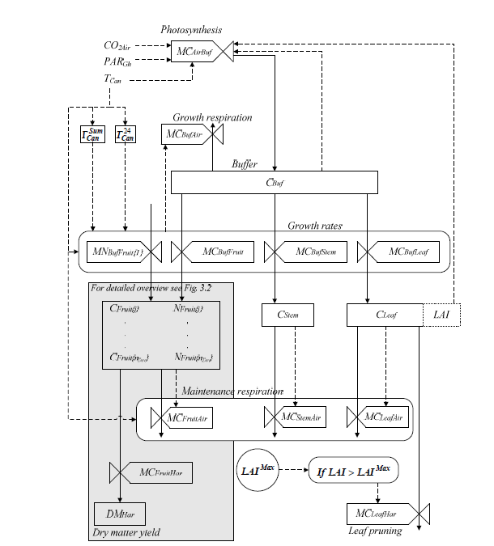
Crop growth model

Slide 12
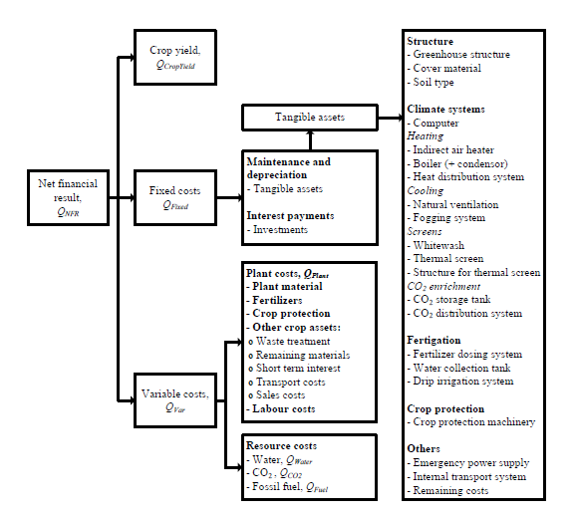
Economic model
Crop growth model
Taiwan
Greenhouse climate model

Slide 13
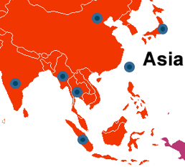
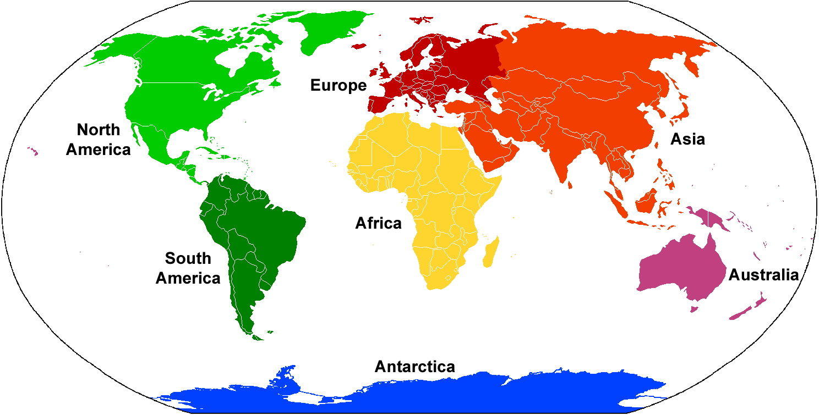
Microclimate prediction under different plastic films in the tropics
Taiwan
Notes:
Different regions in the world

Slide 14
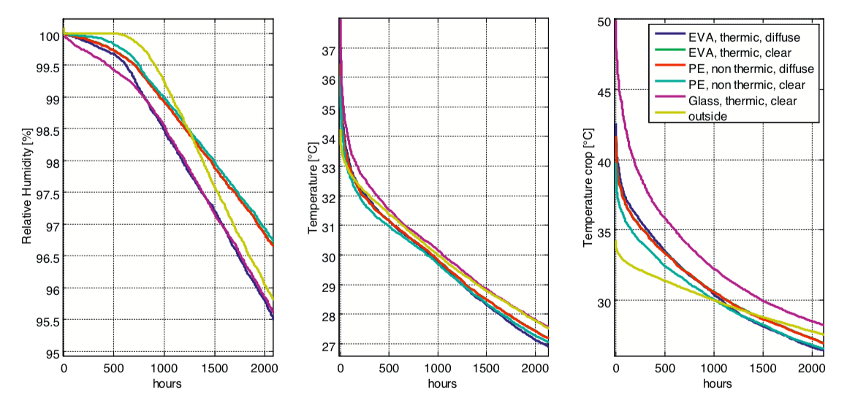

Slide 15
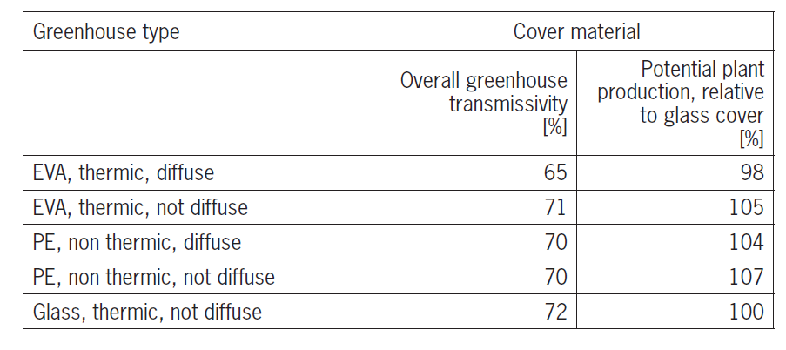
Advise: to use a plastic film that is diffuse/high transmission, also to thermal radiation (to help reduce extreme greenhouse temperatures)

Slide 16
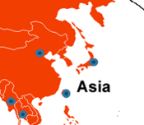
Energy consumption prediction under different coverings in a humid subtropical climate
Japan
Notes:
Different regions in the world

Slide 17
Radiometric properties of different greenhouse covering materials

Slide 18
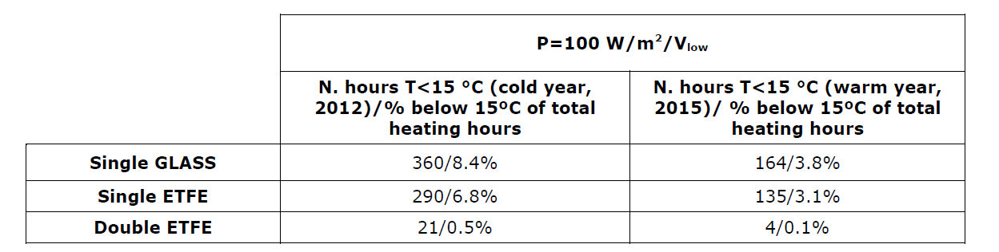
Advise: economic model showed that single ETFE was better option, despite of lower energy use efficiency

Slide 19
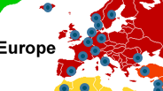
Greenhouse crop production under different coverings in a cold winter climate
Notes:
Different regions in the world

Slide 20
Standard glass (hemispherical light transmission of 81,9%) vs glass with a new coating (hemispherical light transmission of 85,6%)
 | Tomato(+%) | Sweet pepper(+%) | Cucumber(+%)
Light in greenhouse | 4,5 | 4,5 | 4,5
Photosynthesis | 3,2 | 3,0 | 3,1
Leaf area | 0.9 | 0,2 | 0,0
Plant weight | 3,1 | 1,6 | 2,2
Yield | 3,2 | 2,9 | 5,2
 | Chrysanthemum (+%) | Gerbera(+%) | Rose(+%)
Light in greenhouse | 3,8 | 3,6 | 2,4
Photosynthesis | 3,2 | 2,6 | 1,5
Leaf area | 3,0 | 0,0 | 1,3
Plant weight | 3,0 | 2,6 | 1,2
Yield | 3,4 | 2,6 | 2,8
Crop growth parameters, all values (in %) show the beneficial effect of a glass with higher light transmission

Slide 21
Conclusions
Greenhouse models are suitable to compare different covering materials with each other while keeping all other factors constant
This gives fast answers without very intensive and costly agronomic trials.
Models shown in this paper have been intensively validated with experimental data in different climate conditions, for different greenhouse types and different crops and cropping strategies.
The described models always assume a “good grower”. More conservative yield values can be obtained by using correction.
Connecting model output with economic figures makes it possible to define interesting business cases for growers
Help growers in their decision for a suitable covering or can help producers to develop new materials for the greenhouse market.

Slide 22
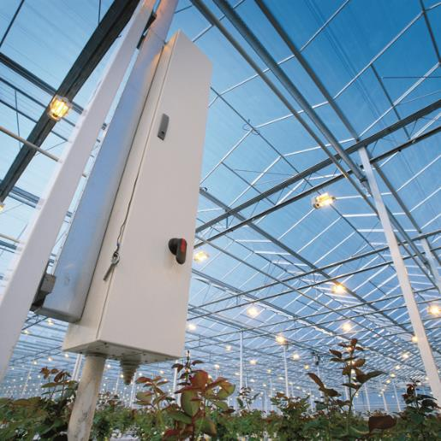
Wageningen University & Research,
BU Greenhouse Horticulture
Innovations for the horticultural sector
THANKS A LOT FOR YOUR ATTENTION!

