Slide 1

Plasticulture in China
Li Zhen
Chinese Academy of Agricultural Sciences

Slide 2
Main Content
1. Plastic Industry in China
Agro-Plastic Application
3. Plastic Waste Recycling

Slide 3

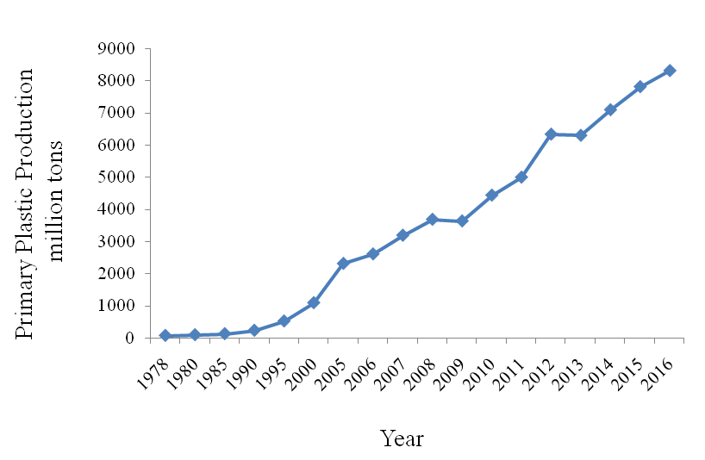
PLASTIC INDUSTRY IN CHINA
Development of Plastic Industry in China
( )
Main Business Income
（trillion yuan）
Year
Notes:


Slide 4
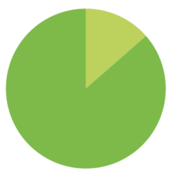
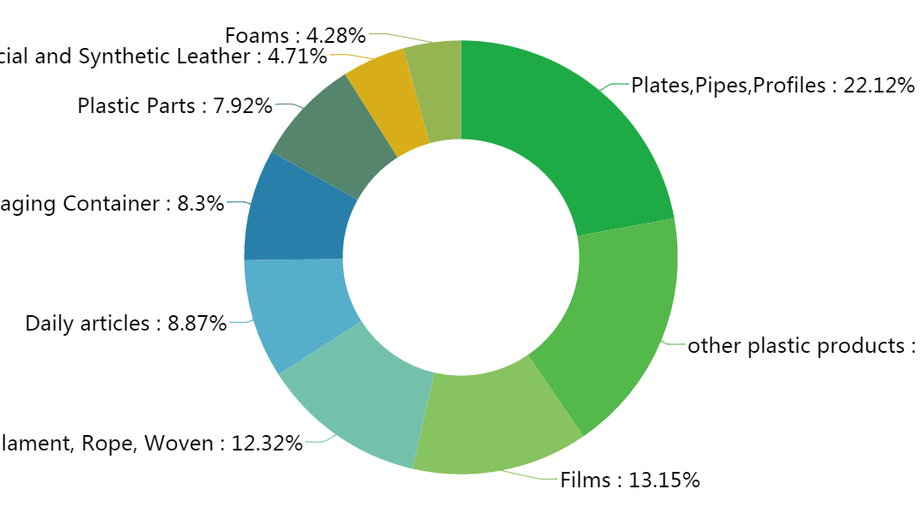
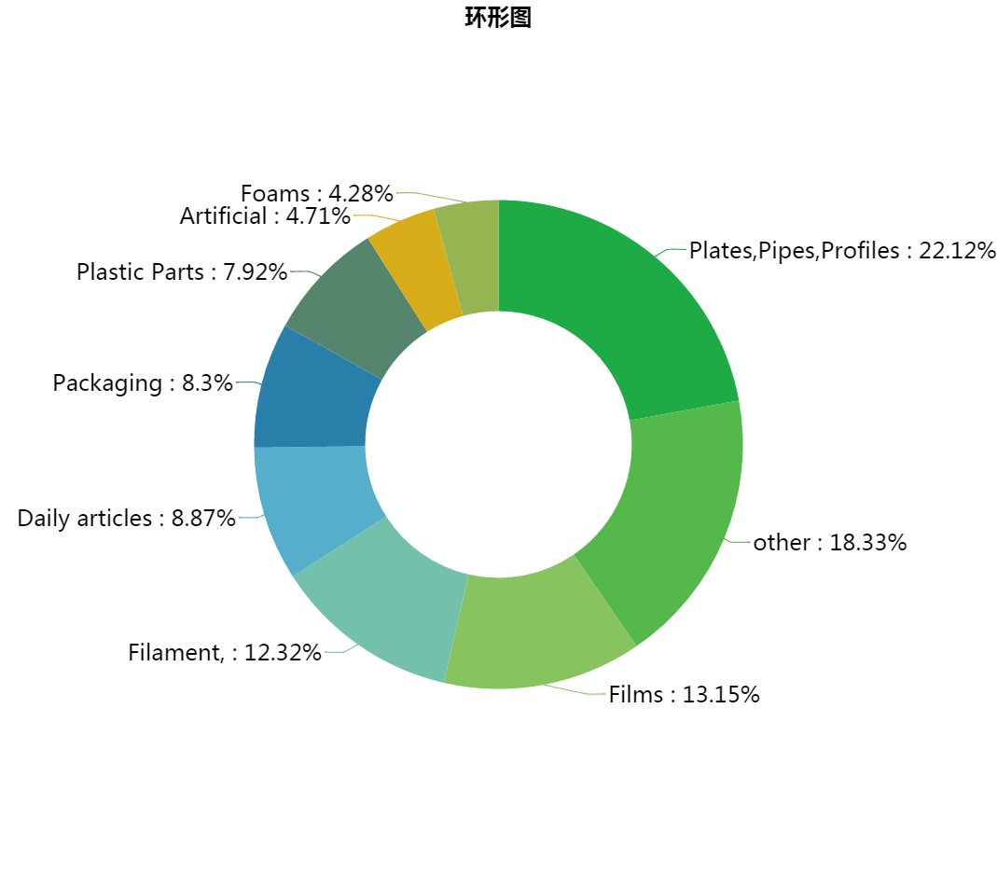

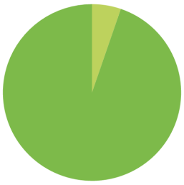
PLASTIC INDUSTRY IN CHINA
Structure of Plastic Production
13.40%
Films
17.00%
Pipes
5.25%
Total

Slide 5

PLASTIC INDUSTRY IN CHINA
Distribution of Plastic Production in China
N < 0.3 MT
0.3 MT ≤ N < 0.7 MT
0.7 MT ≤ N < 1.5 MT
1.5 MT ≤ N < 3.0 MT
3.0 MT ≤ N < 4.5 MT
N ≥ 4.5 MT

Slide 6
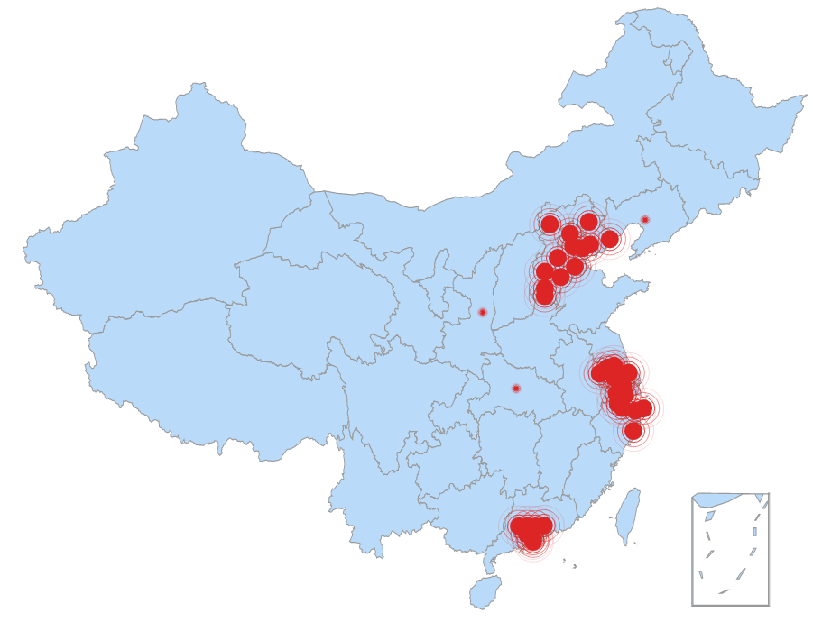

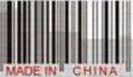
PLASTIC INDUSTRY IN CHINA
The Plastic Industrial Demonstration Areas
Capital economic circle
Yangtze River delta
Pearl River delta
Industrial towns in the Northeast, Central and Western regions

Slide 7
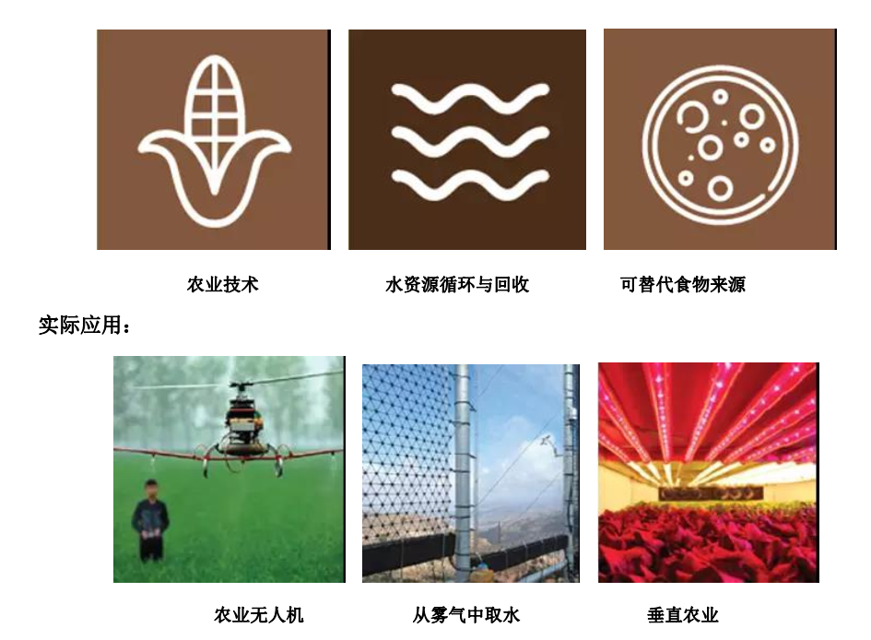
PLASTIC INDUSTRY IN CHINA
Water Saving and Vertical Farming Technologies

Slide 8

AGRO-PLASTIC APPLICATION
Primary Agricultural Application
Crop Growing
Water Irrigating
Livestock Raising
Aquaculture Fishing
Mulch Film
Plastic House
Shading Net
Fly Net
Seedling Container
Drip Irrigation Pipe
Flood Irrigation Pipe
Spray Irrigation Pipe
Heating Sheepfold
Silage Film
Breeding Net
Fishing Net

Slide 9
AGRO-PLASTIC APPLICATION
Plastic Film Mulching Regions

Slide 10
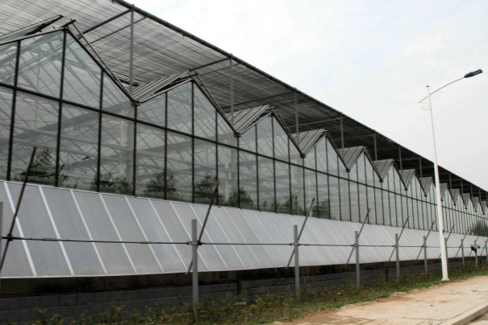
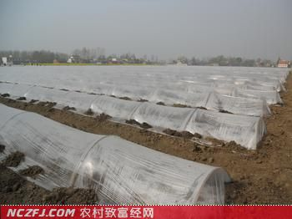

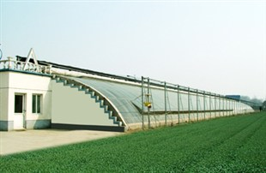
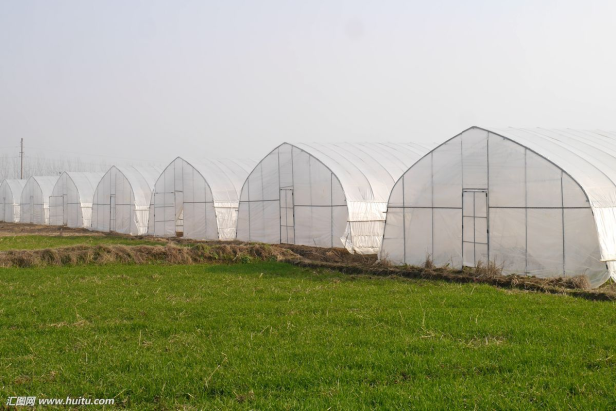
AGRO-PLASTIC APPLICATION
Protected Horticulture
Tunnel
28.55%
Green House
24.84%
36,000hm²
1,150,000hm²
Plastic Shelter
46.62%
930,000hm²
1,900,000hm²

Slide 11
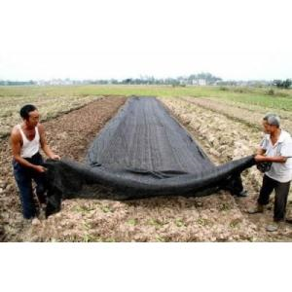
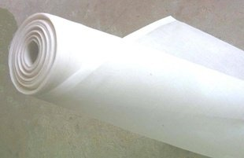
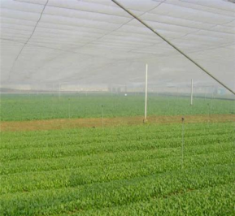
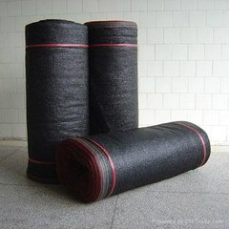
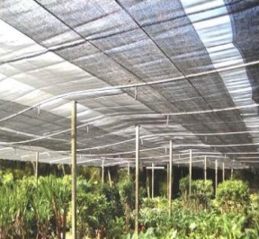
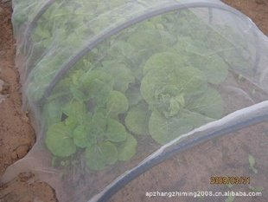
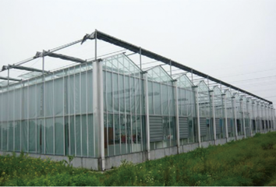
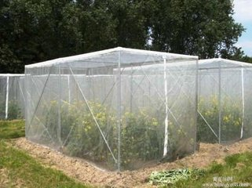
AGRO-PLASTIC APPLICATION
Shading Net & Fly Net
Usage Quantity
Usage Quantity
1500 Million M²
400 Million M²
Fly Net
Shading
Net
52K
2018 Q4
26K
2018 Q2
Annual Renew
Annual Renew
500 Million M²
60 Million M²

Slide 12
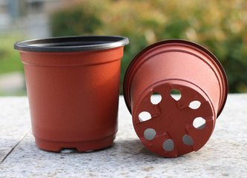
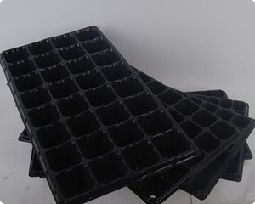
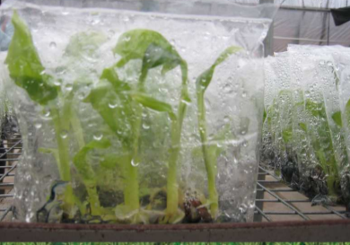
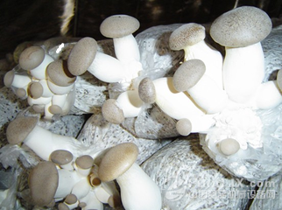
AGRO-PLASTIC APPLICATION
Seedling Container
01
02
03
04
Flower Pot
Hole Tray
Seedling Bag
Fungus Cultivation

Slide 13
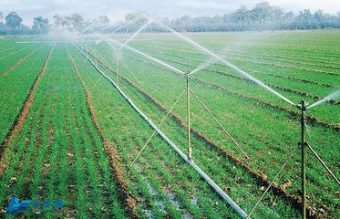
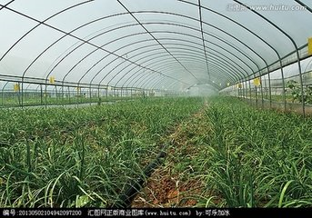
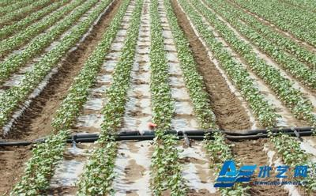
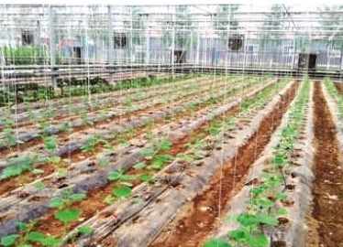
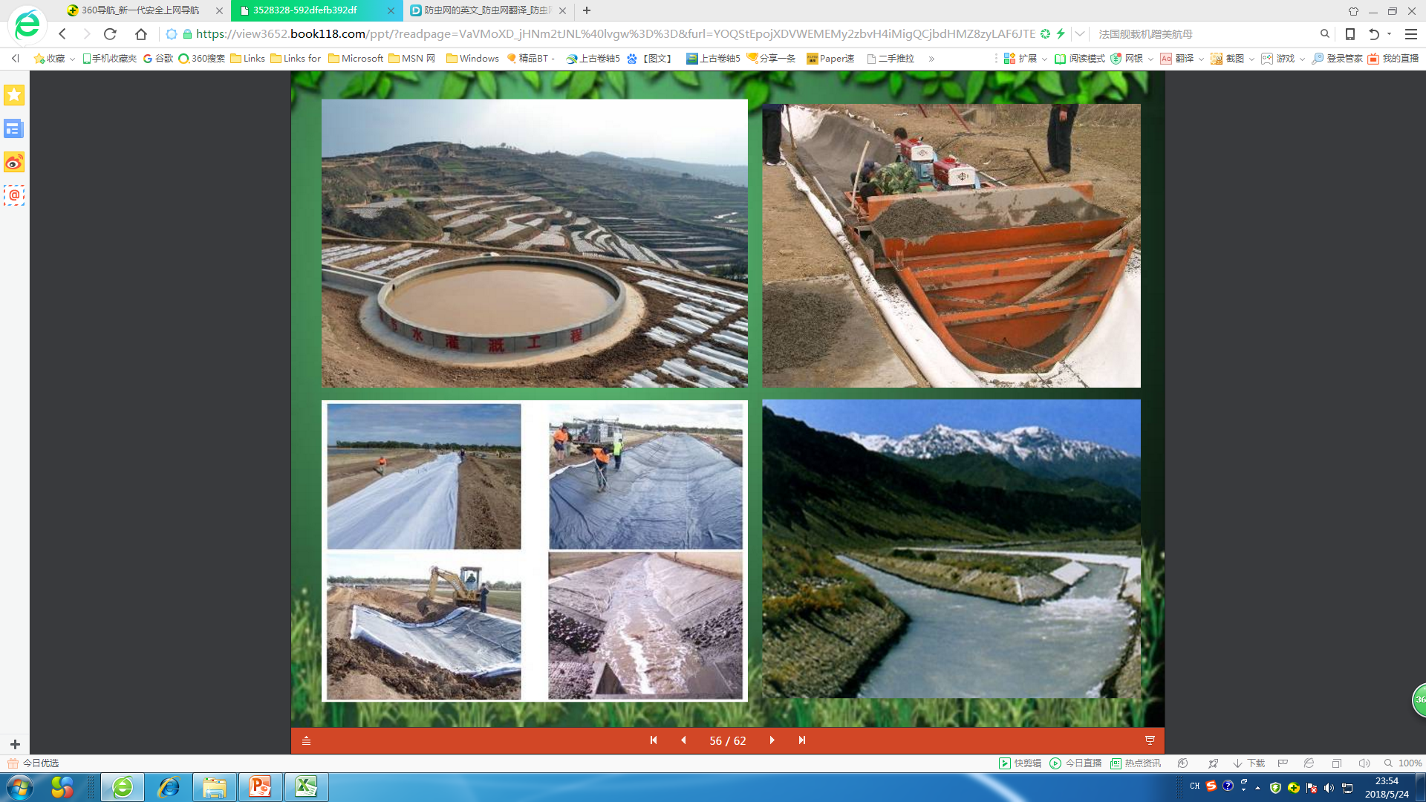
AGRO-PLASTIC APPLICATION
Irrigation and Water Conservancy
14,700,000hm²
Annual water-saving irrigation area in China
2,000,000 ton
Annual consuption of water saving equipment

Slide 14

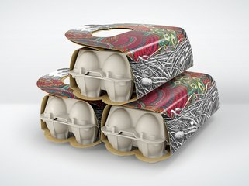
AGRO-PLASTIC APPLICATION
Livestock Breeding
WARM SHED
SILAGE
FOWLERY
PRODUCT
PACKAGE

Slide 15
AGRO-PLASTIC APPLICATION
Aquaculture Fishing

Slide 16

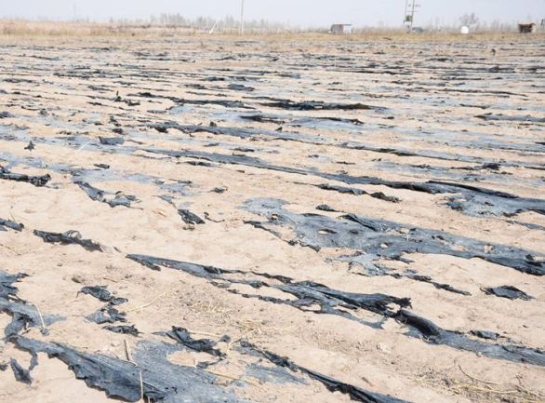
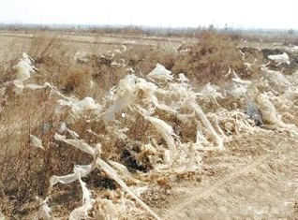
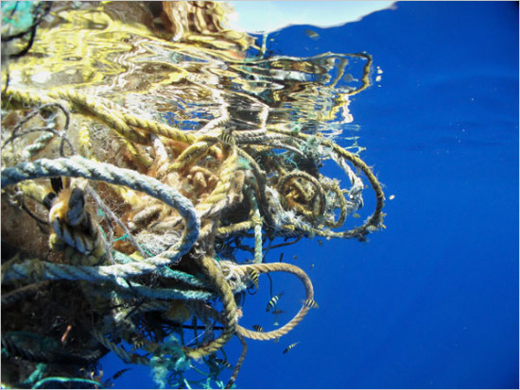
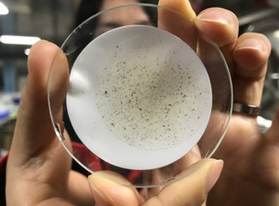
PLASTIC WASTE RECYCLING
Agricultural Plastic Waste
The average amount of plastic residues at intensive farming areas of China varied from 50 to 270 kg/hm²
The marine environment is also faces serious plastic pollution.

Slide 17
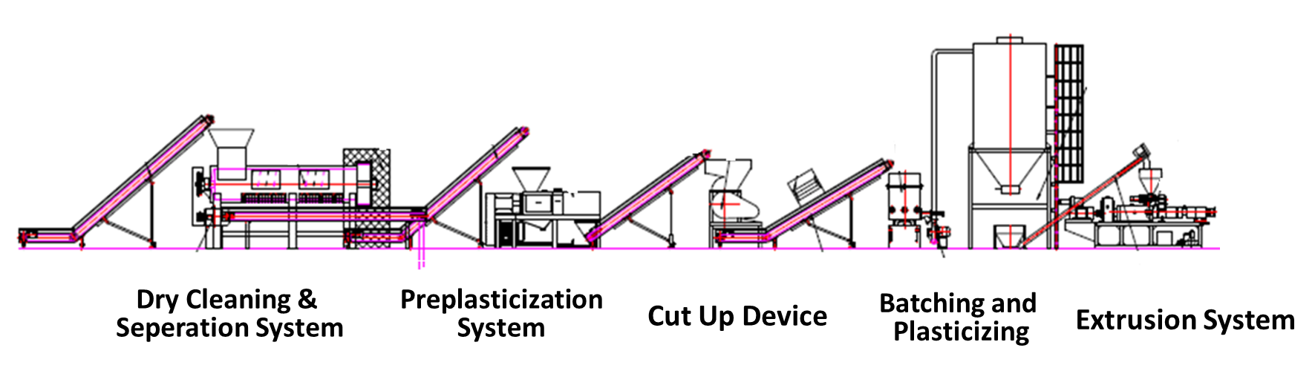

PLASTIC WASTE RECYCLING
Recycling Process Flow Diagram

Slide 18

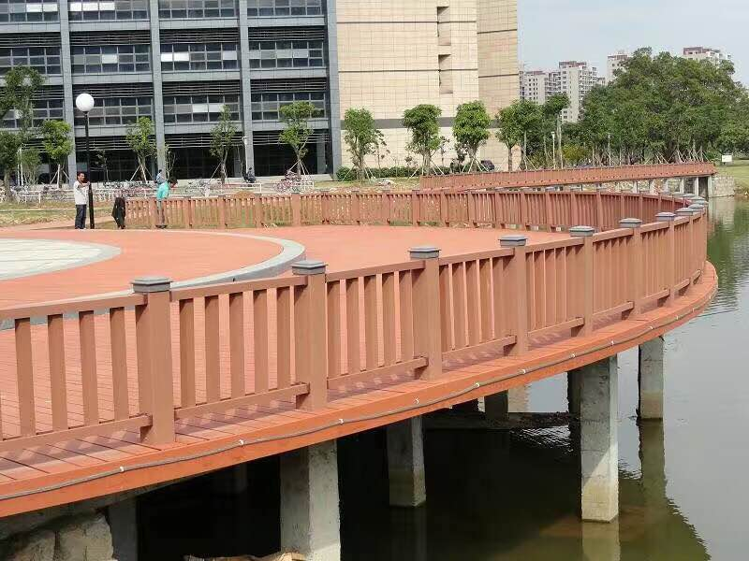
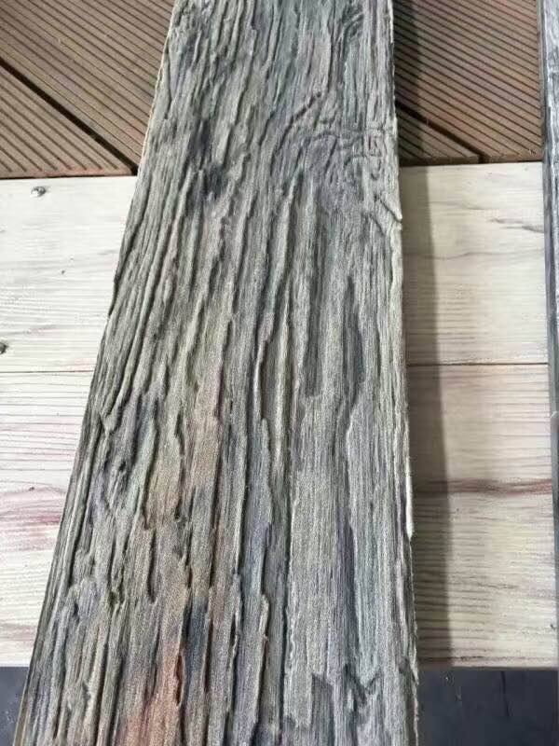
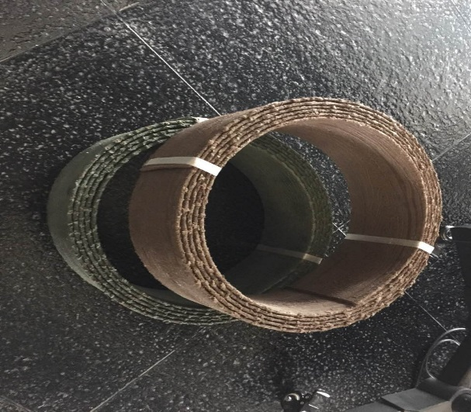
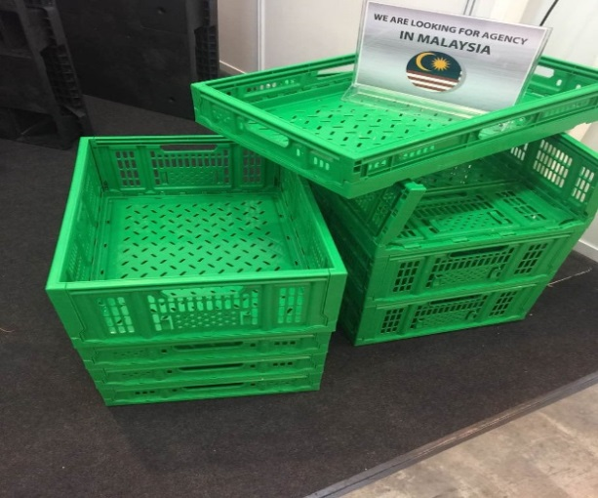
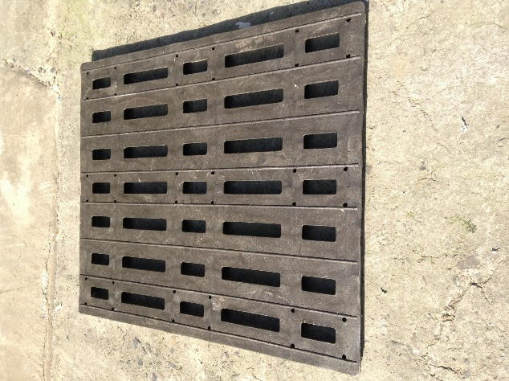
PLASTIC WASTE RECYCLING
Recycled Products

Slide 19
Thank You!

