Slide 1
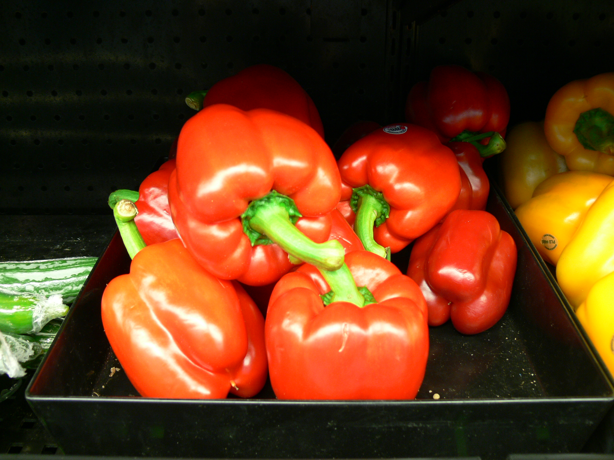
Light Level Under Shading Nets Affects Bell Pepper (Capsicum annum L.) Fruit Mineral Nutrients
Juan Carlos Díaz-Pérez
Department of Horticulture
University of Georgia –Tifton Campus

Slide 2
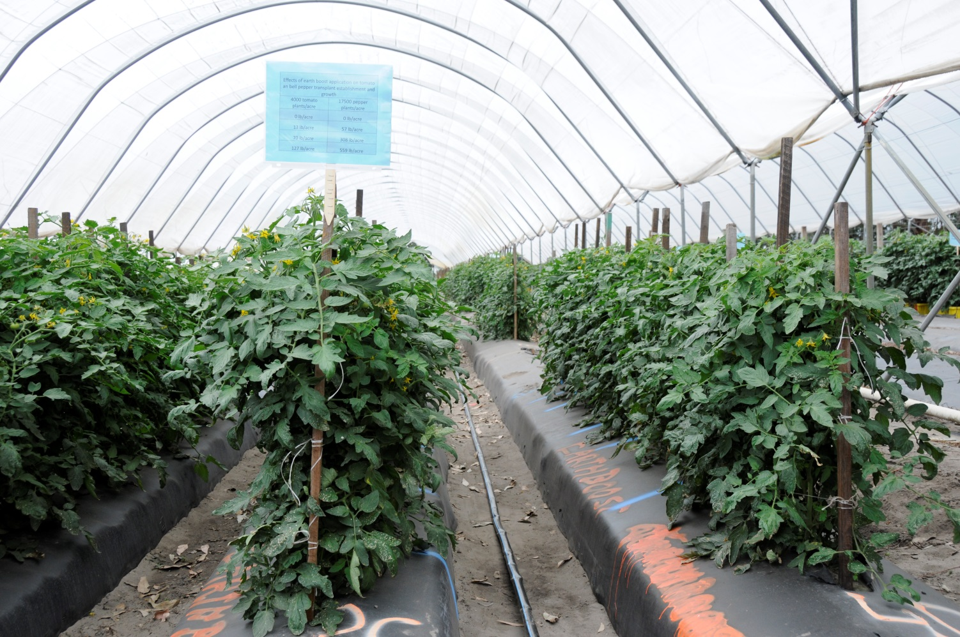
For centuries horticulturists have modified crop microenvironment to extend the production season and enhance crop growth, yield, and quality.

Slide 3
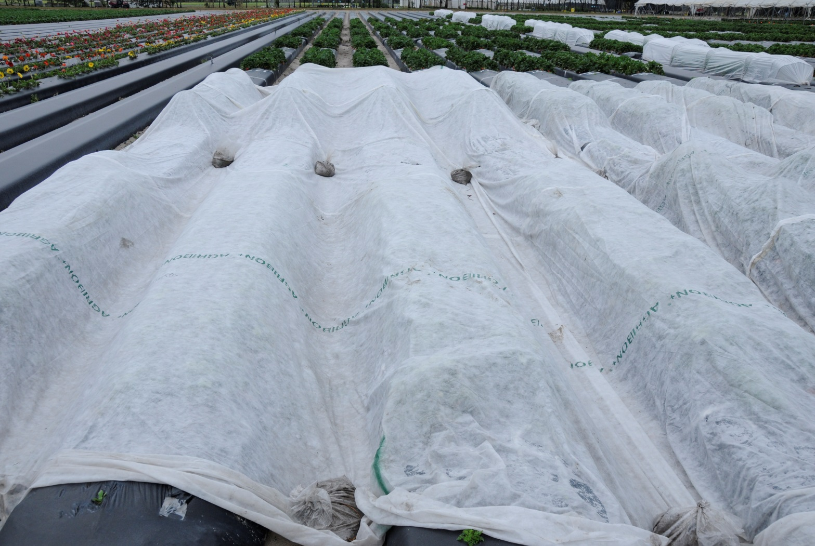
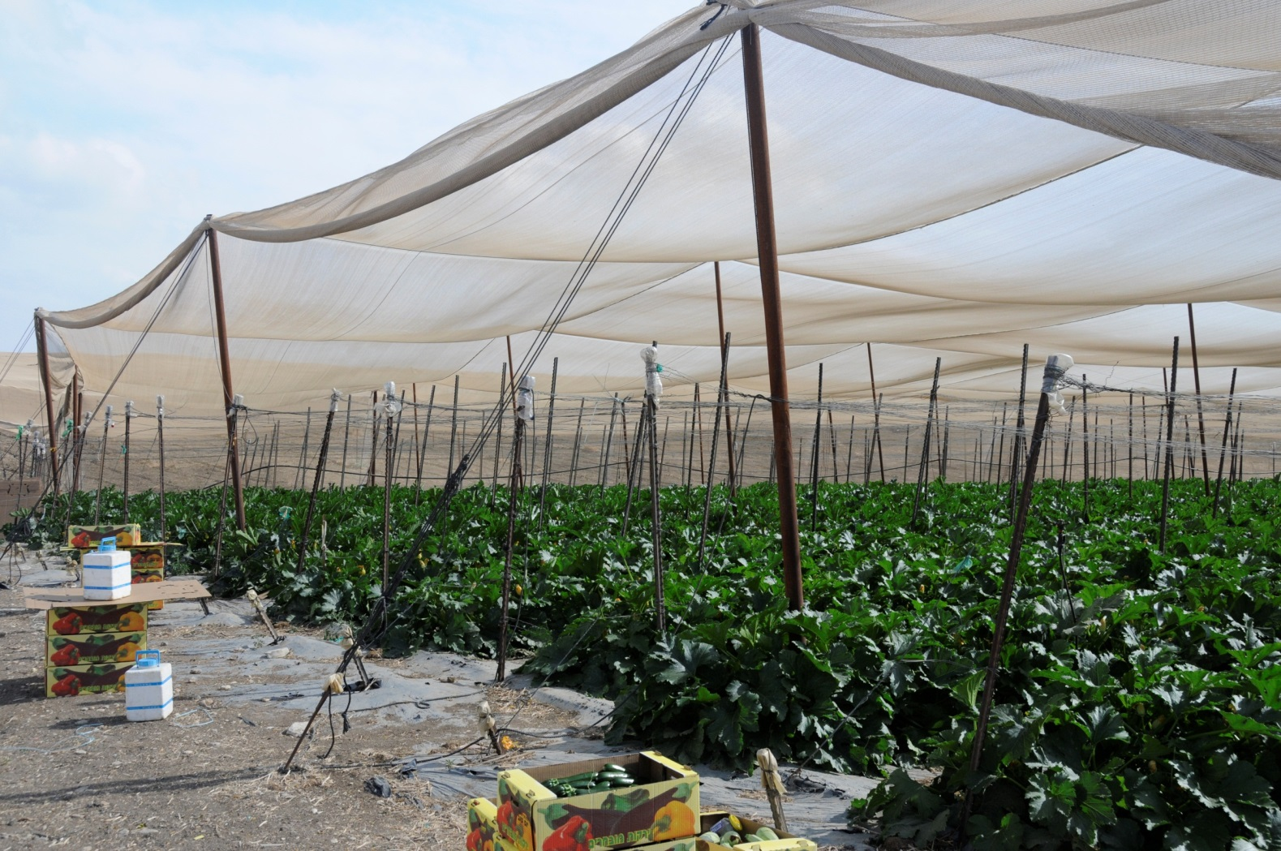
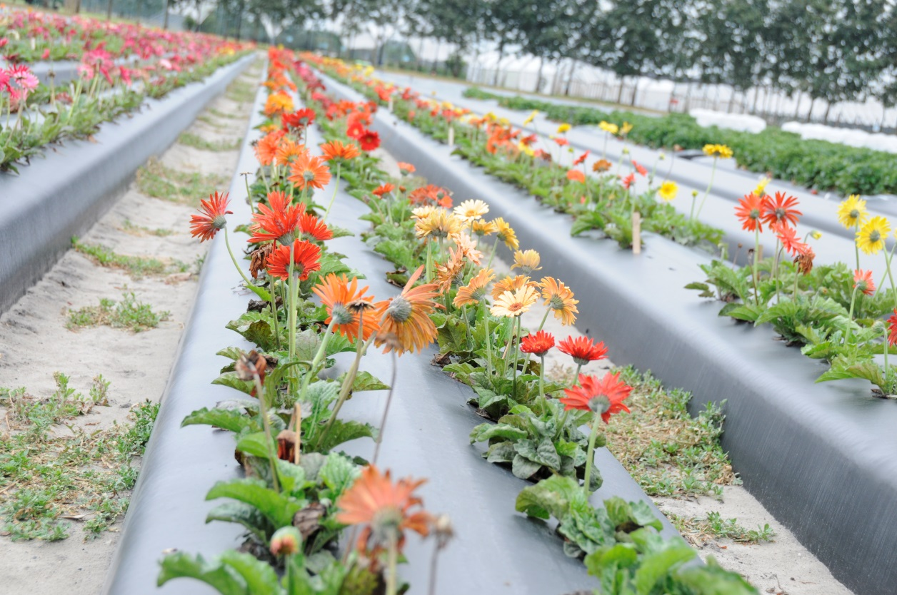
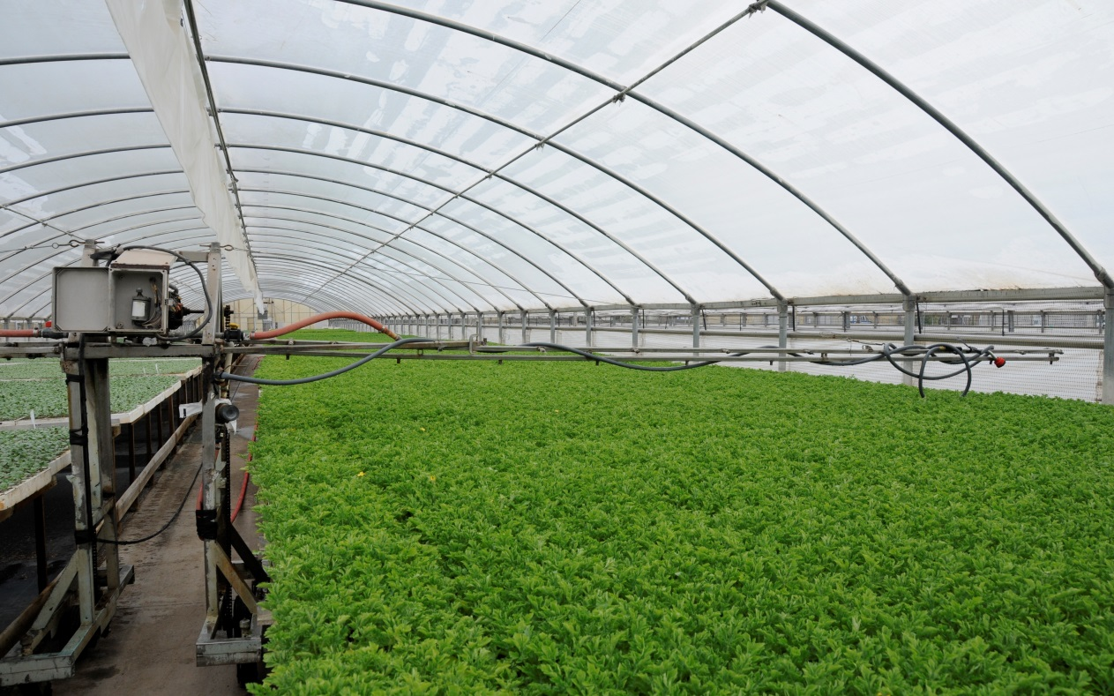
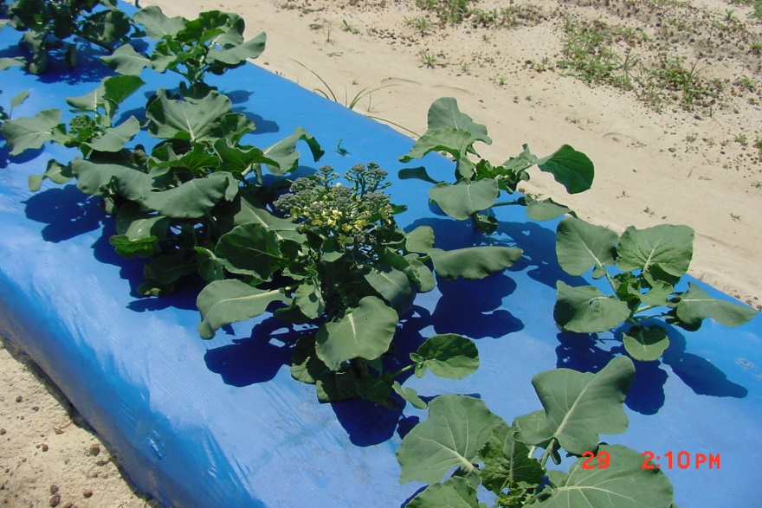
Plasticulture
Plastic mulches
Row covers
Windbreaks
Low tunnels
High tunnels
Shade/net houses
Greenhouses

Slide 4
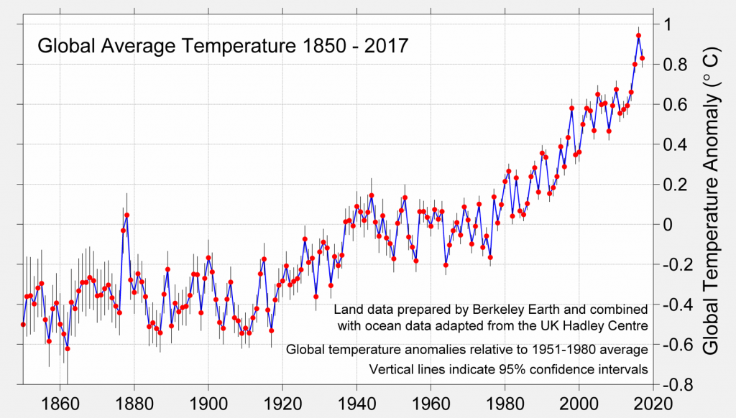
http://berkeleyearth.org/global-temperatures-2017/

Slide 5
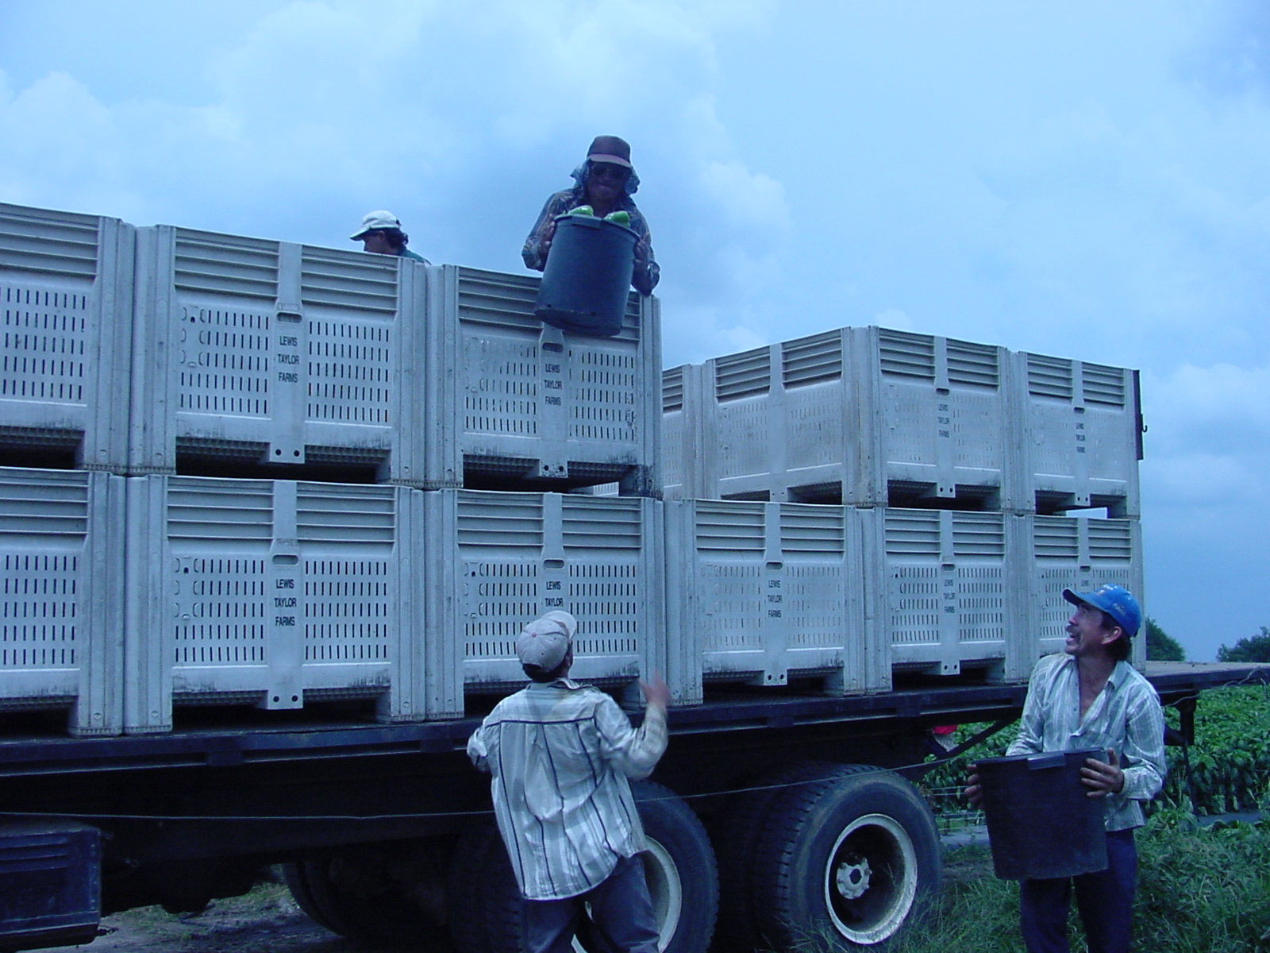

Bell Pepper production in Georgia
2,000 hectares
$70 million (per year)
90% of the total surface is under plastic

Slide 6
Production seasons
Spring
  Planting: March-April
  Reduced presence of pests and diseases
  Highest fruit yields
  Harvest: May-July
  High summer temperatures →
    +++ Fruit diseases (e.g., anthracnose, soft rot)
    +++ Physiological disorders (blossom-end rot, sunscald)
Fall
  Planting: July-August
  High presence of pests and diseases
  Reduced fruit yields

Slide 7
Tomato yield

Slide 8
Bell pepper yield was maximal at a mean root zone temperature (10 cm deep) lower than 27 C.

Slide 9
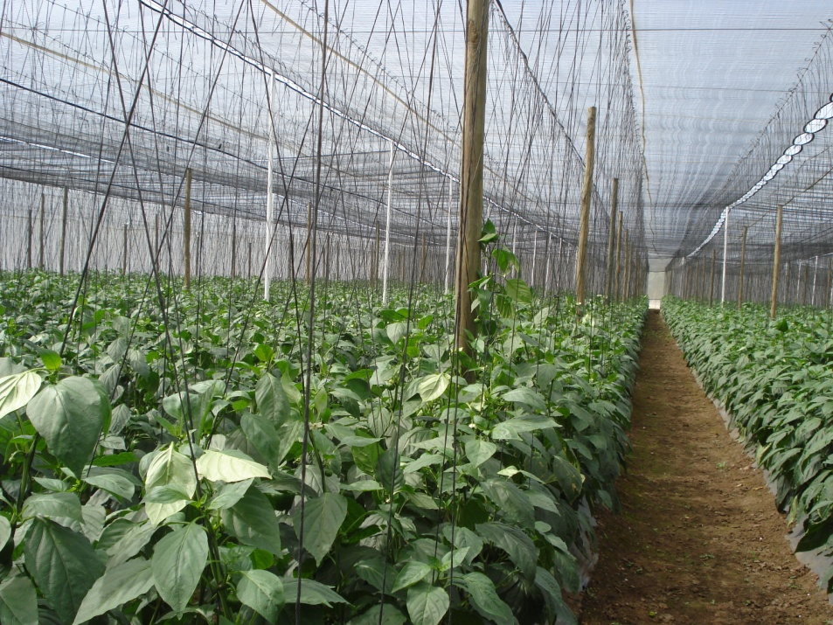
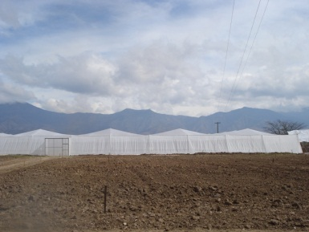

Shade houses
Increased fruit quality
Season extension
Increased irrigation water use efficiency
Improved pest and disease management
A fraction of the cost of a greenhouse.

Slide 10
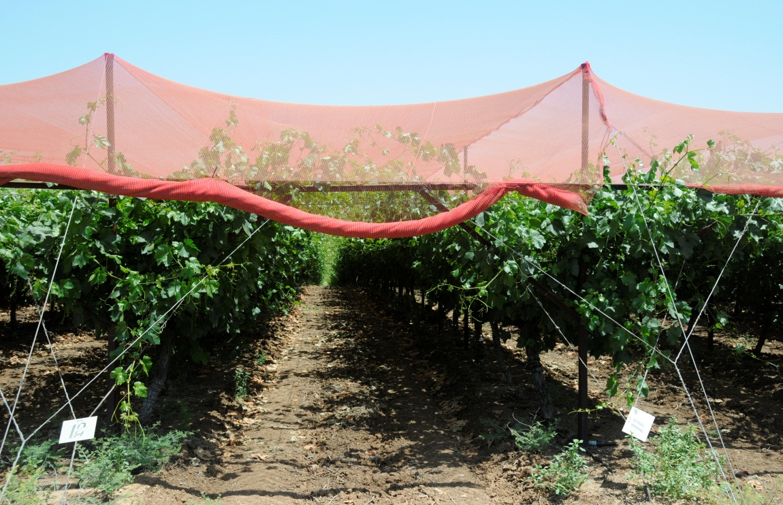
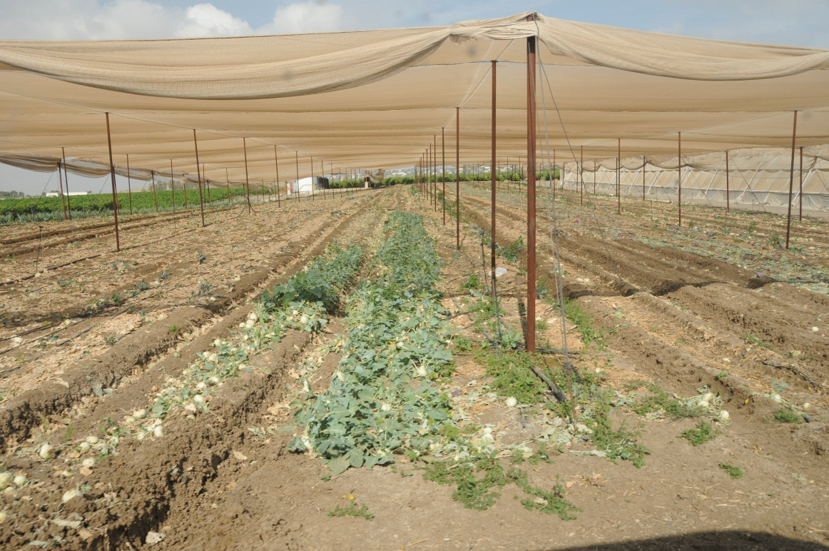

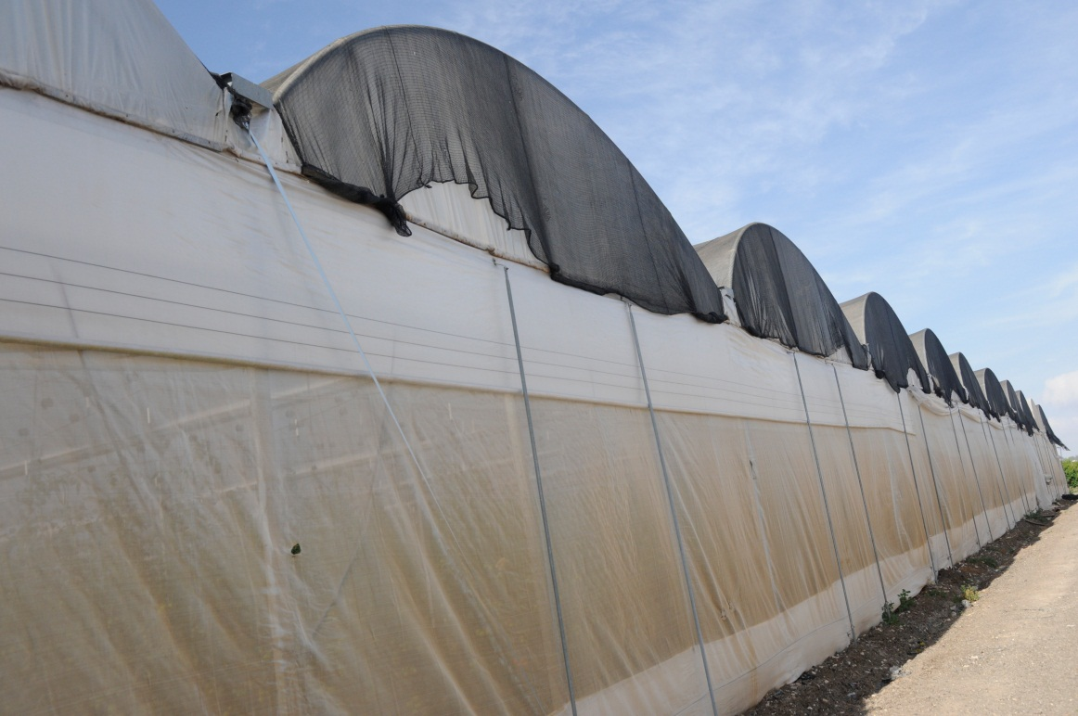
How does shading affect plants?

Slide 11
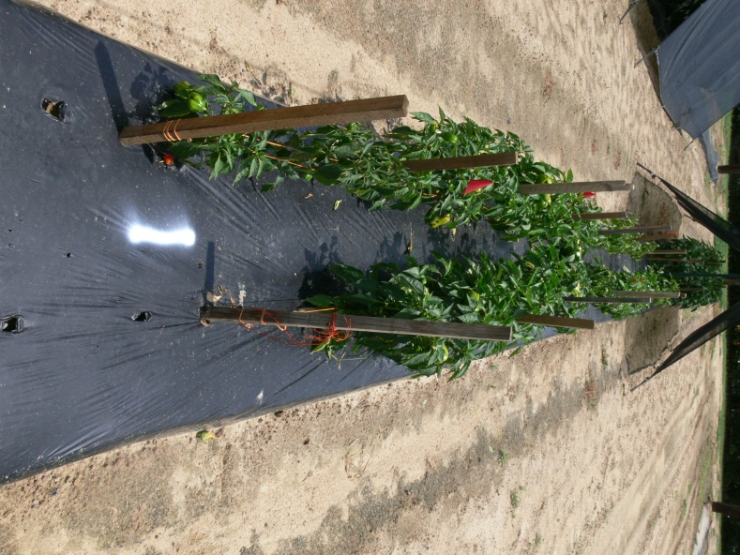
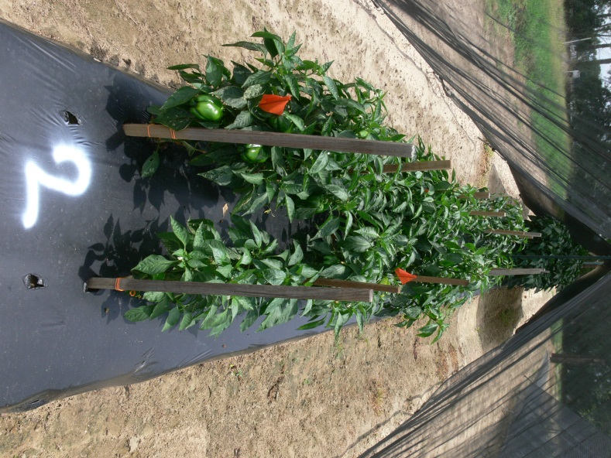
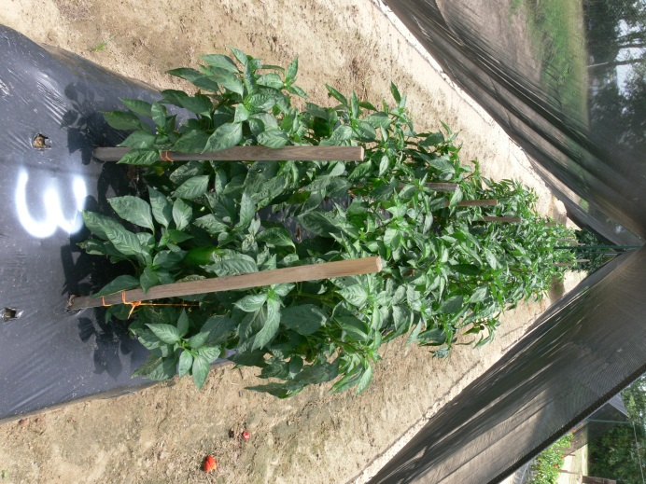
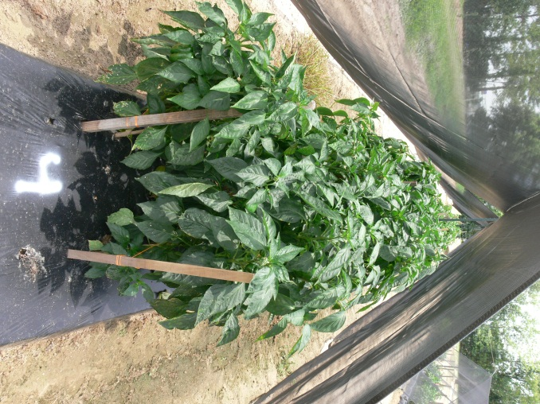
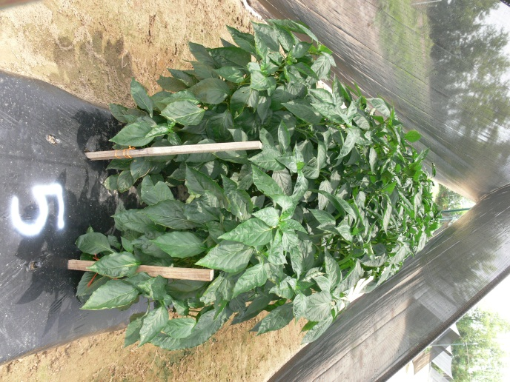
0% Shading
30% Shading
47% Shading
63% Shading
80% Shading

Slide 12
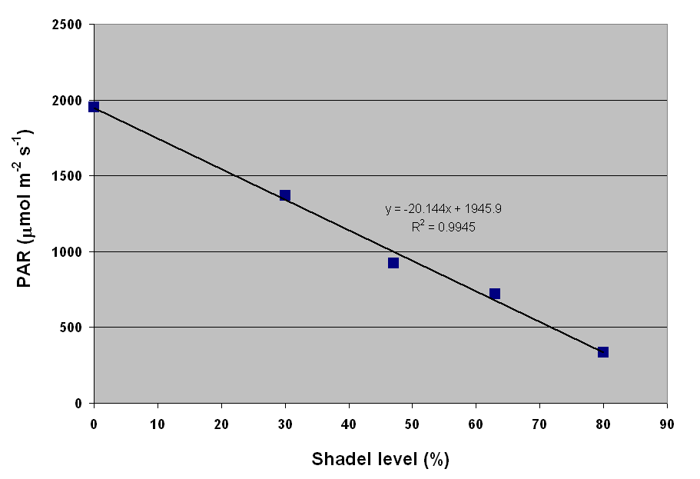

Slide 13
Shading level | Leaf DW (g) | Stem DW (g) | Veg. Top DW (g)
0% | 39 | 72 | 111
30% | 50 | 66 | 116
47% | 49 | 58 | 107
63% | 44 | 59.0 | 103
80% | 46 | 61 | 107
Significance
L | NS | NS | NS
Q | NS | NS | NS
Shading level did not affect total above ground biomass accumulation

Slide 14
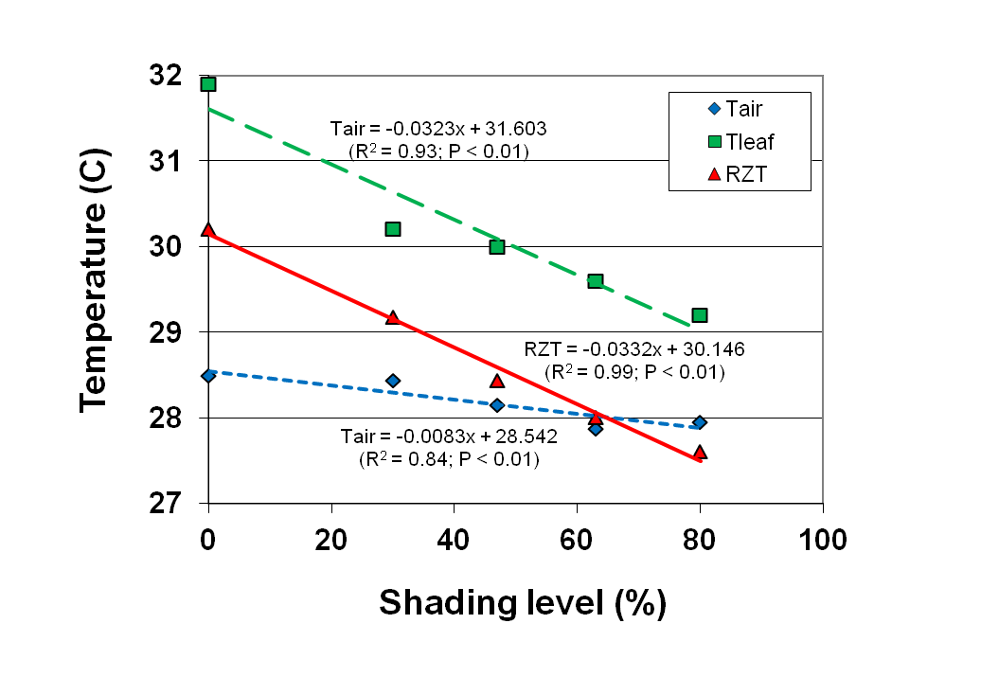

Slide 15
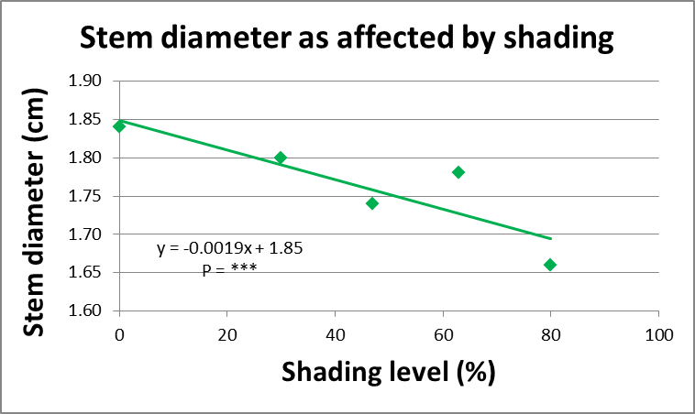

Slide 16
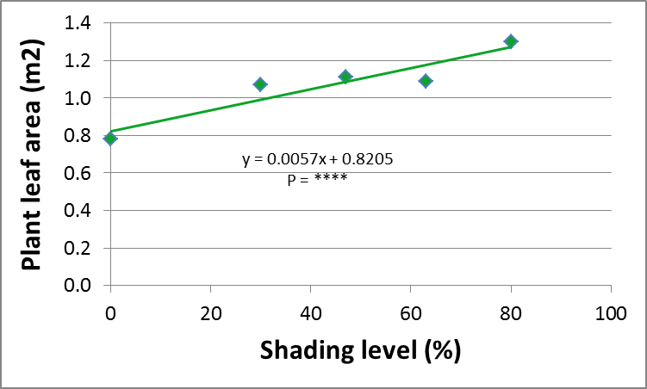

Slide 17
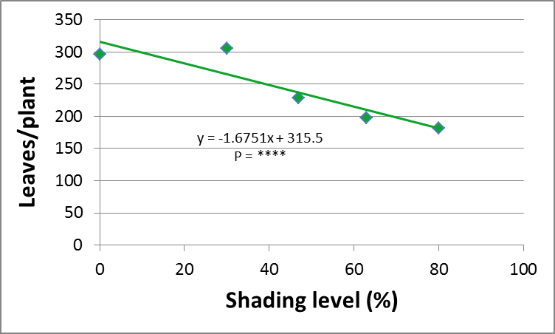

Slide 18
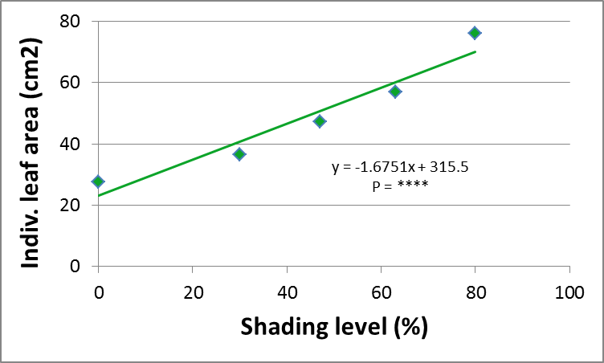

Slide 19
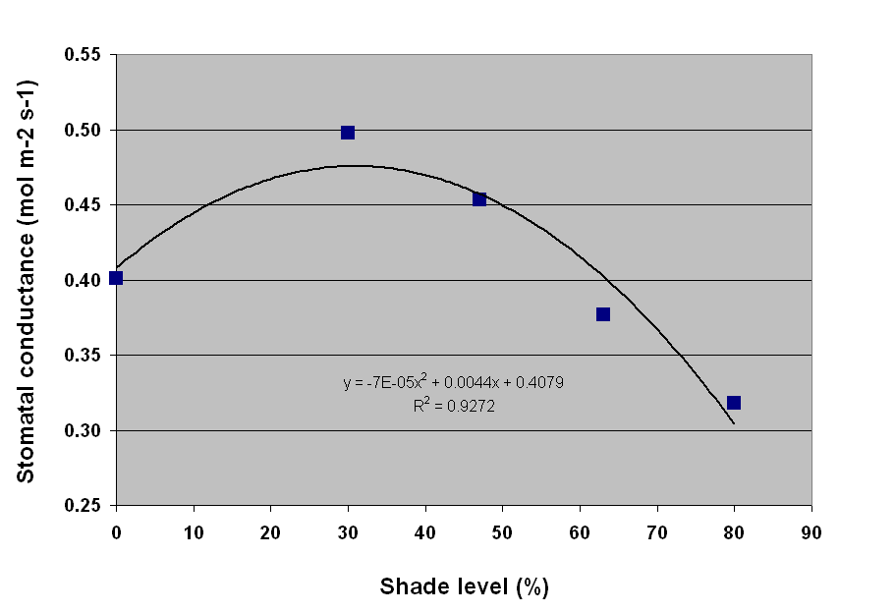

Slide 20
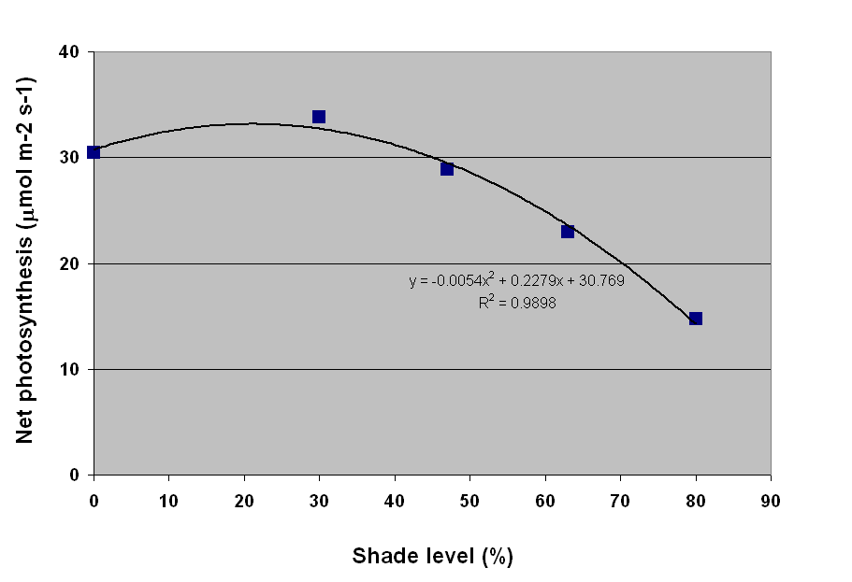

Slide 21
The number of fruit decreased with increasing shading level

Slide 23
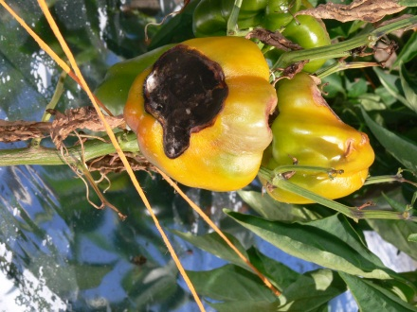
Highest incidence of sunscald and other physiological disorders

Slide 25
Incidence of Phytophthora blight (caused by Phytophthora capsici) decreased with increased shading level.

Slide 26
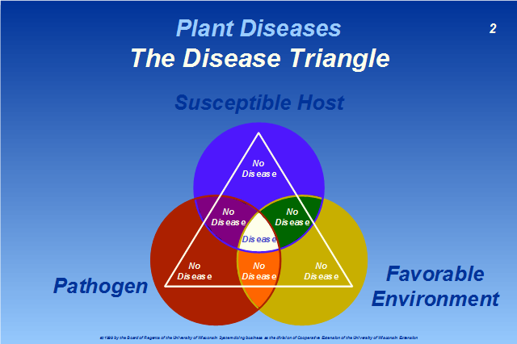
https://pddc.wisc.edu/wp-content/blogs.dir/39/files/Master_Gardener/img1.php

Slide 29
Objective
To determine the effects of shading level on the concentration of mineral nutrients in bell pepper fruit and on the fruit-to-leaf partitioning coefficients

Slide 30
Materials and Methods
Tifton, Georgia
Spring season
Raised beds, black or silver reflective plastic mulch
Two rows of plants per bed
Cultivars
  Camelot, Lafayette, Sirius, Stiletto

Slide 31
0% Shading
30% Shading
47% Shading
63% Shading
80% Shading

Slide 32
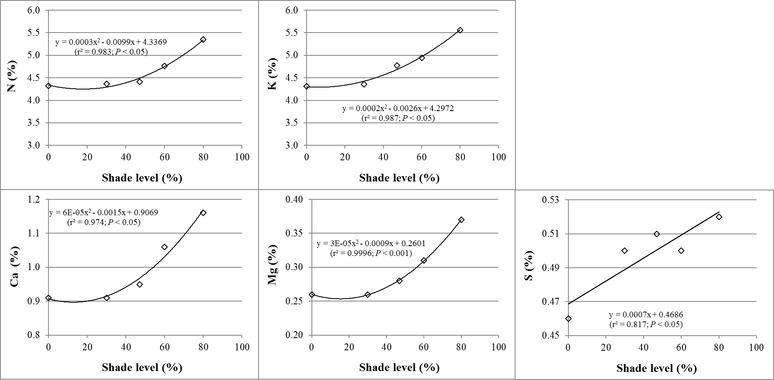
Leaf Macronutrients
**
*

Slide 33
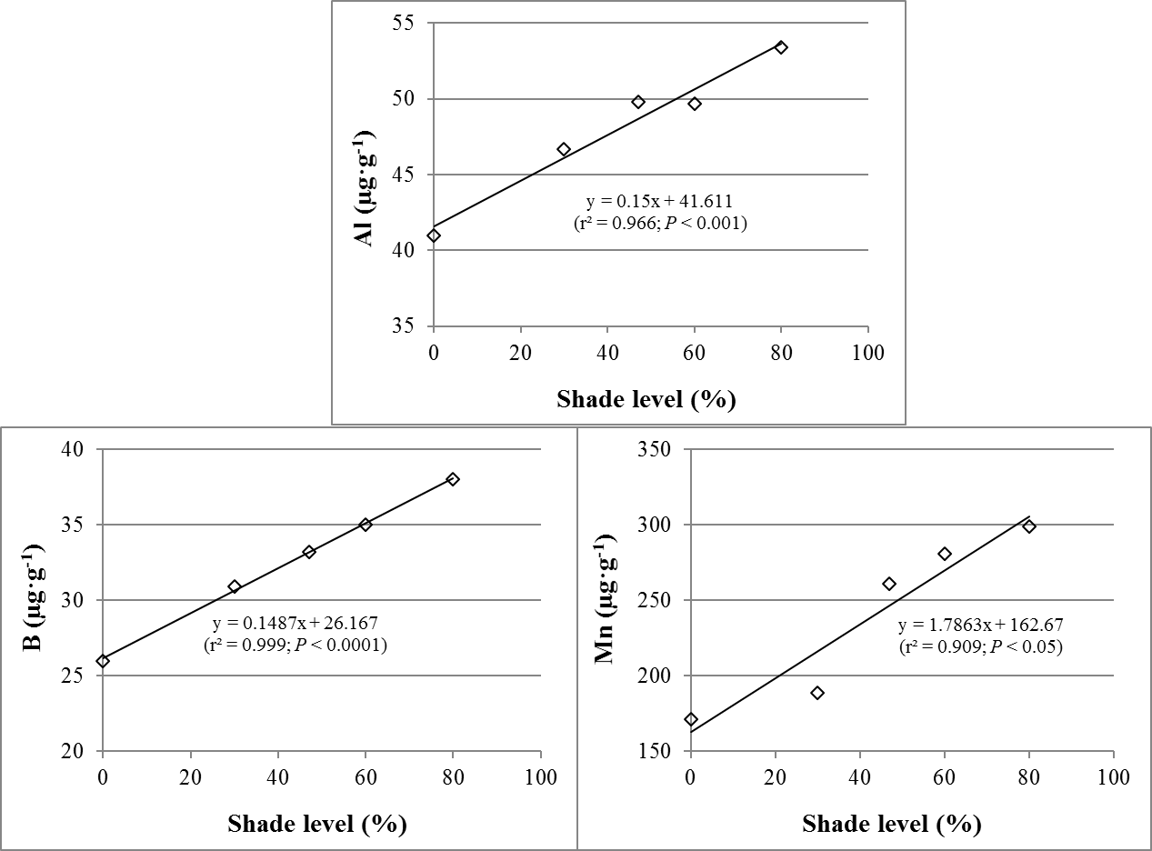
Leaf Micronutrients
*

Slide 34
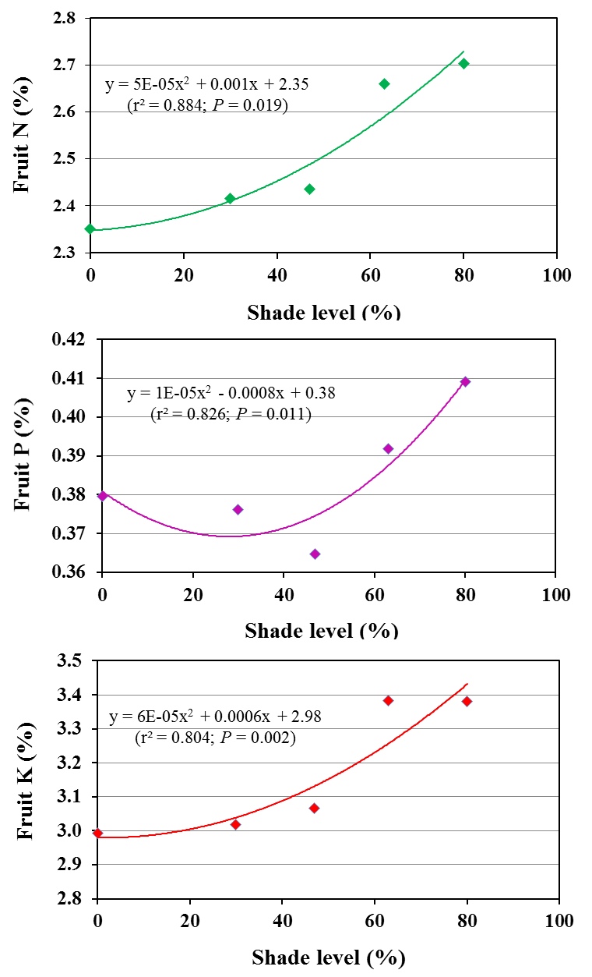
Fruit
Fruit Macronutrients
**
*

Slide 35
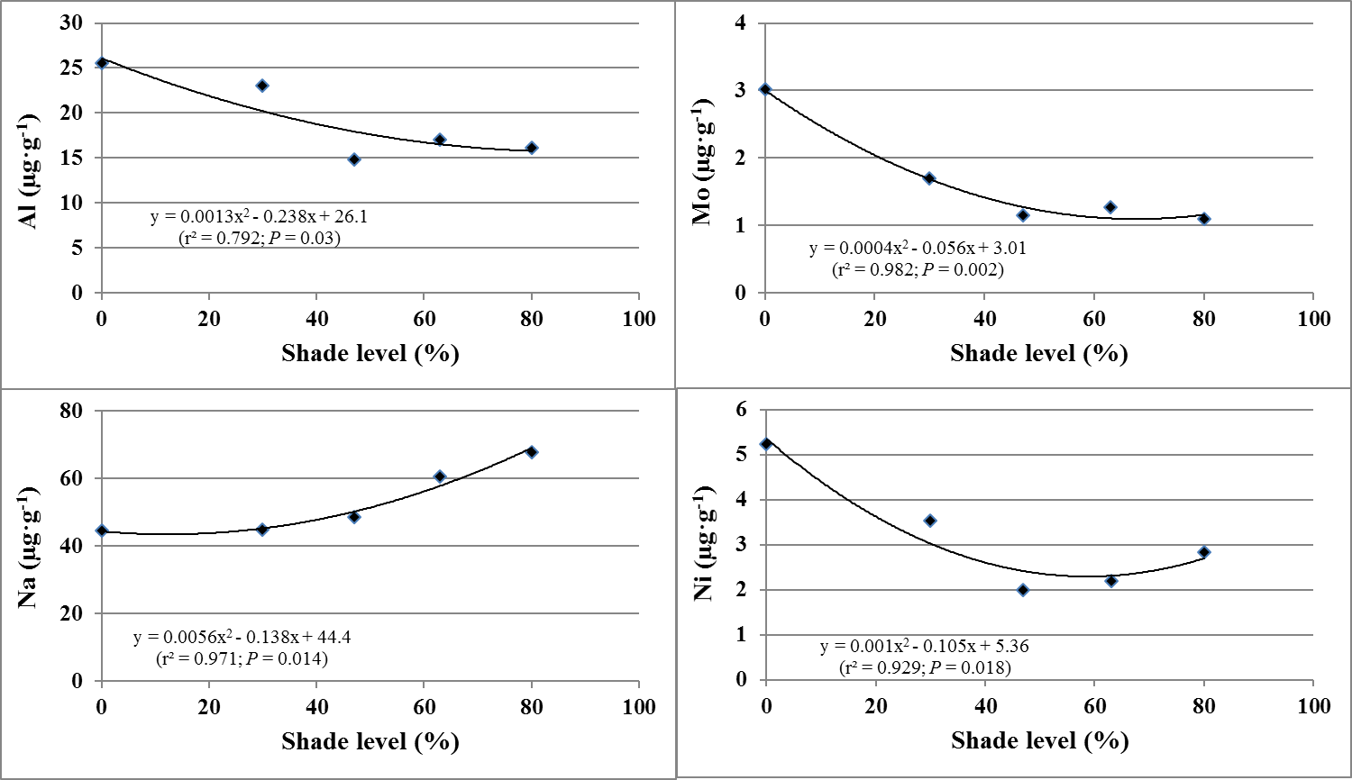
Fruit Micronutrients
**
*

Slide 36
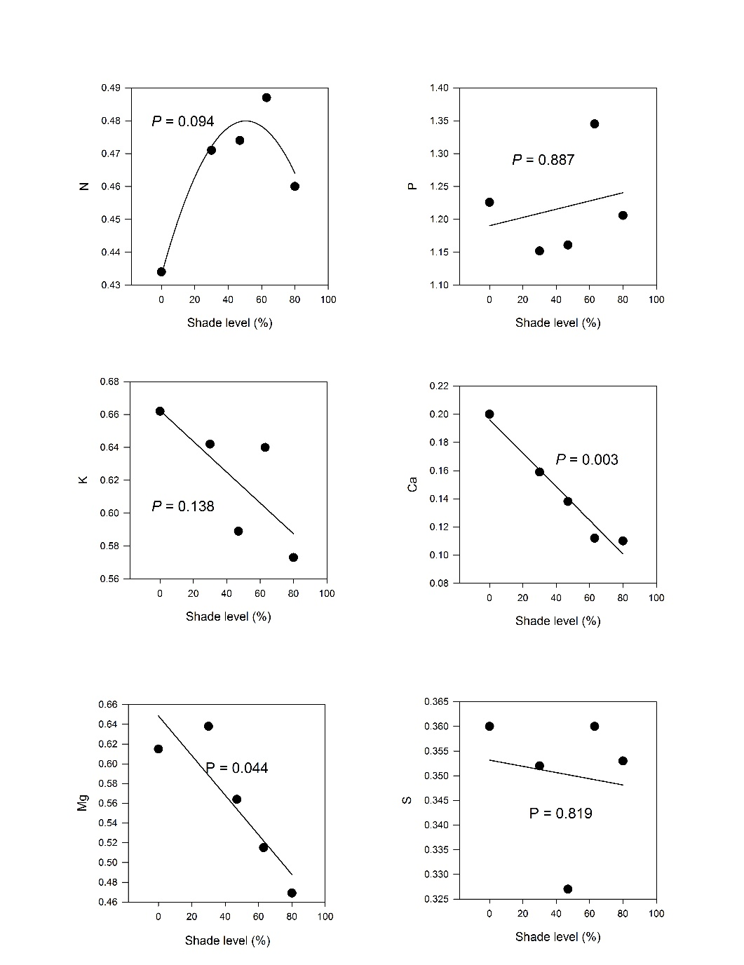
Fruit
Fruit to leaf nutrients (macro) ratio
**
*

Slide 37
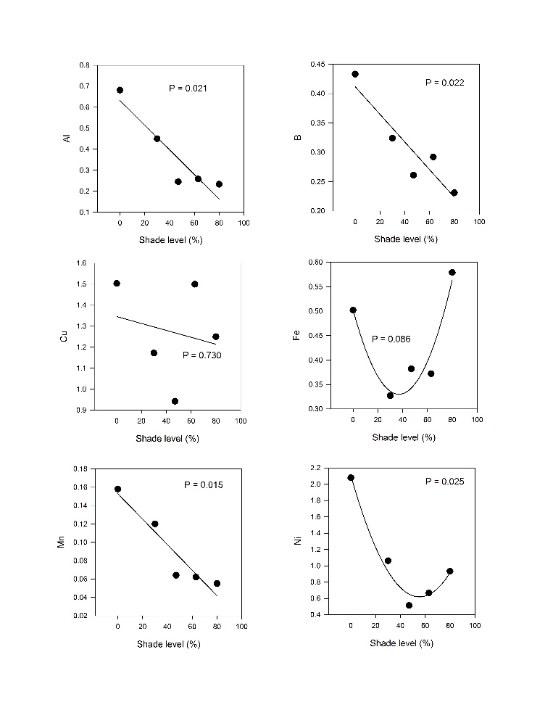
Fruit
Fruit to leaf nutrients (micro) ratio
*
*
*
*

Slide 38
Conclusions

Slide 39
Macronutrients
Fruit N, P and K increased with shade level.
Fruit Ca, Mg, and S were unaffected by shade level.

Slide 40
Micronutrients
Fruit Al, B, Mn, and Ni decreased with shade level.
Fruit Cu and Fe were unaffected by shade level.

Slide 41
Fruit-to-leaf partitioning coefficients for P, Cu, Na and Ni were higher than one (i.e., fruit concentrations were higher than leaf concentrations)

Slide 42
Fruit-to-leaf partitioning coefficients for N, K, Ca, Mg, S, Al, B, Fe, Mo, and Zn were lower than one (i.e., fruit concentrations were lower than leaf concentrations)

Slide 43
Conclusions
Partitioning coefficients for Ca, Mg, Al, B, Mn, Mo, and Ni decreased with increasing shade level
Partitioning coefficients for N, P, K, S, Cu, Fe, Na, and Zn were not significantly affected by shade level.
The partitioning coefficient was similar among bell pepper cultivars (data not shown).

Slide 44
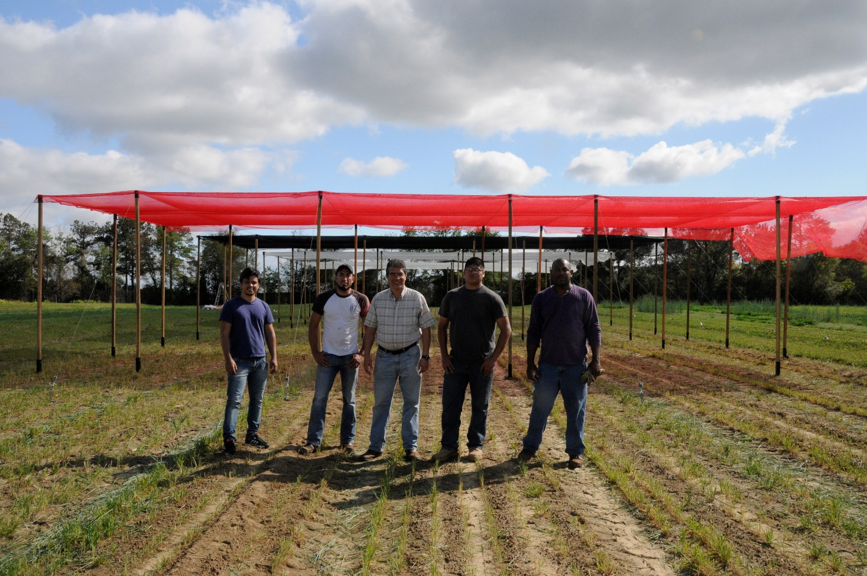
Acknowledgements

Slide 45
Merci!
¡Gracias!
Thanks!

