Slide 1






Evaluation of two degradable mulches in sweet pepper greenhouse cultivation
Piotr Siwek, Andrzej Kalisz, Iwona Domagała-Świątkiewicz
Michał Puchalski and Konrad Sulak

Slide 2


THE AIM OF RESEARCH in BIOGRATEX
Formulation of degradable nonwovens for
soil mulching and direct covering of plants
Assessment of vegetables yield quantity and quality
Assessment of nonwovens durability in field conditions
Assessment of biodegradable pots for the transplants
Assessment of strings for plants fixing in greenhouses
Assesment of degradation progress in the field

Slide 3

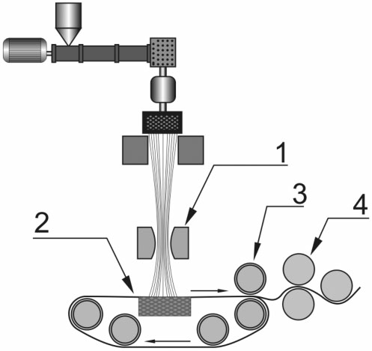
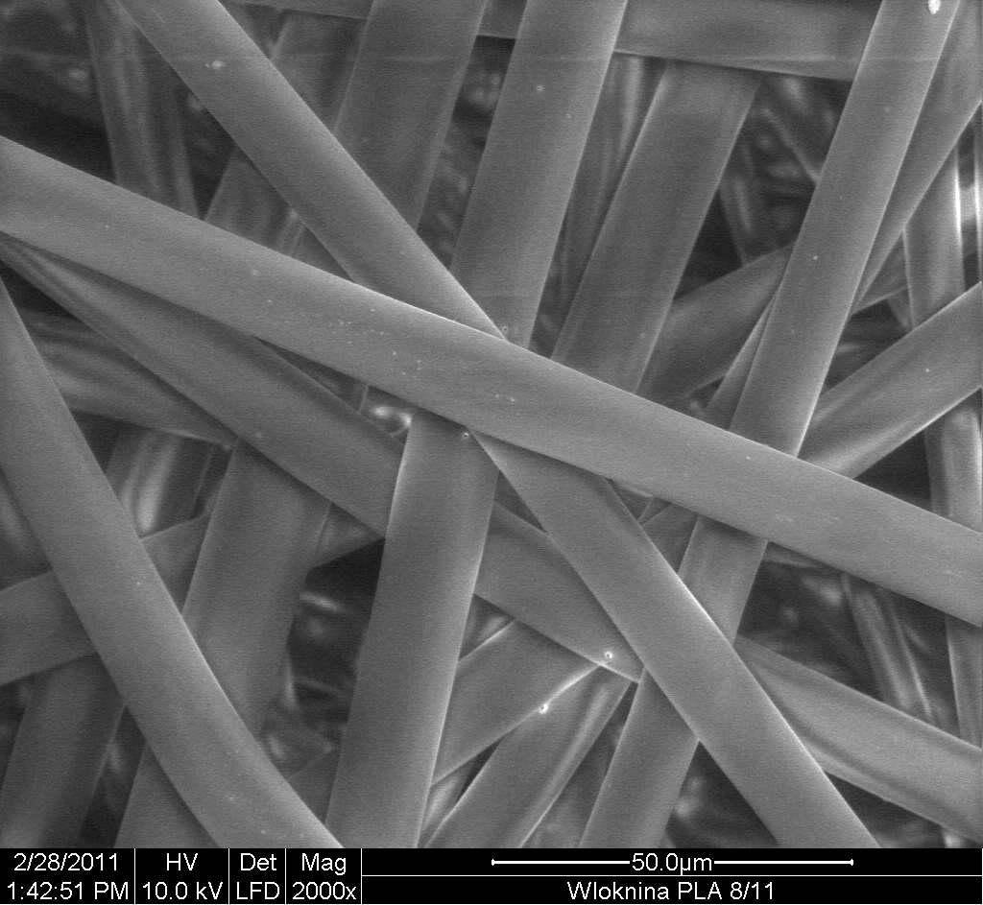
Spun-bonded technology
In spun-bond technology manufacture of fibre and non-woven production are combined in one process. The essence of this technology is to obtain in a short process of manufacturing, flat textile product with characteristics similar to technical fabrics at a much lower price. Due to the high efficiency and high speed of non-woven manufacture, this technology is preferred for economic reasons. Environmental benefits resulting from the use of spun-bonded technology is the lack of side products, both solid and gas and a small amount of waste.
Selection and characterization of additives (e.g
photodegradation activator)
Pre-mixing of polymer and additives
The non-woven fabrics were formed at the Institute of Biopolymers and Chemical Fibres in Łódź. The process parameters were as follows: a temperature in the range from 215°C to 225°C and a polymer throughput in the range of 0.34-0.43 g/min/hole can be used. The calender temperature was varied from 95 to 125°C.
Pre-mixing of polymer and nano-additives . Developing optimal form of modifying the concentrate.
Production of non-woven using a mixture of base polymer and modifying the concentrate.
The steps of the preparation of modifying non-woven for agriculture
A scheme of the spun-bonded line.
(1)-air attenuator, (2) – belt, (3) compaction roll, (4) heated calender
Microphotos of PP nonwoven

Slide 4
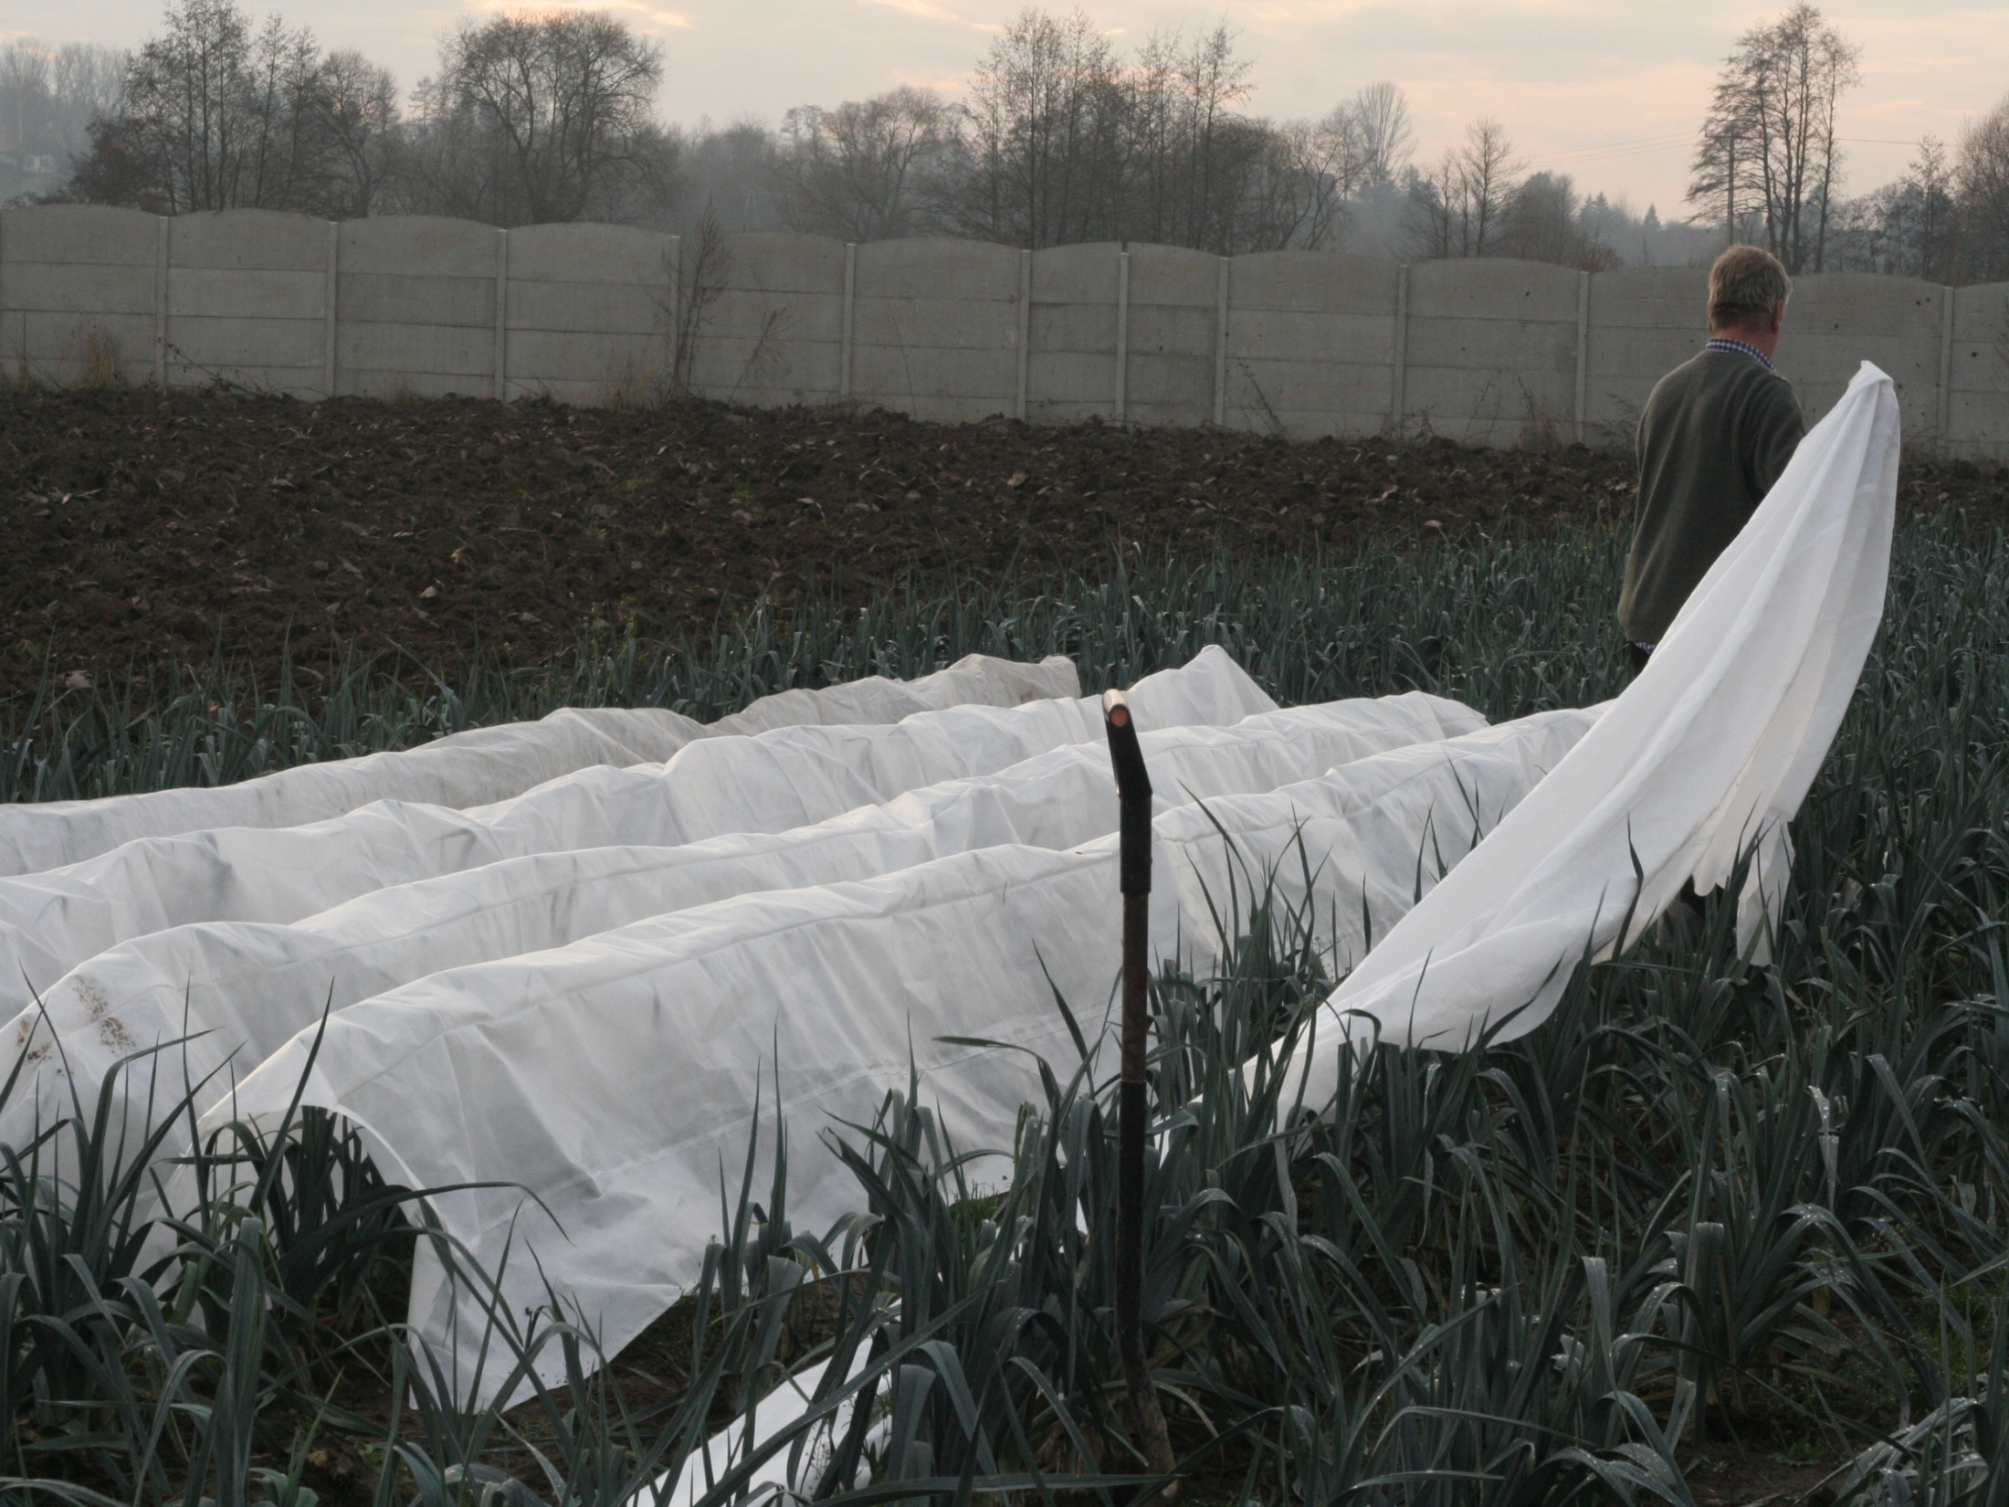
Direct covering with nonwovens of the winter leeks
20.11.2011

Slide 5
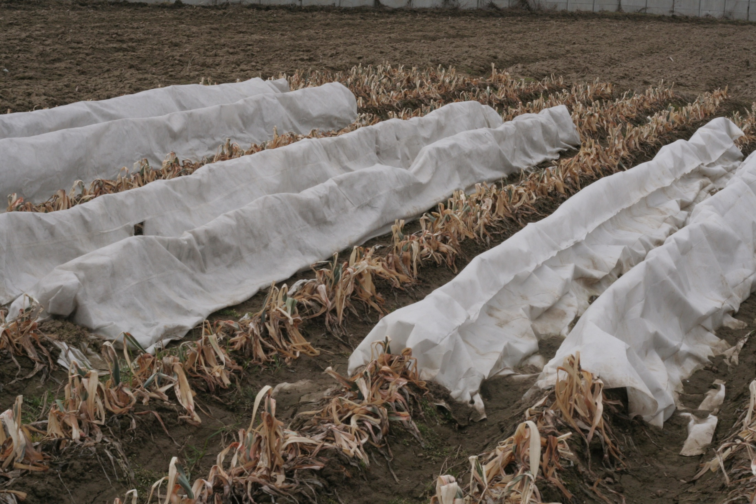
Plants of the leeks after the winter 2011/2012
4.04.2012

Slide 6
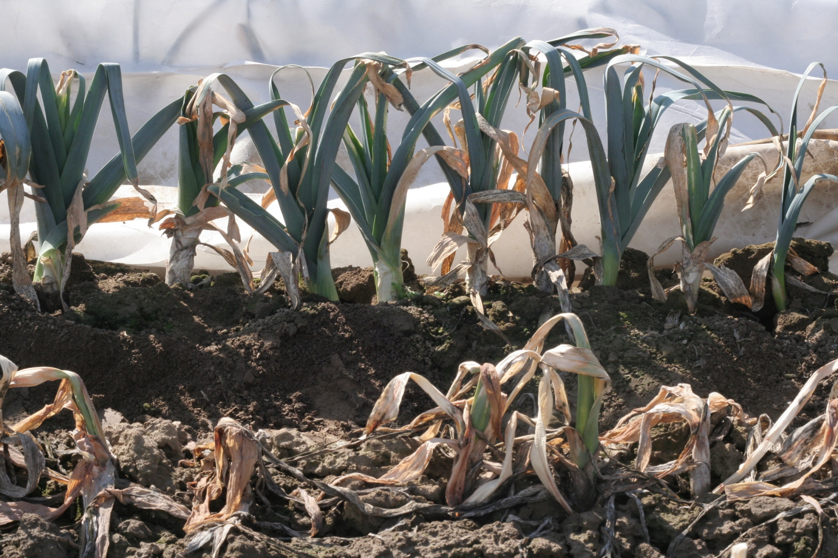
Leeks grown without and with the nonwoven, April 2012
18.04.2012 r.

Slide 7
Yield of the winter leeks under direct nonwoven covers, kg m⁻²
Kind of cover | Market. yield kg m⁻² |  | Dry matter % |  | Total sugars %
 | 2012 | 2013 | 2012 | 2013 | 2012 | 2013
PLA 50 g m⁻² | 2,00 b | 2,20 b | 21,2 b | 21,5 a | 4,07 b | 4,69 c
PP ph. 50 g m⁻² | 2,15 b | 2,04 b | 13,9 a | 24,9 b | 3,35 a | 3,97 b
PP 50 g m⁻² | 1,75 b | 2,06 b | 17,1 b | 23,4 b | 4,82 b | 3,41 b
Control | 1,02 a | 1,40 a | 18,0 b | 22,0 a | 3,90 a | 3,01 a
POIG.01.03.01-00-007/08

Slide 8
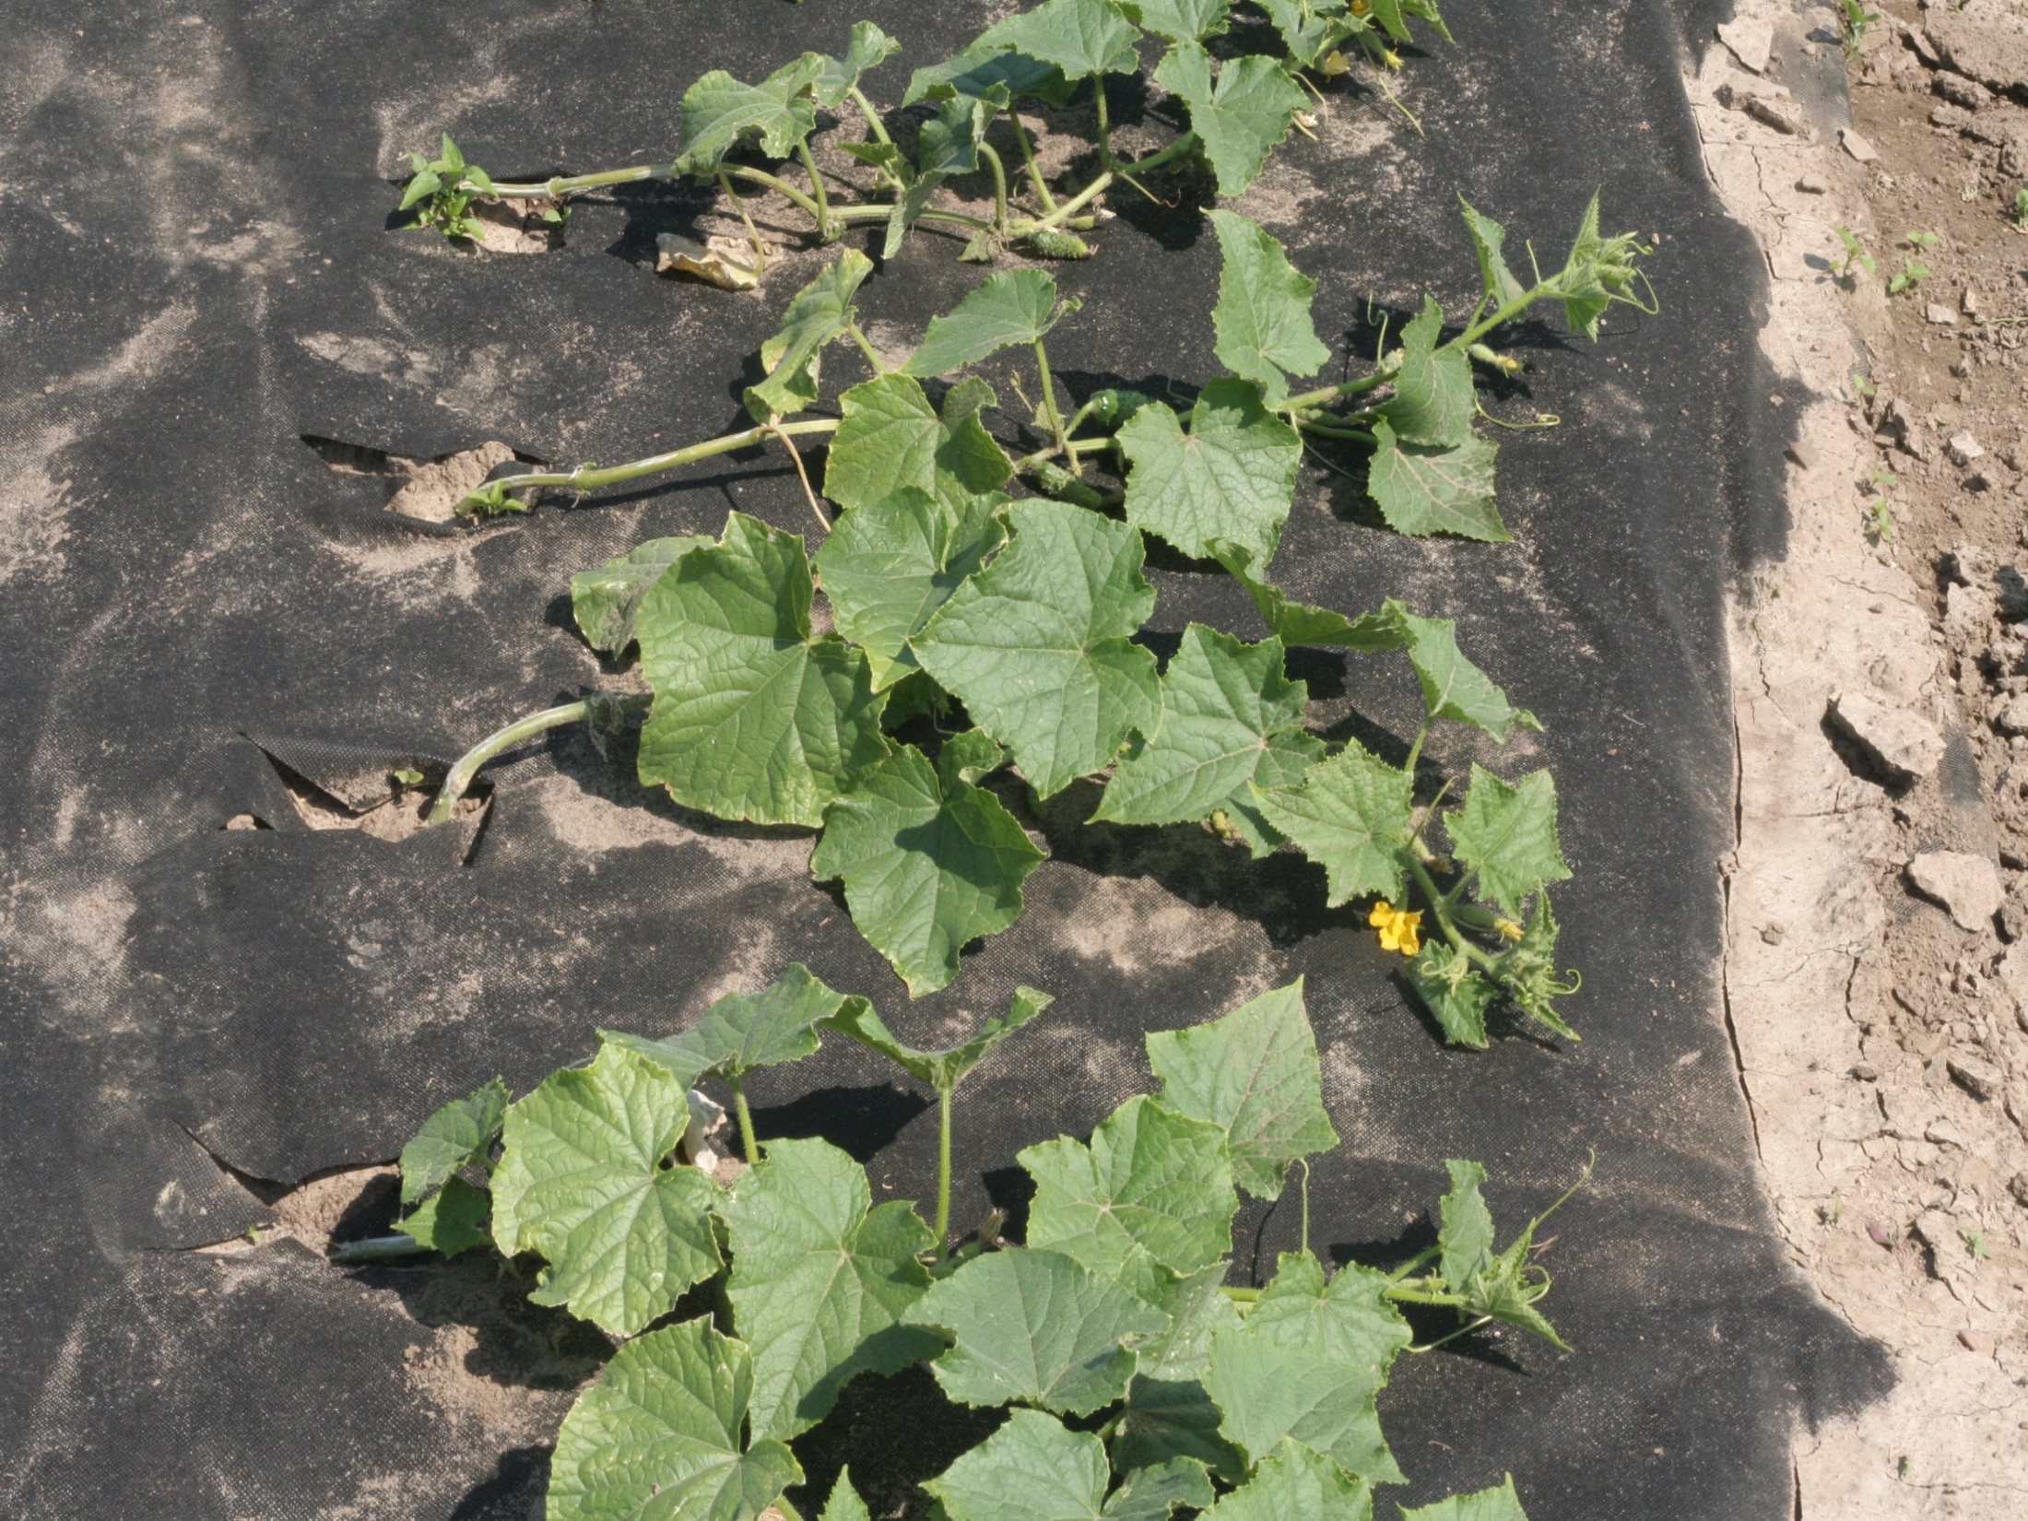
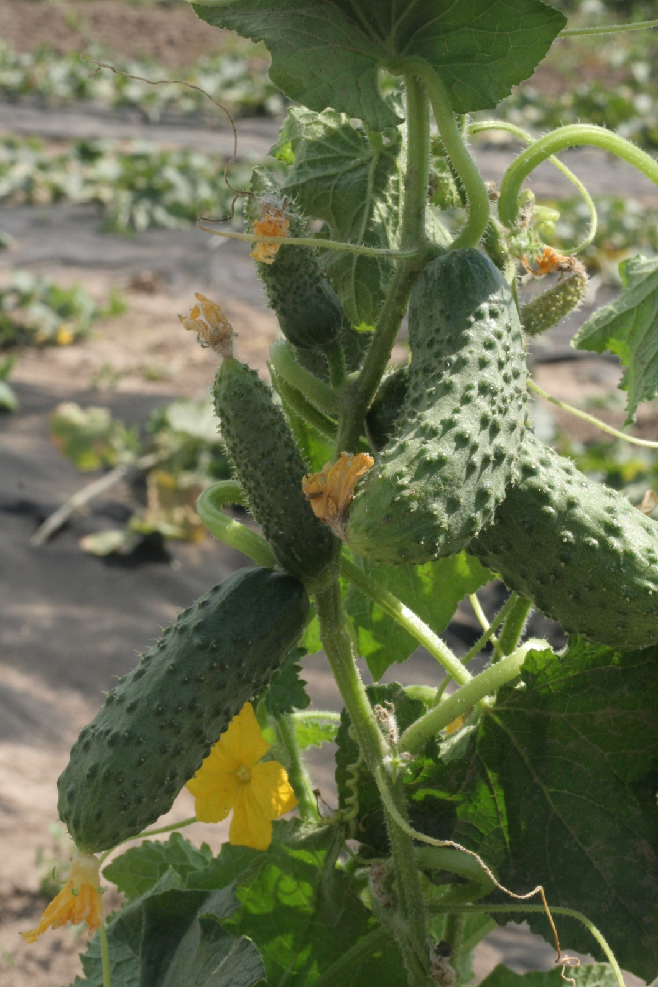
Mulching with nonwovens of the soil in cucumber cultivation

Slide 9
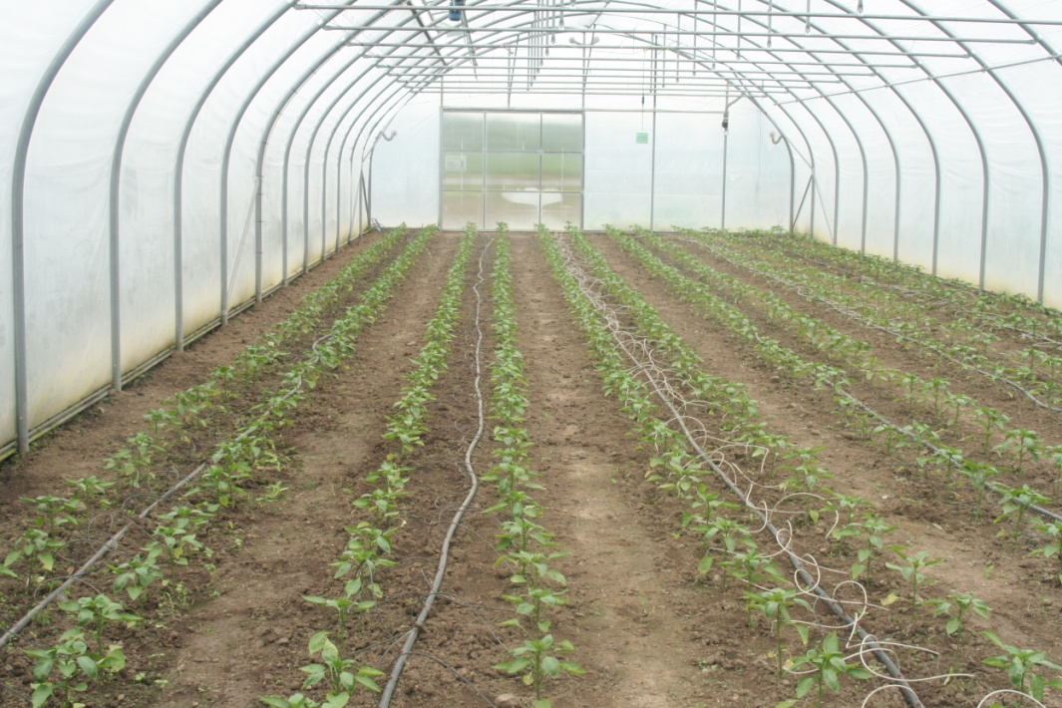
Materials and methods of experiment
The experiment with degradable soil mulches in sweet pepper cultivation was carried out in 2012 and 2013 in plastic greenhouse FARMER 4,6 x 9 x 30 m covered with double Gemme 200 mic. film.

Slide 10
Kind of mulches
Three kinds of degradable materials were used:
- polyprophylene non-degradable (PP Agro)
- degradable PP with 0,02% photoactivator (PP ph.)
- polylactide (PLA)
Control treatment was the plots without mulching.
The non-woven fabrics all with the surface mass 50 g m⁻²
were formed by a spun-bond technique on a laboratory line, designed and constructed by the Research and Development Centre of Textile Machinery Polmatex-Cenaro, Poland.

Slide 11
Plant cultivation
Seeds of the ‘Collado’ F₁ cultivar (blocky type, Fito Semilas) were sown on 20 February. The transplants were planted on 4 May 2012 and 10 May 2013 in each hole in the mulch, with row and plant spacing of 80 × 60 × 50 cm in four replications of 20 plants each
The two-shoot plants were pruned regularly, as at the every node was leaved only one fruit. Yielding started: 29 June 2011 and 12 July 2012 and ended 29 September and 9 October respectively.

Slide 12
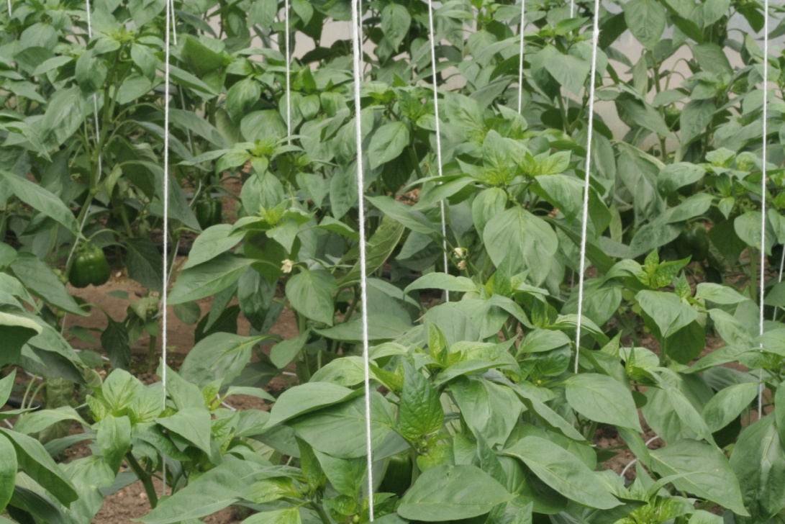
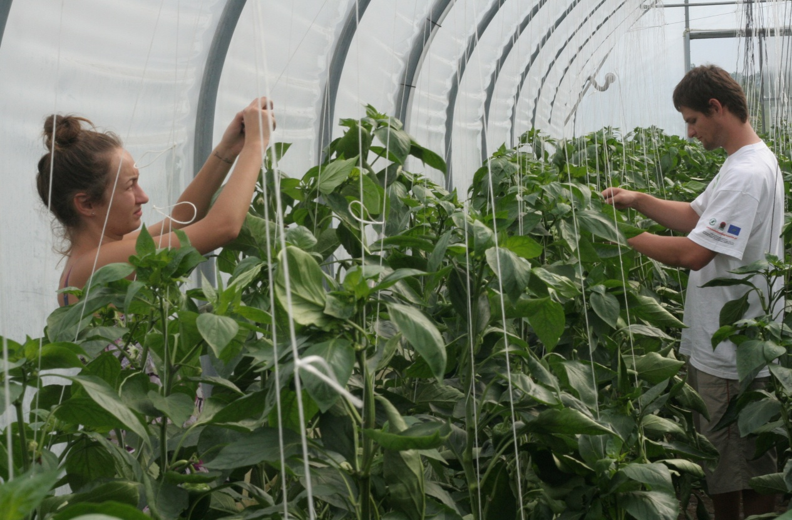
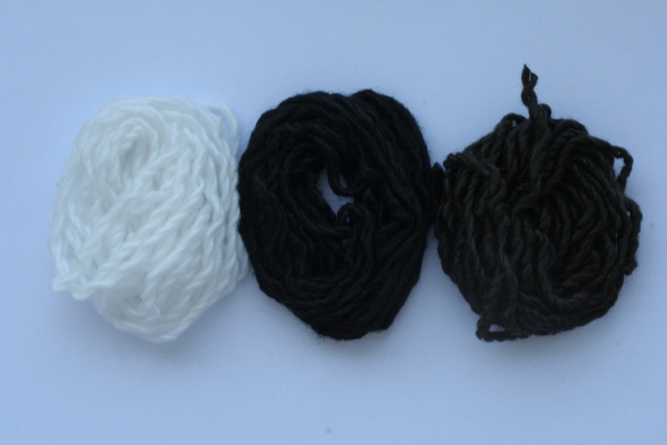
Strings for plants fixing
PLA (polylactide)

Slide 13
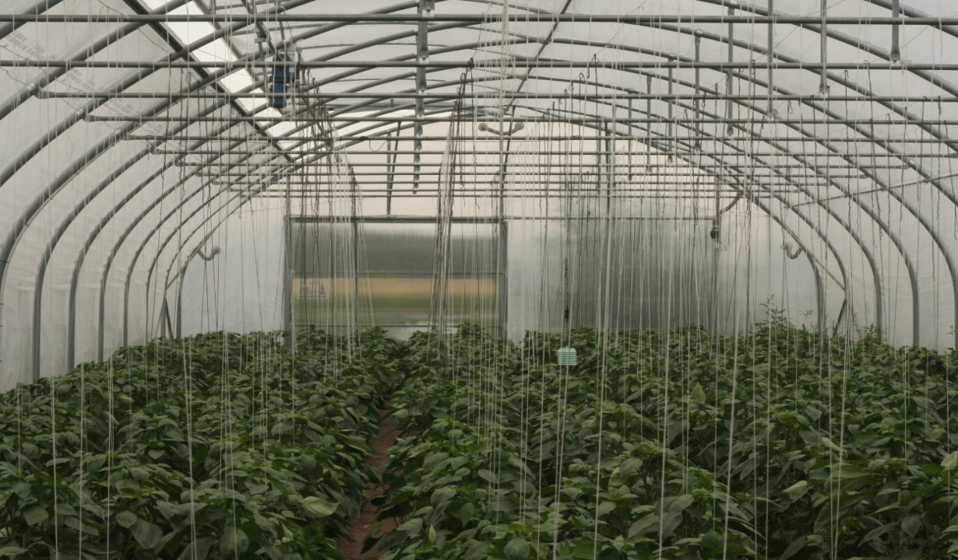
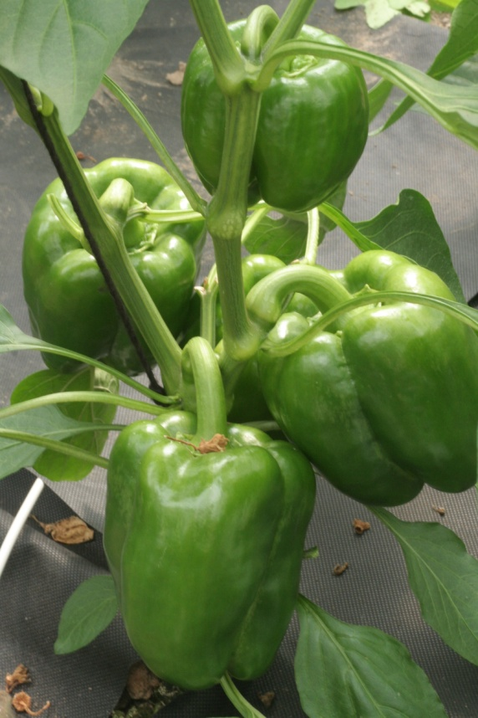

Slide 14
Yield of sweet pepper cultivated on different mulches in a plastic greenhouse in 2012 and 2013
Mulch type | I grade |  | II grade |  | Marketable yield
 | fruits per 1 m² | kg m⁻² | fruits per 1 m² | sz. m⁻² | fruits per 1 m² | kg m⁻²
PP 50 photo. | 23 a | 4.12 a | 0.6 a | 0.36 a | 23.6 a | 4.48 a
PLA 50 | 24 a | 4.17 a | 0.6 a | 0.32 a | 24.6 a | 4.49 a
PP 50 | 25 a | 4.51 a | 0.6 a | 0.29 a | 25.6 a | 4.80 a
Control | 21 a | 3.61 a | 0.2 a | 0.32 a | 21.2 a | 3.93 a
Mulch type | I grade |  | II grade |  | Marketable yield
 | fruits per 1 m² | kg m⁻² | fruits per 1 m² | kg m⁻² | fruits per 1 m² | kg m⁻²
PP 50 photo. | 29 a | 4.67 a | 1.0 a | 0.12 a | 30.0 a | 4.79 a
PLA 50 | 36 b | 5.47 ab | 2.1 a | 0.18 a | 38.1 b | 5.65 ab
PP 50 | 36 b | 5.68 b | 1.2 a | 0.19 a | 37.2 b | 5.87 b
Control | 39 b | 6.12 b | 1.3 a | 0.18 a | 40.3 b | 6.30 b

Slide 15
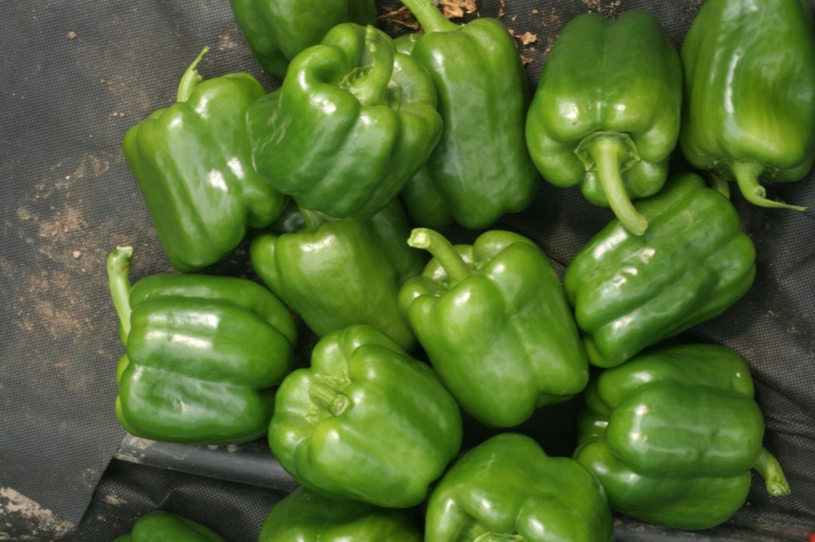
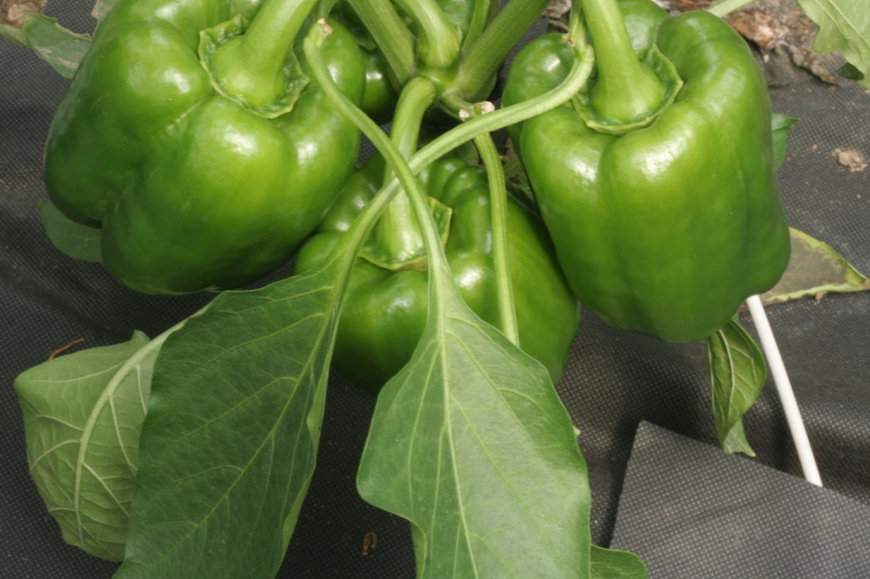
Chemical constituents of sweet pepper cultivated on different mulches in a greenhouse, 2012-2013.
Mulch type | L-ascorbic acid (mg 100 g⁻¹ FW) |  | Dry weight (% FW) |  | Soluble sugars (% FW)
 | 2012 | 2013 | 2012 | 2013 | 2012 | 2013
PP 50 photo. | 84.8 b | 67.6 a | 5.81 a | 5.86 a | 2.47 a | 2.18 a
PLA 50 | 73.0 a | 78.4 a | 5.78 a | 5.78 a | 2.24 a | 2.34 a
PP 50 | 72.1 a | 104.5 b | 5.90 a | 5.97 a | 2.90 a | 2.49 a
Control | 81.6 b | 108.5 b | 5.80 a | 6.10 a | 2.33 a | 2.45 a

Slide 16
CONCLUSIONS
The influence of degradable and non-degradable mulches on the soil
temperature was negligible in comparison with non-mulched plots
Microclimatic factors were similar in whole area of the greenhouse
The yield of pepper did not differ significantly between the treatments
The dry weight and soluble sugars of the plants were also similar
After first season of tests, the supramolecular changes of polymers
suggest the degradation only polypropylene with iron stearate but these
changes did not excluded use of this material in the second season
The supramolecular structure of polypropylene changed insignificantly,
this confirmed the resistance of this material to degradation factors

Slide 17
ACKNOWLEDGEMENTS
This work was partially financed by European Regional Development Fund in the frame of “Biodegradable fibrous products”
Project (acronym BIOGRATEX) No. POIG 01.03.01-00-07/08-09
and from funds of statuary activity by Lodz University of Technology
Part of work was financed from funds of Ministry of Science and Higher
Education of Republic of Poland.
Thank You for the attension

