Slide 1
Cleanfarms & Ag Waste
April 16, 2017

Slide 2
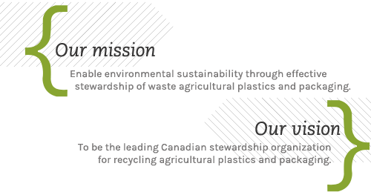
Who is CleanFARMS?
Notes:
Based on my experience, the most efficient way for ‘get’ CleanFARMS is to draw a comparison to tires or the LCBO…

Slide 3
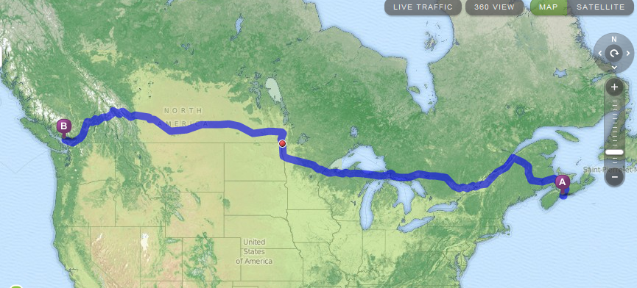
Canada’s Geography
Halifax, Nova Scotia to Vancouver, British Columbia – 5,840 km
Offices:
1. Toronto, ON – head office
2. Montreal, QC
3. Moose Jaw, SK

Slide 4

















































Cleanfarms: industry-led, funded
Harusco Orchards Ltd.
Notes:
Current membership slide:
2017 additions (early) : Intelligro, Semican, Hensall, Norac
2017 changes (early) : made a judgement call and removed Cimarron Label
2016 additions (late) : United Suppliers, KOCH Agronomics, BioForest + additions (early): Sevita, Neudorff, William Houde
2016 changes: new version of BASF, Bayer, Arysta logos,

Slide 5
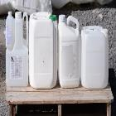
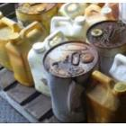
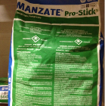
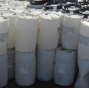
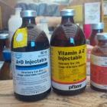
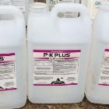
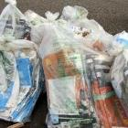
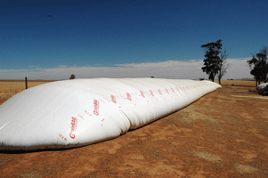
Cleanfarms’ programming
pesticide containers
obsolete pesticides
pesticide bags
bulk pesticide containers
1989
1998
2006
2009
2013
2015
2016
2018
obsolete animal health meds.
fertilizer
containers
seed
bags
grain
bags

Slide 6
Program Success
2017 Collection Totals
<23 Litre Pesticide and Fertilizer Container | 5,050,000 containers
>23 Litre Bulk Pesticide Container | 43,000 bulk containers
Seed and Pesticide Bag | 920,000 bags
Obsolete Pesticide and Animal Health | 275,000 kilograms

Slide 7
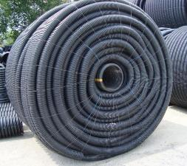
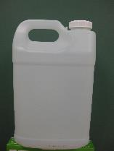
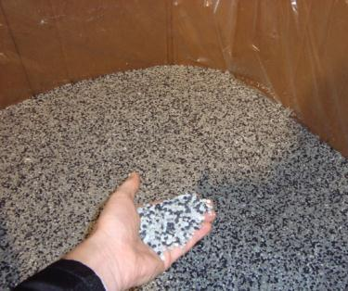
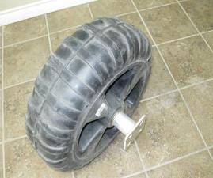
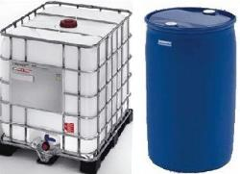
Container Recycling – Canada Wide

Slide 8
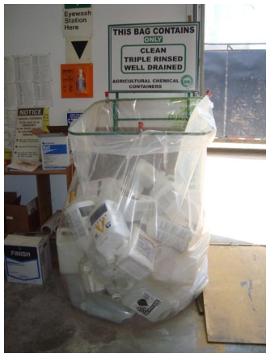
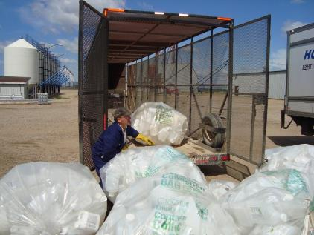
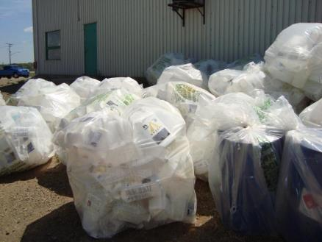
<23L Container Collection – Dealer Storage

Slide 9
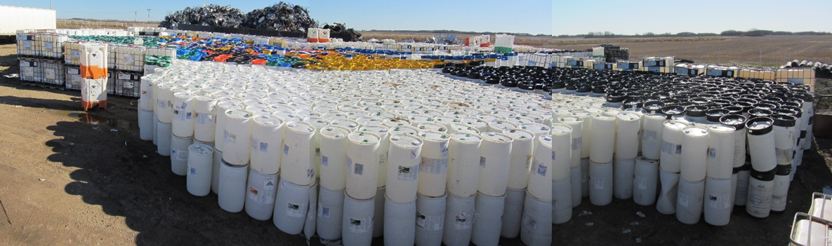
>23L containers (drums and totes)

Slide 10
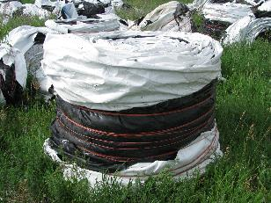
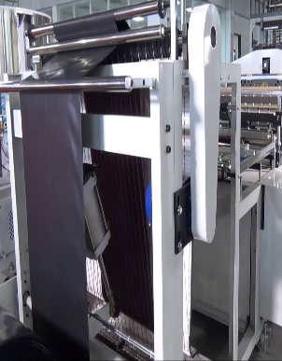
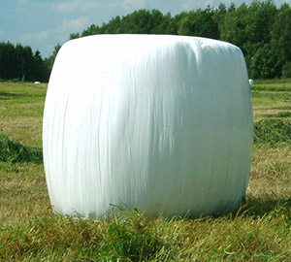
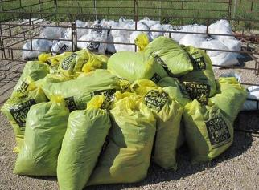
Ag Film Recycling
Bag manufacture

Slide 11
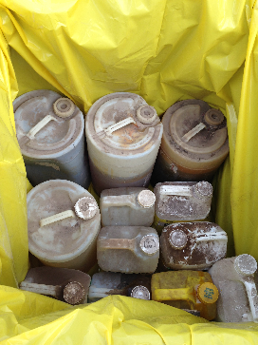
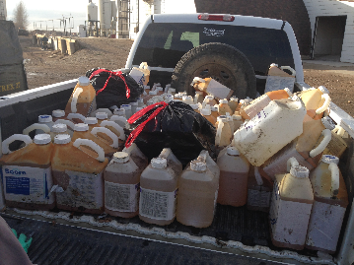
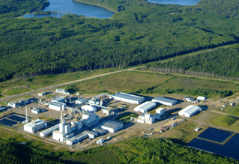
Obsolete Collection
Swan Hills Alberta – Hazardous Waste Destruction Facility

Slide 12
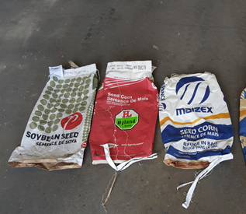
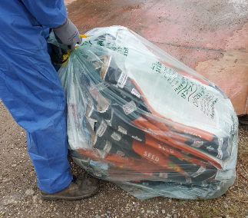
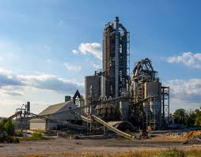
Seed & Pesticide Bag Collection
Energy Recovery – cement kilns

Slide 13
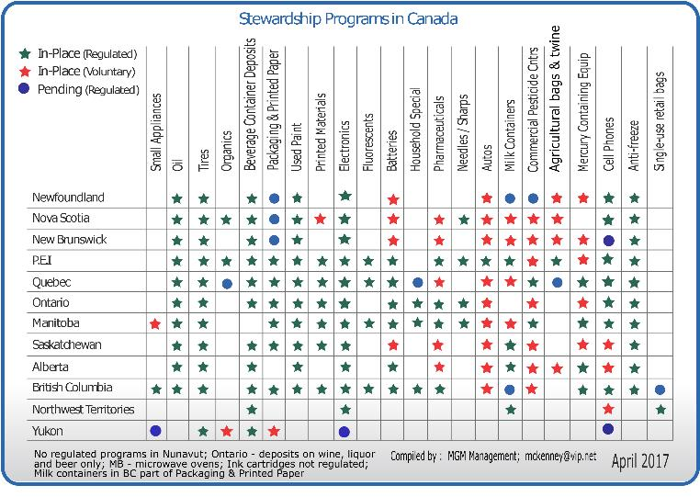
Steward Programs in Canada
There are about 170 organizations operating EPR-like programs across Canada
Member levies total over $1.5 billion annually
The largest program comprises multi-material packaging and printed paper

Slide 14
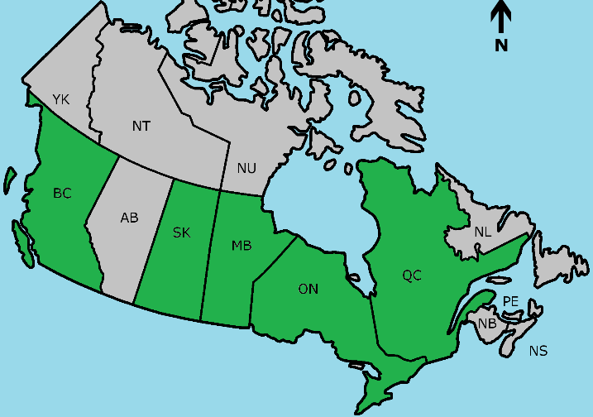
Multi-Material & Printed Paper
Extended Producer Responsibility
30 million Canadians covered by multi-material EPR programs
For consumer… commercial is next

Slide 15
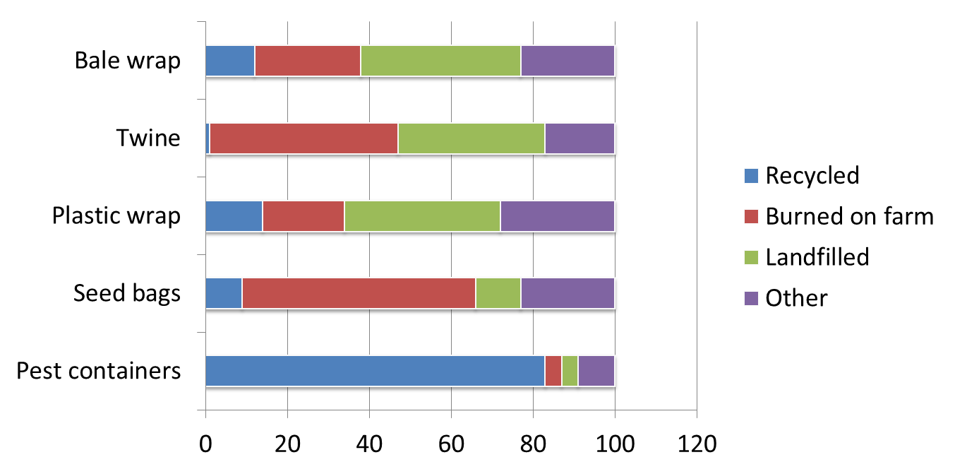
Ag waste diversion programs - summary
When convenient, accessible programs are available, farmers use them.
Source: Ontario study, 2012

Slide 16
Current management of ag plastics in Canada
Agricultural Waste – mainly plastics
Estimated at 40,000 tonnes annually
Notes:
Estimated total annual generation (tonnes) (in order from greatest amount of waste to least amount of waste)
PP Twine → 2000 to 6000
Silage plastic → 1500 to 2300
Grain bags → 700 to 1800
Bale wrap → 550 to 1400
Cardboard → 650 to 800
Paper and multi-walled bags → 630 to 815
Pesticide containers → 620
Net wrap → 450 to 700
Polypropylene totes → 275 to 300
Greenhouse film → 60 to 160
Sanitation containers → 4
Total ag waste → 7900 to 15600

Slide 17
Key Opportunities
Markets, markets, markets
  Chinese ban on dirty plastic is China’s gift to the developed world
EPR – all manufacturers and retailers need to step up to the plate
Global GAP (Good agricultural practices) – tying exports into measurable practices i.e. did you return your containers or ag film?
Environmental Farm Plans – present in every Canadian province but needs measurable results

Slide 18
What are others doing?

Slide 19
United States, New Zealand and Australia
New Zealand – AgRecovery and Plasback
Australia – Agsafe – Drummuster and Chemclear
United States – Ag Container Recycling Council

Slide 20
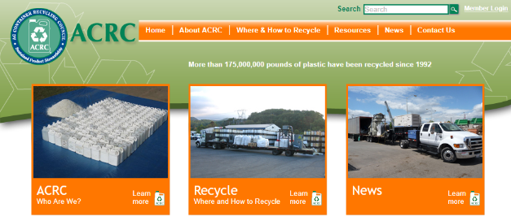
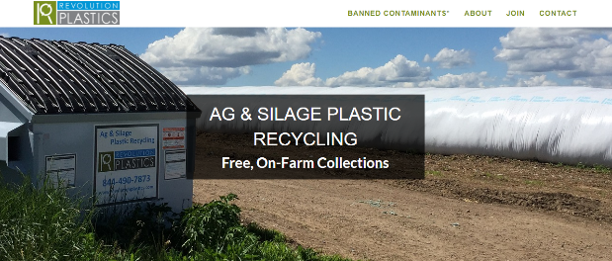
United States
ACRC – Not-for-profit sister company to Cleanfarms. Operates only pesticide containers up to 55 US gallon.
Revolution Plastics – private sector company collecting mainly bale wrap for manufacture into flexible irrigation tubes

Slide 21
Revolution Plastics
Offers free, on-farm collection of bale wrap
Offered in California and Wisconsin
Material sent to Delta Plastics (parent company) located in Arkansas
Delta manufactures a flexible irrigation tube made from the bale wrap

Slide 22


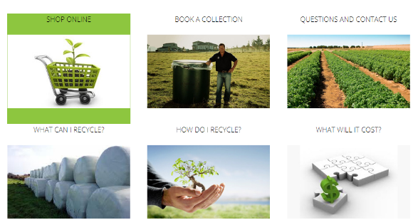
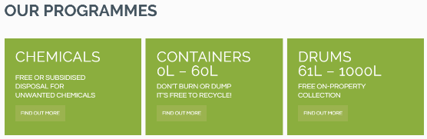
New Zealand
Plasback – www.plasback.co.nz
AgRecovery - www.agrecovery.co.nz

Slide 23
New Zealand
AgRecovery is ‘sister’ company to Cleanfarms. It operates as a not-for-profit
  Small containers, large containers and obsolete pesticides
  Containers include pesticides, fertilizers and sanitation liquids (i.e. dairy)
Plasback is a for-profit company run by a distributor of agricultural products
  They collect eight different materials including twine, bale wrap, pp bags and drums
  On-farm collection
  Six collection regions
  All markets overseas

Slide 24
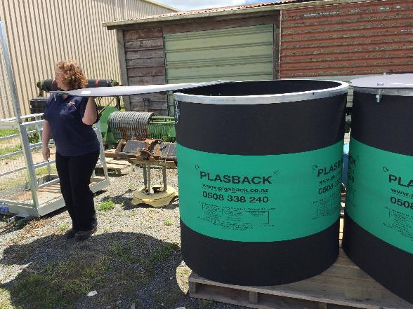
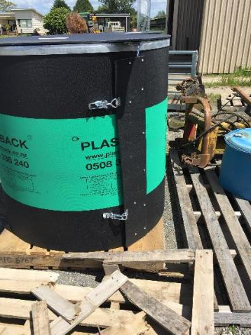

Slide 25
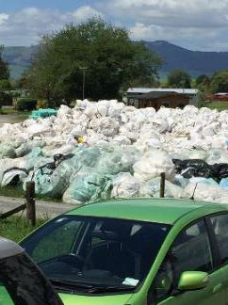
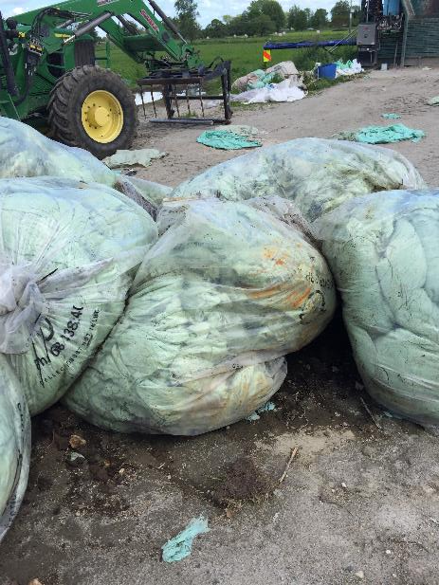
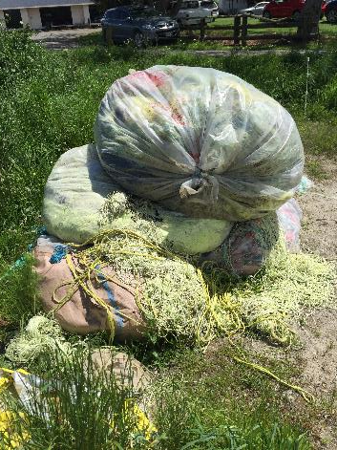
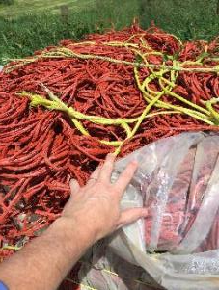

Slide 26
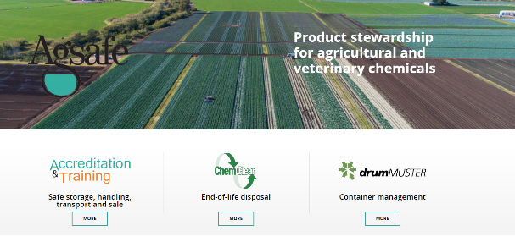
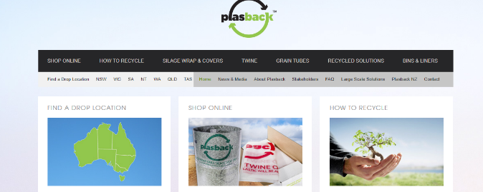
Australia – Agsafe and Plasback

Slide 27
Collections are easy – what do you do next?

Slide 28
Current market conditions
Markets exist for ag plastics – at home and south Asia
Health, safety and environmental standards in overseas plants – some are very poor, if they exist at all
Cleanfarms is working with EPRO to develop strict protocols to ensure that our plastic is only sent to plants that meet this protocol

Slide 29
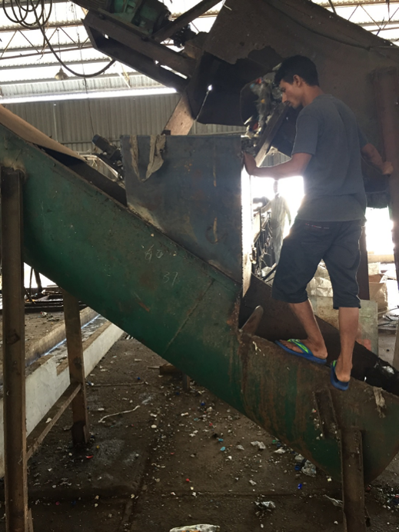
Traceability standards are imperative
Operating conditions in developing countries have three tiers:
  Bad (sometimes really bad!)
  Medium
  Good
Cleanfarms is currently using overseas markets
Our markets would currently fall into the ‘medium’ and ‘good’ categories
Internally, we don’t allow any of our materials associated with pesticide to be shipped overseas because our traceability requirements for these products extend right to the end use of the product

Slide 30
Questions?
Barry Friesen, P.Eng.
General Manager
Cleanfarms Inc.
friesenb@cleanfarms.ca
877-622-4460 x 2230

