Slide 1
Rivulis
Arjan Janknegt
Europe & Africa Technical Manager

Slide 2
Rivulis,
a world leader in Micro Irrigation

Slide 3
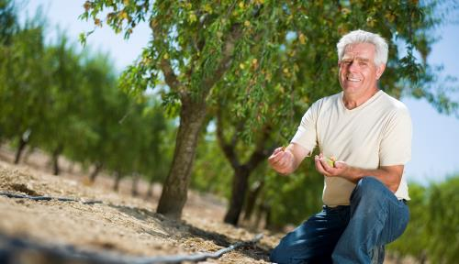
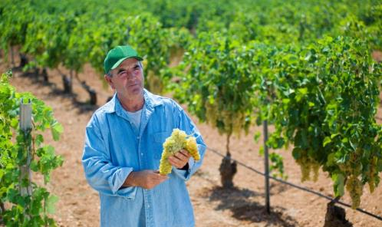
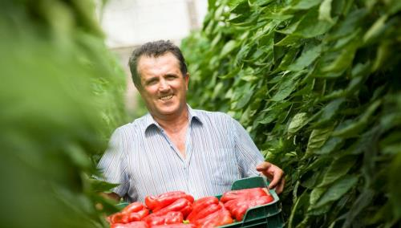
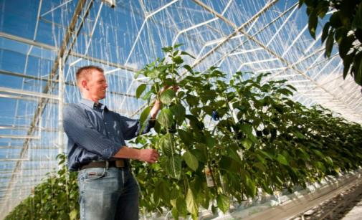
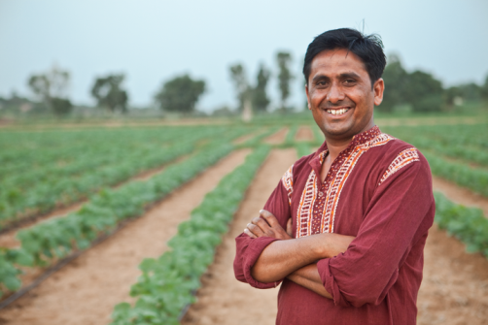
Serving micro-irrigation solutions for any crop any grower globally
Orchards
Vineyards
Fruit & Vegetables
High Value Horticulture Production
Greenhouse & Intensive Ag
Row Crops
(Sugar Cane, Potatoes , Corn)

Slide 4
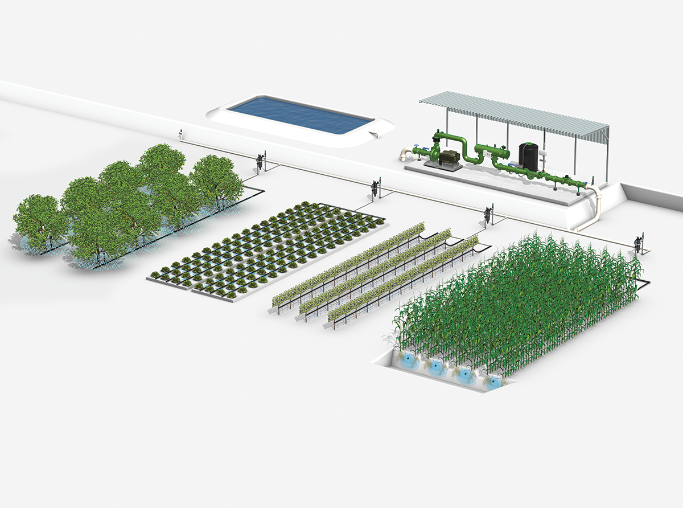
Solutions throughout your irrigation system
PUMP STATION
Metal Filtration
Pressure sustaining (valves)
Fertigation
WATER EMISSION
Drip Tape
Drip Line
Micro-aspersion
Micro-sprayers
WATER DISTRIBUTION
Durable layflat
High quality LDPE Hose
Backup filters
Field valves

Slide 5
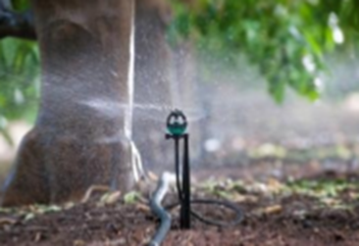
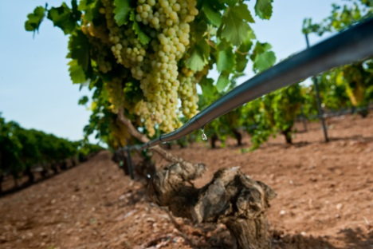
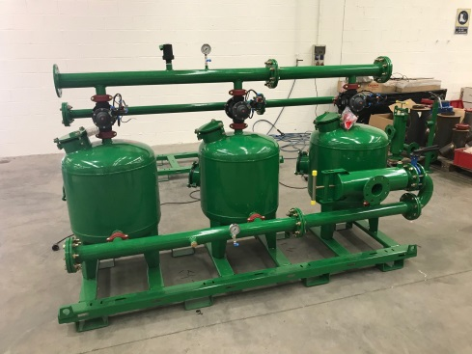
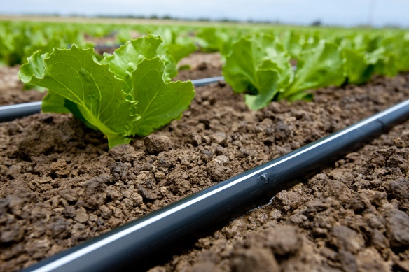
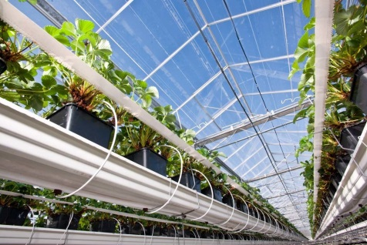
Pioneering world leading micro-irrigation solutions
since 1966
Sales by Product Type:

Slide 6
ABOUT RIVULIS
Our Solid Foundation: Past, Present & Future
1969
2006
2015
2017
1966
1977
2014
2016
DEL
Plastro
Irrigation established
Roberts Irrigation established
T-Systems, Int. established
John Deere Water created from acquisition of three companies
FIMI acquired John Deere Water business unit and created Rivulis Irrigation
DEL of India Investment
Manna, Precision Agriculture Subsidiary founded
Merger of Rivulis and Eurodrip

Slide 7
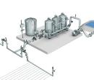
ABOUT RIVULIS
Our company strengths: Winning Combination
Delivering on large scale operations, global distribution, leading product brands and complete irrigation solutions to the irrigation industry and growers worldwide.
Operations
Distribution
Products
Solutions
Large Producer
Big Buyer
Availability
Dealer Network
Technical Support
Global Coverage
Leading Brands
Broad Offering Top Quality
In-house Design
Complete Package
Personalized solutions

Slide 8
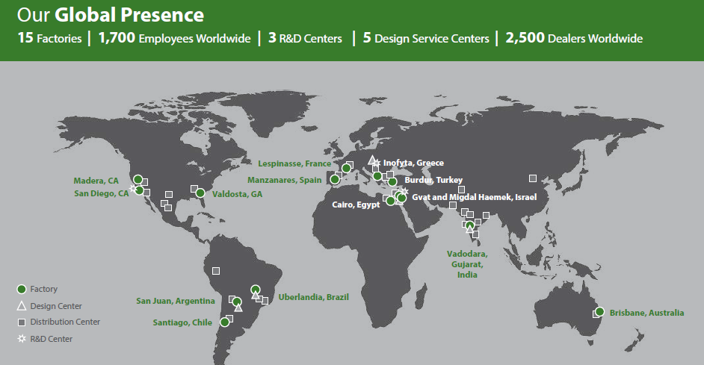
Our Global Presence

Slide 9
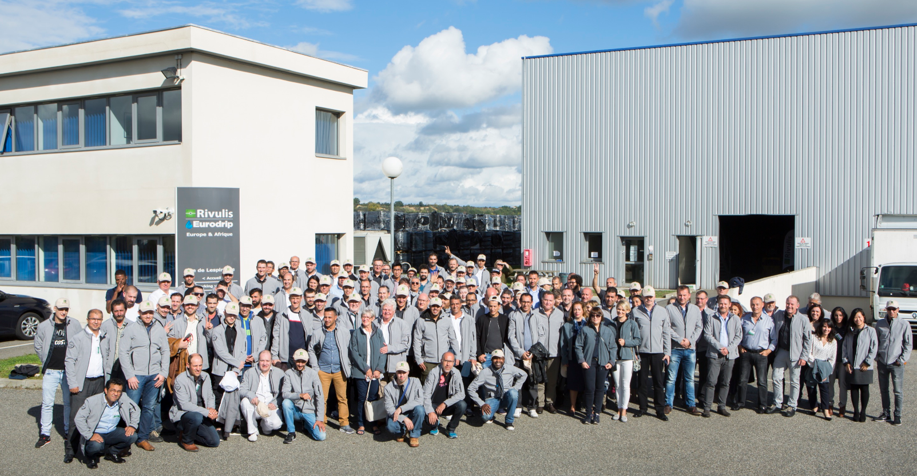
Rivulis – Eurodrip Europe & Africa
30th anniversary of our T-Tape factory – Lespinasse - FRANCE

Slide 10
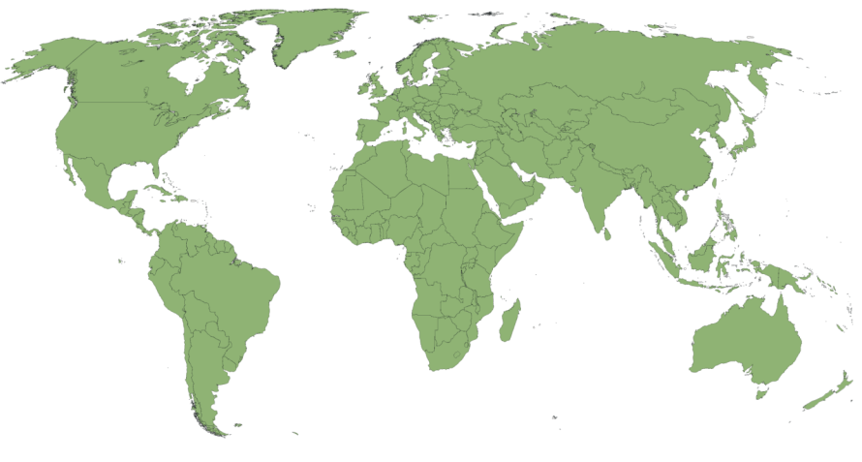
DISTRIBUTION
Distribution
A Global Network of over 2,500 Partner Dealers
1,100
400
100
400
80
290
150
Notes:
Notes:
All dealers are active and purchased goods from Rivulis Irrigation (since 1 June 2014)
Only mother companies are counted (branches or shops are not counted)

Slide 11
Rivulis Europe Africa
E&A BU
Regional H.Q. Office
France – Lespinasse
2 factories
Lespinasse France
Manzanares – Spain
>1000 dealers
>60 countries

Slide 12
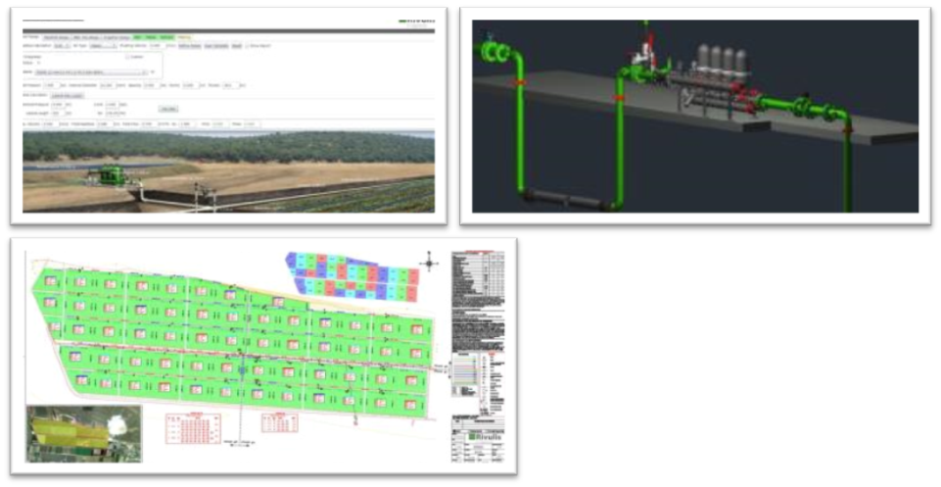
DISTRIBUTION
2 kind of collaboration with our local partners
Production Distribution
Rivulis and dealers distribute solutions to small/mid size growers
Micro-irrigation system design (Projects)
Rivulis and dealers provide a all-in-one key turn irrigation system to large/very large farms

Slide 13
Our daily business
is all about
‘plastic made’ innovations !

Slide 14
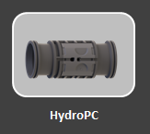
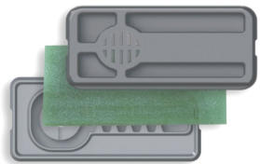
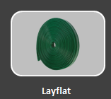
Type of plastic used in our products
Extruded Polyethilene (PE) => Drip Tape
Drip Line
Molded Polyethilene (PE) => Drippers
Microsprinklers
Fittings
Plastic filters
Silicon Flow regulated Drippers
PVC Layflat
Screen filter

Slide 15
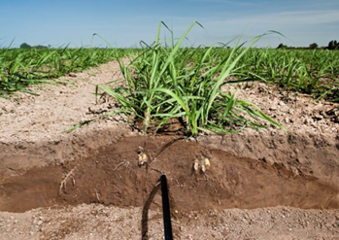
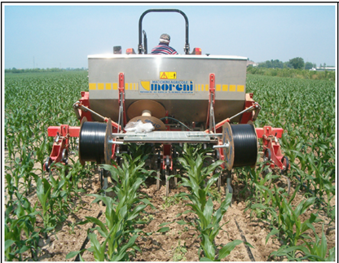
Outstanding mechanical properties of our PE drip tape
1/ What does the grower need ?
Use a cost effective drip tape to irrigate crops uniformly
manage the water supply to the real plant requirements
Practical and 100% mechanized installation/retrieval process
100% recyclable PE product
2/ Field Constraints
Tape should allow its Installation and retrieval economically without any agronomic obstruction
A drip tape wall thickness with optimum balance between efficiency and practicality
A dripper with reliable performance over it’s service life
3/ THE Rivulis Solution
T-Tape outstanding tensile strenght with a slit outlet
Explanations

Slide 16
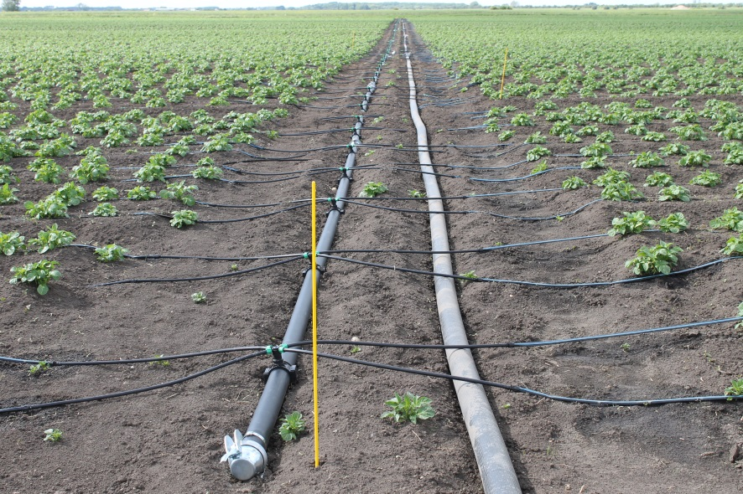
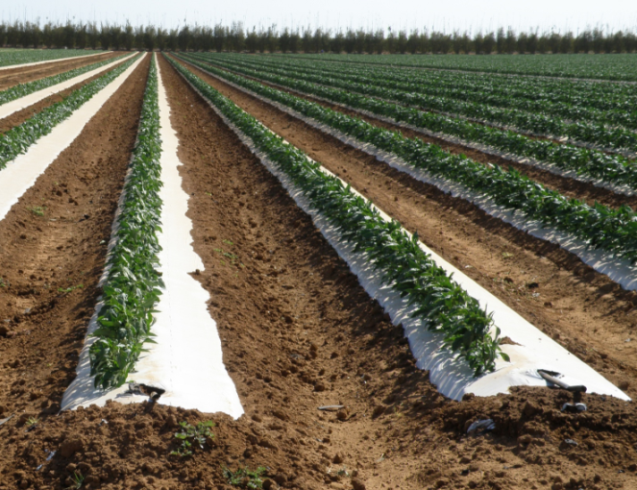
PROJECTS
T-Tape – drip tape on potatoes
Potato are grown on ridges or beds, creating ideal conditions for dripirrigation, very localized and controlled application of water and crop additives ( bio stimulants, (organic)fertilizers, etc) is possible.
Leading to a maximized crop management and crop result ( yield and quality)

Slide 17
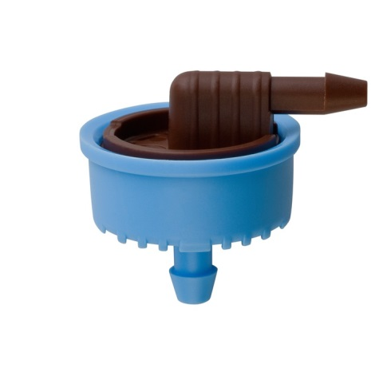
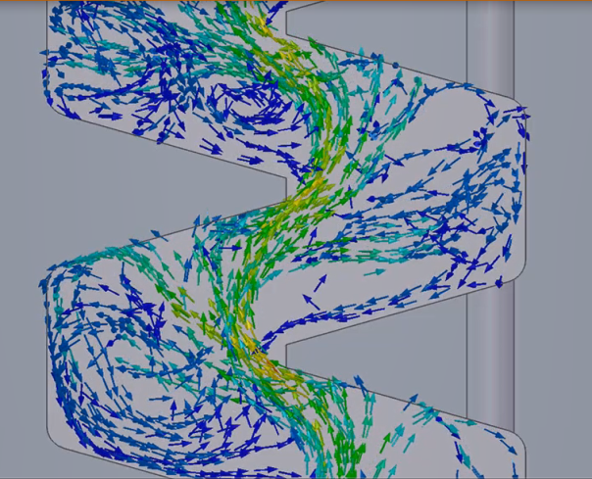
Outstanding mechanical properties
=> Supertif PCND dripper membrane
1/ What does the grower need ?
Very accurate water, nutrient and additive supply to every single plant
2/ Field Constraints
Reliable performance within strict and narrow limits in variying climats, growing systems, conditions for more than the economic life time
3/ THE Rivulis Solution:
Silicon membrane for specific emitting characteristics
Precise production
High level of hydraulic engineering design

Slide 18
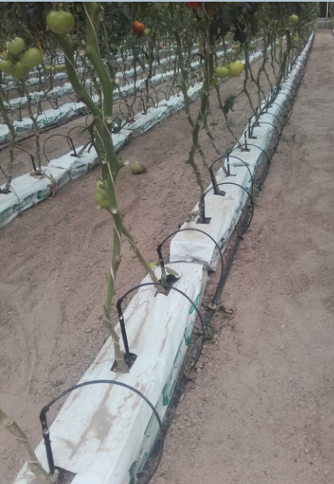
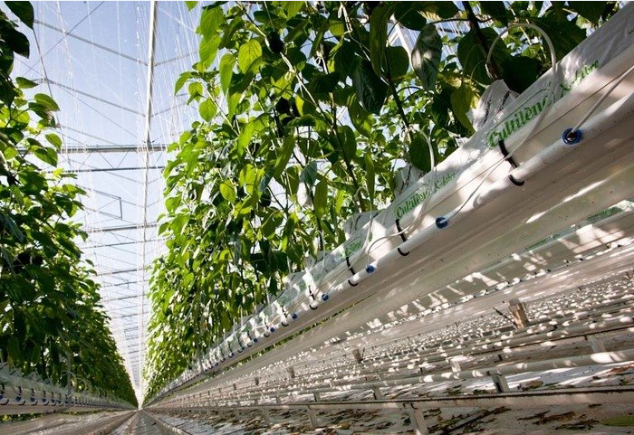
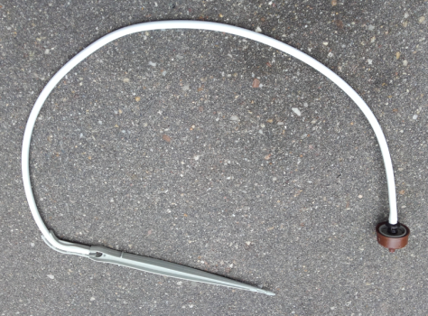
Supertif PCND in Intensive greenhouse production

Slide 19
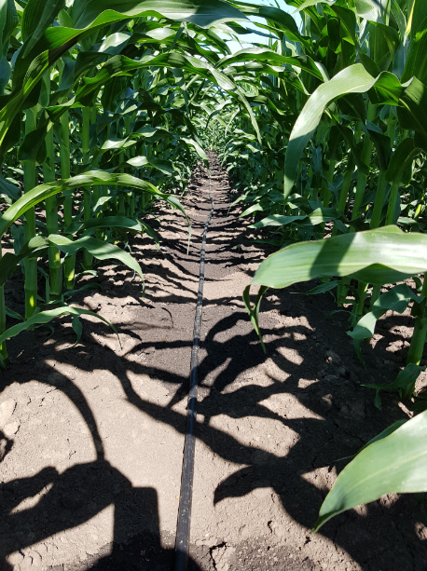
D5000 PC
Outstanding mechanical & chemical properties
1/ What does the grower need ?
A long lasting and reliable irrigation system 10+ years lifetime
Accurate irrigation over flat sloping terrains
2/ Field Constraints
Dripper, tubing and dripper membrane to resist the most adverse field conditions
Oxydation
Abrasion by water contaminants
Climatic stress (-30C -> +55C) ,UV
All AgroChemicals
Mechanical stress ( Ag machines, wild life etc.)
3/ Rivulis solutions
D5000 PC Drip line and PC dripper membranes
must be designed and made of high quality raw material

Slide 20
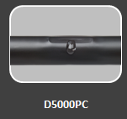
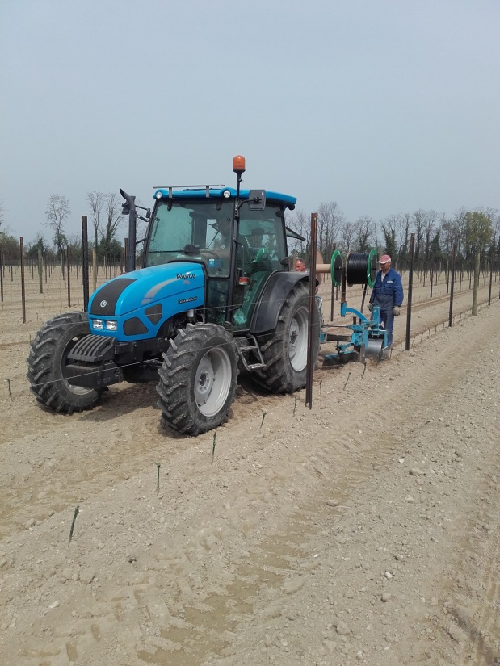
D5000PC in vineyard
Subsurface installation of dripline in Northern Italy in order to avoid obstruction of surface activities and better target the most active rootzone

Slide 21
Upcoming innovations to make micro-irrigation even more accessible and sustainable

Slide 22
Produce more yield with less PE , more recycled PE and less water
Upgrade our processing technologies to make our drip line even more cost efficient
Least quantity of PE to buy to install and to recycle
Lower transportation cost (to Africa) (the thinner the drip tape the more meters you ship per reel per pallet)
Even more resistant to field constraints (mechanisation)
Improve extrusion processes to include even more recycled raw material (in thick wall but also in thin wall products)

Slide 23
Produce more yield with less PE , more recycled PE and less water
Promote and sustain recycling process of all PE drip line
Rivulis in line with CPA and Adivalor in France
Offer solution inline with governmental environmental regulations
Meet circular economy requirements
Substitute non recyclable by New 100% Recyclable products
PE layflat to replace PVC layflat
60% Lighter , 100 % recyclable PE ,
Permanent SDI
Some thin wall technologies are now available to set a long lasting subsurface irrigation system (no need to change the tape yearly)

Slide 24
The End
THANK YOU

